Slide 1
Dr. Gary Adams, President
trustuscotton.org

Slide 2
U.S. Cotton Trust Protocol
A voluntary farm-level program designed to engage growers in continuous improvement
A system that will provide aggregate data that can be passed through the textile supply chain which includes: producers, merchandisers, manufacturers, brands and retailers and others

Slide 3
Requirements of Brands and Retailers
From Ad Age, a marketing and media daily:
HOW SUSTAINABILITY IN FASHION WENT FROM THE MARGINS TO THE MAINSTREAM
Nearly every apparel marketer is following consumer demand by leaping onto the green wagon
By Adrianne Pasquarelli. Published on March 04, 2019.
"We believe that brands that are able to distinguish themselves from a sustainability perspective are the best positioned to capture a larger share of the millennial consumer's wallet," wrote Camilo Lyon, an analyst at Canaccord Genuity.

Slide 4
Increased Regulatory Pressure in the EU
For the first time ever, the Commission has designated a top Commissioner to be in charge of EU sustainability – a clear shift from the previous focus on jobs and growth.
EVP Timmermans will spearhead the European green deal and is slated to prioritise textiles in upcoming circular economy activities.

Slide 5
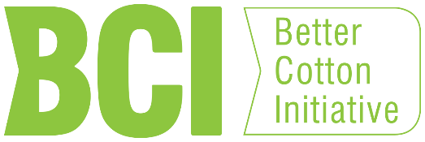
EU Public Procurement
EU green public procurement guidelines on textiles favor organic cotton and lists as acceptable alternatives: BCI; AGRO 2 (Greece); Cotton Made in Africa; Fair Trade, and the Australian Better Management Program (BMP).

Slide 6
Pressure on Brands/Retailers
Corporate Sustainability Report
Socially Responsible Investing
Environment
Social
Governance

Slide 7
Notes:
We are very pleased with our progress but we will not rest there. The U.S. cotton industry is committed to continuous improvement and innovation, in order to set a new standard in sustainable cotton production.
These are the goals we set in 2018 for improvement by 2025.
With the help of a team of leading cotton scientists, we set goals for the 5 metrics we discussed before. But then added a sixth—soil carbon, which is a good indicator for soil health.
All these targets are measured in pounds of fiber per acre (except soil loss). Greenhouse gasses are science-based targets and pegged to the Paris Climate Accord.
These goals are both aggressive and achievable and as shown on the next page, will reduce our environmental footprint even further.

Slide 8
Notes:
The past 35 years have been a quite journey for U.S. cotton.
To produce a bale of cotton, we have reduced land use by 49%, soil loss by 37%, water usage by 79% (did you know that 60% of all U.S. cotton acres are rain-fed?), energy usage by 54% and finally, we have reduced greenhouse gas emissions by 40%. We know all of this because the USDA collects all of this information.
On average our footprint is 45% smaller than it was 35 years ago. Are we finished? No.

Slide 9
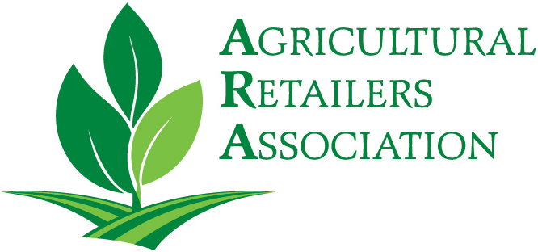
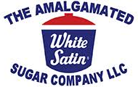
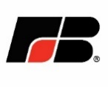
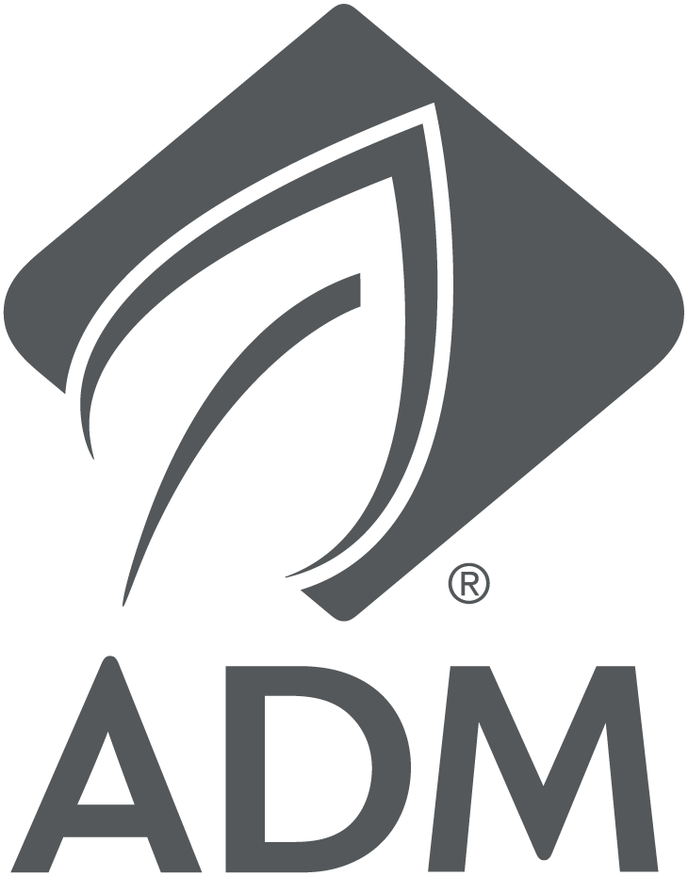
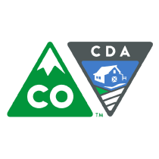
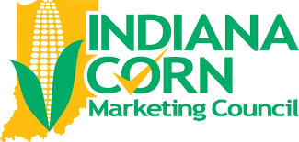
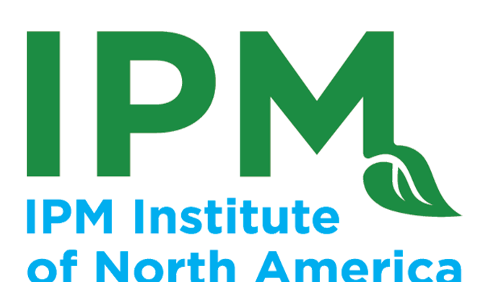
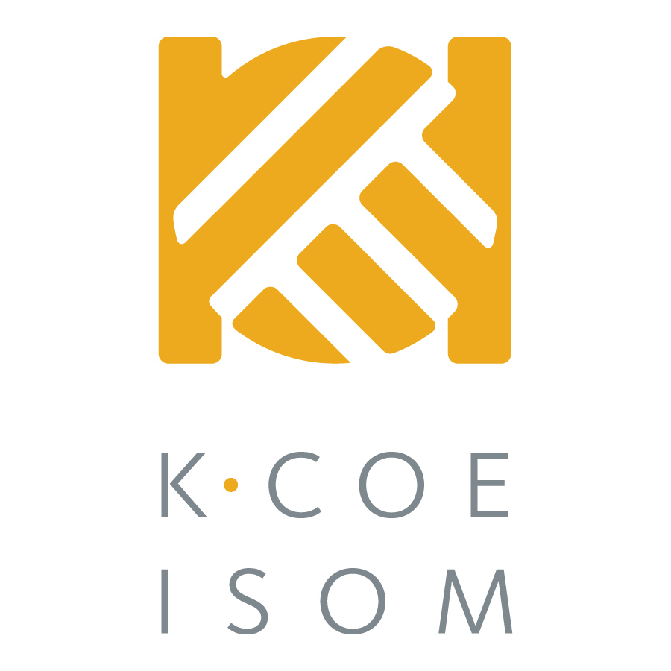
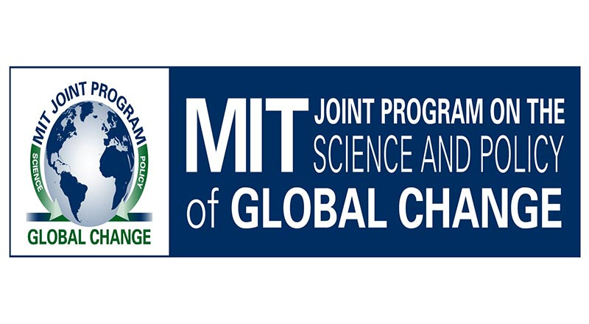
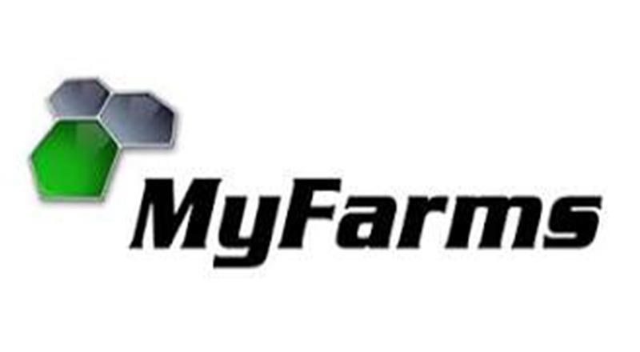
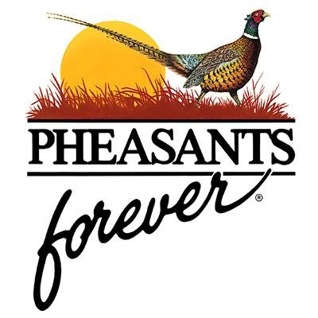
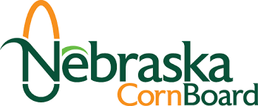
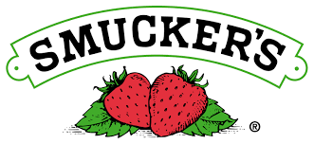
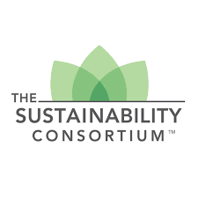
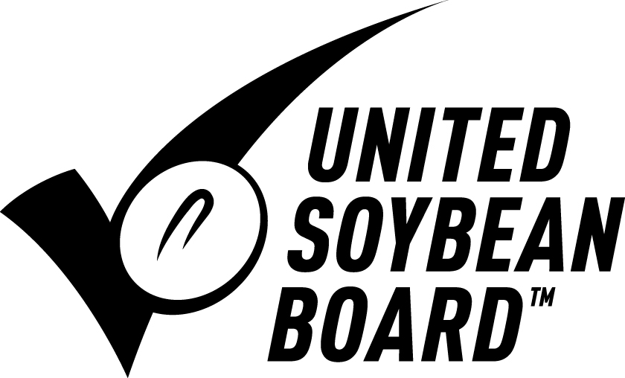

Slide 10
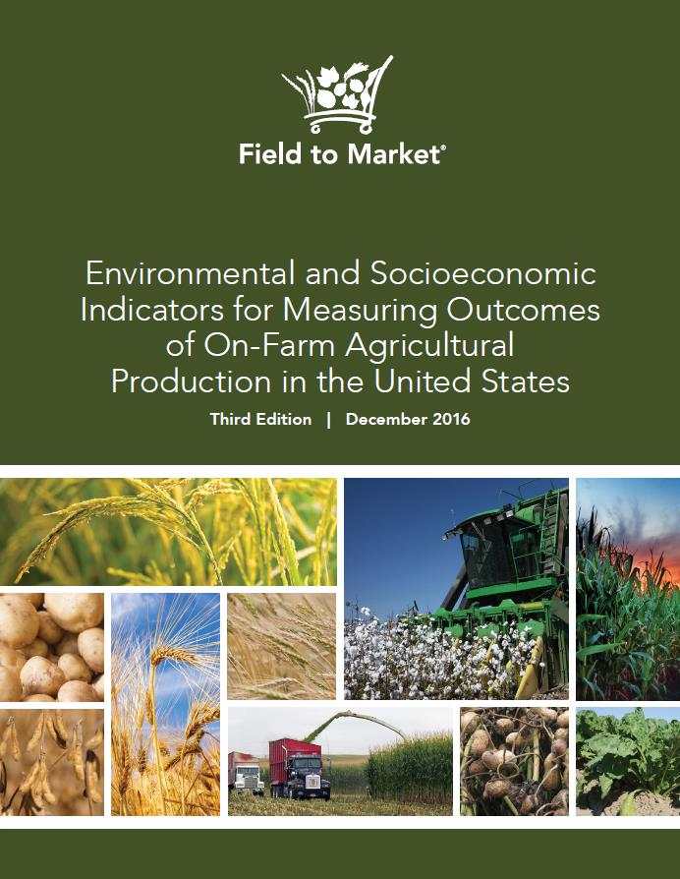
National Indicators Report
Released in December 2016
New in Third Edition
Include barley, corn silage, peanuts and sugar beets for the first time
Include discussion of trends for biodiversity, soil carbon and water quality
Available from: www.fieldtomarket.org/report

Slide 11
Key Requirements for the Producer
Self-assessment questionnaire
Use of a data tool for environmental metrics
Verification by an independent party

Slide 12
Self-Assessment Questionnaire
9 categories with approx. 100 questions
Choices for answers
I do now on most of my fields
I am implementing on 1 or more of my fields
I will consider in next 3 years
Not appropriate for my farming operation

Slide 13
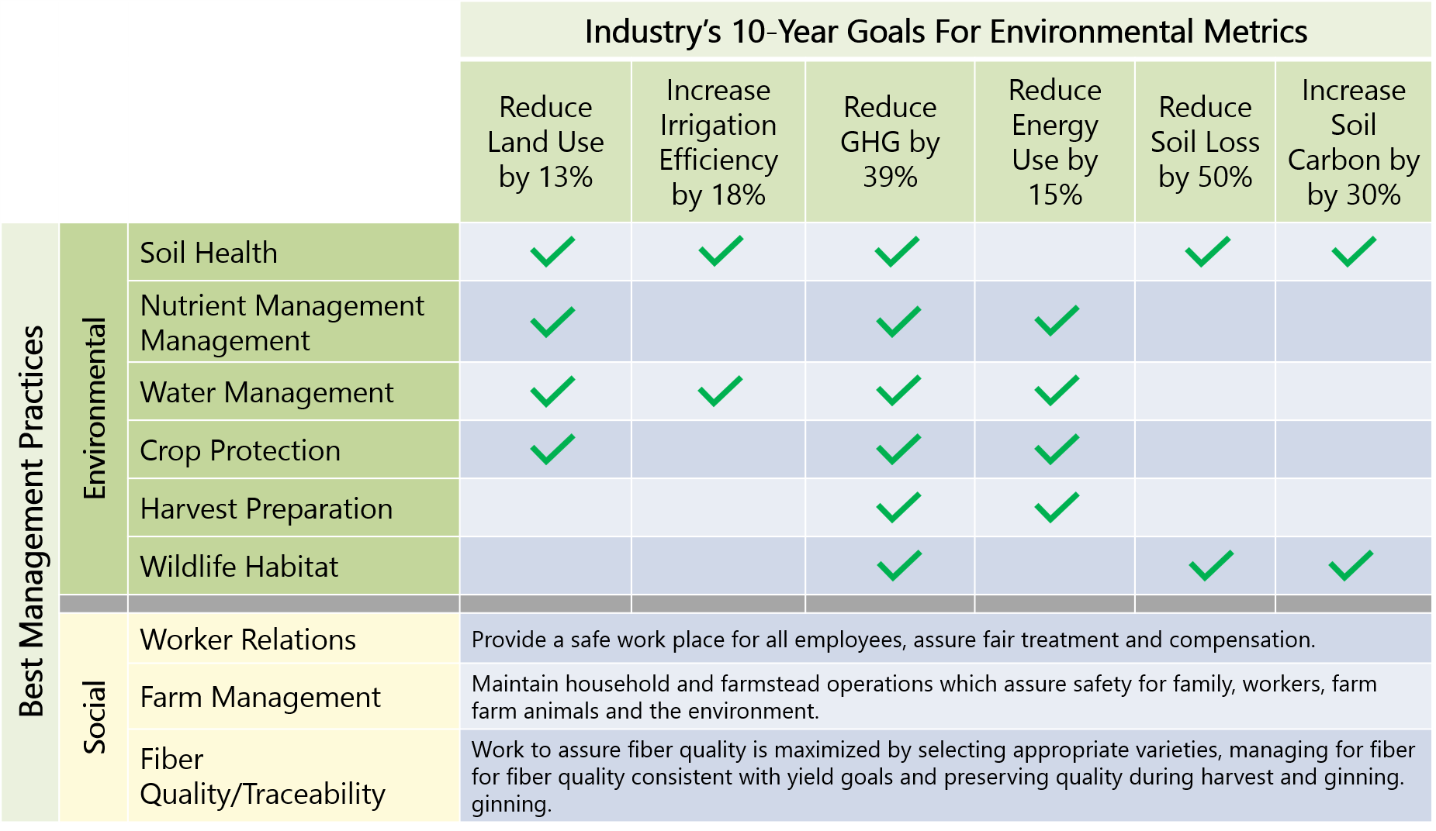
The Questionnaire Aligns with the Industry Goals

Slide 14
Self-Assessment Questionnaire
33% Required Management Practices
67% Recommended Management Practices with 4 Choices
Provides Cumulative Data as Producers Answer Questionnaire

Slide 15
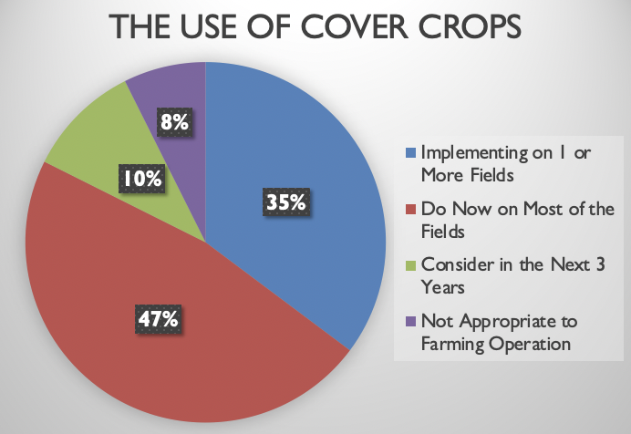
Self-Assessment Data Results
Plant cover crops with a goal to have living roots on as many months of the year as possible to protect soil and improve soil organic matter.

Slide 16
Self-Assessment Data Results
Conserve and utilize natural rainfall and/or tail water through use of cover crops, terraces, furrow diking, holding ponds, reservoirs or conservation tillage

Slide 17
Self-Assessment Data Results
Utilize flow meters to measure water use

Slide 18
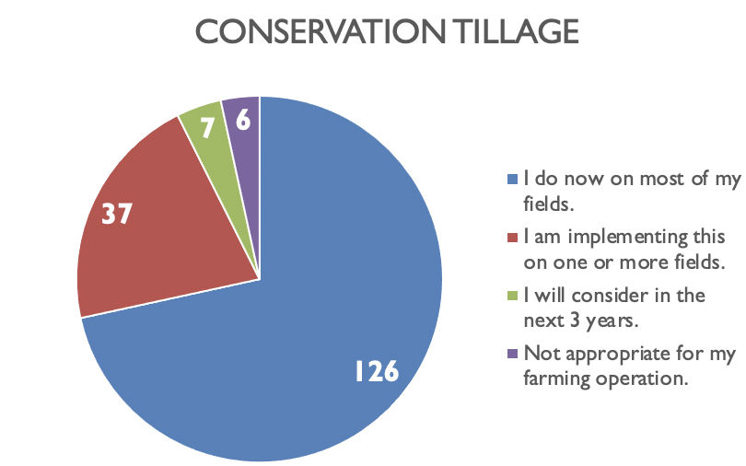
Self-Assessment Data Results
Utilize conservation tillage practices such as minimum, strip, mulch or no-till

Slide 19
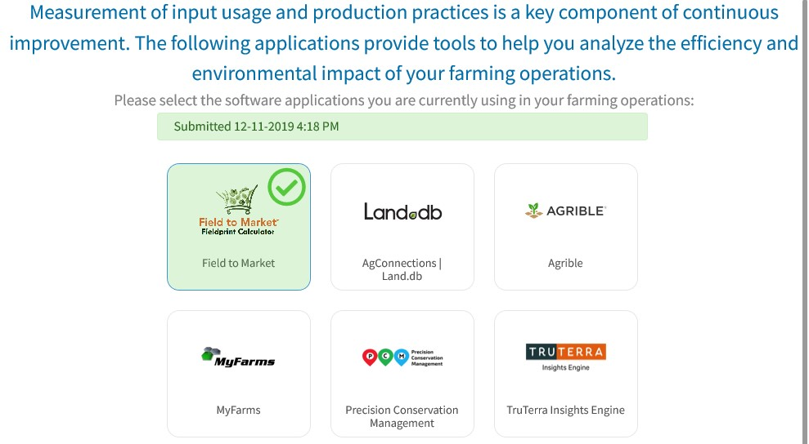
Use of a Data Tool
Field to Market tool named the Fieldprint Calculator
Record inputs into a system that measures the environmental impacts of crop production and identify opportunities for improvement
Use on 10% of acres
Additional qualified data management Field to Market partners who can make these recordings for the producer

Slide 20
TRY IT OUT: http://calculator.fieldtomarket.org
Step 1: Select a Cotton Field
For every cotton field in the United States, the U.S. Department of Agriculture knows:
Type of soil
Slope/contour of the field

Slide 21
TRY IT OUT: http://calculator.fieldtomarket.org
Step 2: Input the Data
Tell Us About:
Crop rotation, tillage practices, cover crops
Details on every pass over that field
Irrigation practices (if applicable)
What type of irrigation?
How much is applied?
From how deep is it pumped?
Nutrient Management
How much fertilizer and other nutrients are used?
Crop Protection Products
How many are used?

Slide 22
TRY IT OUT: http://calculator.fieldtomarket.org
Step 3: Feedback for the Farmer
In the areas of:
Land use
Soil conservation
Soil carbon
Water use
Energy use
Greenhouse gas emissions
Water Quality

Slide 23
Verification
2nd party assurance
3rd party independent, random, on-farm visits

Slide 24
What the Protocol Is and Isn’t
The Protocol is NOT about
One grower or one bale being more sustainable than another
Guaranteeing a premium
Telling a producer how to farm
The Protocol IS about U.S. cotton
Telling our story
Meeting the needs of our customers
Competing in every market and every supply chain

Slide 25
trustuscotton.org

