Slide 1
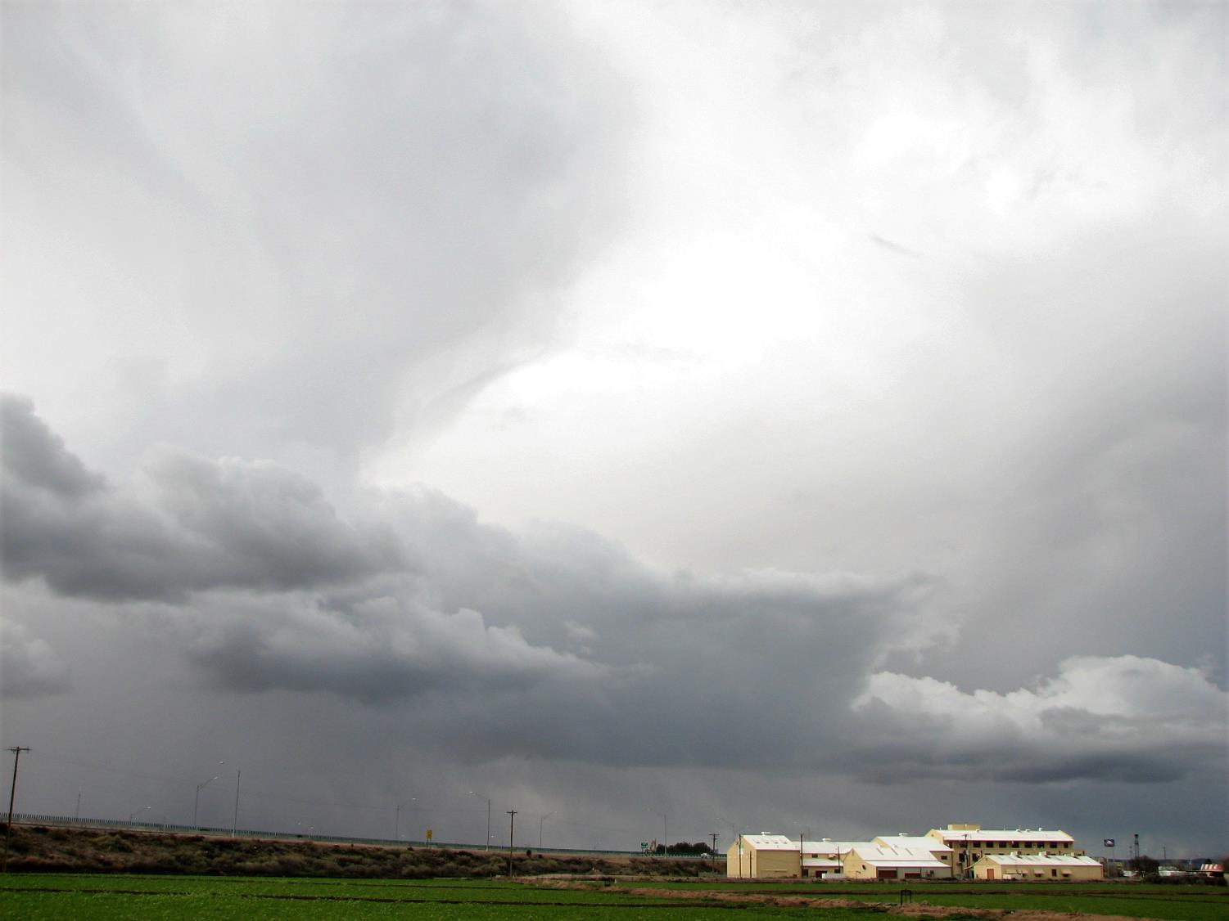
Saving Energy in Cotton Gins
Paul A. Funk, Robert G. Hardin IV, and Albert A. Terrazas

Slide 2
Energy
Energy costs represent 20% of the total cost of post-harvest processing.
A national industry survey indicated:
Electricity cost varied from $1.62 to $21.58
Fuel costs from $0.23 to $9.07 per bale

Slide 3
Energy
Energy costs represent 20% of the total cost of ginning; a national industry survey indicated:
Electricity cost varied from $1.62 to $21.58
Fuel costs from $0.23 to $9.07 per bale
Huge disparities = huge opportunities!

Slide 4
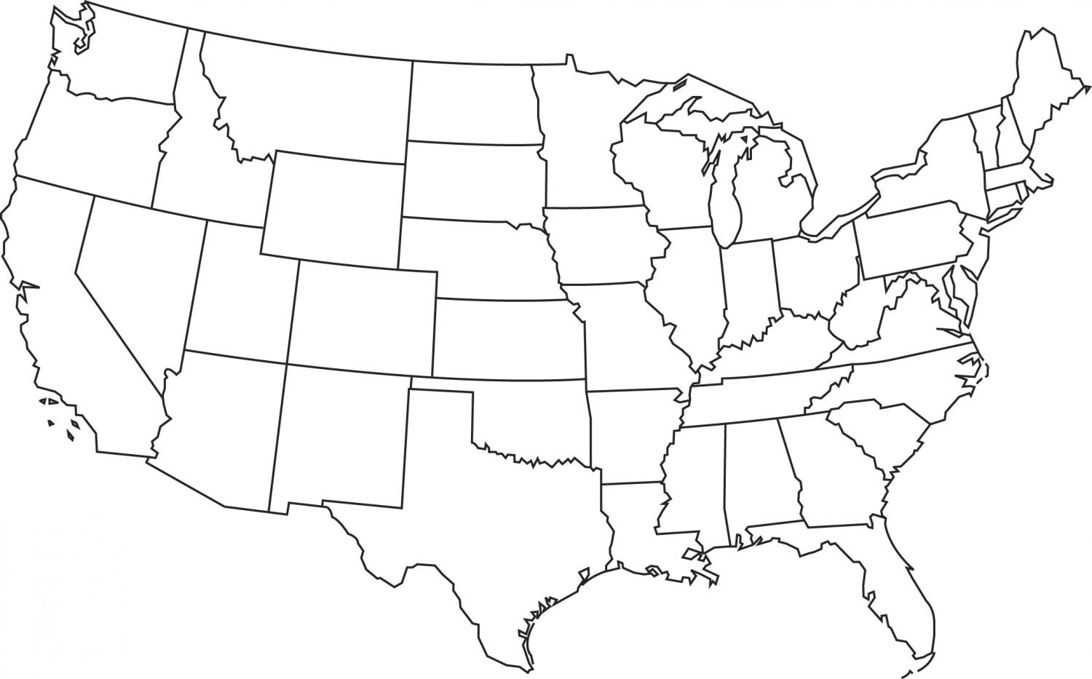
Study locations across US cotton belt

Slide 5
Energy
Two types: electricity (2009-2011) and fuel (2016-2018)
Two tools: audits and monitoring studies

Slide 6
Energy Audits
An audit is a snapshot – one moment in time
An audit quantifies energy consumption
Resolution depends on sample size
Typical cotton gin has ~120 motors and ~8 burners – we measured all
An audit asks, “What proportion is consumed by each subsystem?”
Differences between facilities due to infrastructure

Slide 7
Energy Monitoring
A monitoring study is like a video
It records changes in energy consumption
Resolution depends on sampling rate
Monitoring asks, “What might be causing the change?”
Differences with time due to operating parameters

Slide 8
Electricity: Rationale
Electricity is about 13% of the total cost of post harvest processing

Slide 9
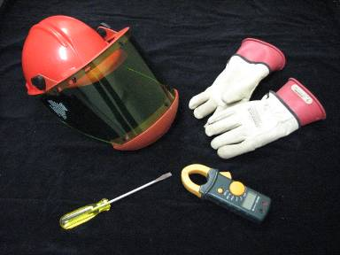
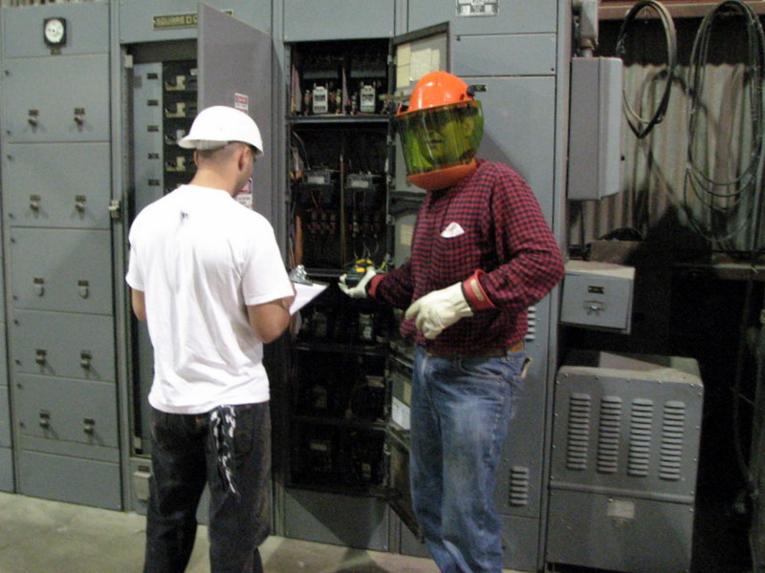
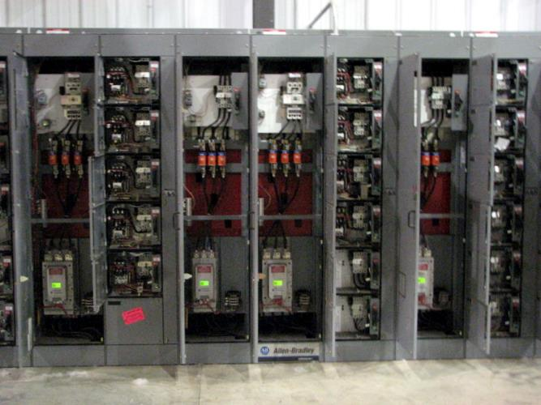
Electricity: Audit Methods
Open motor control boxes
Ammeters measure current
Record values
P = V*I*√3

Slide 10
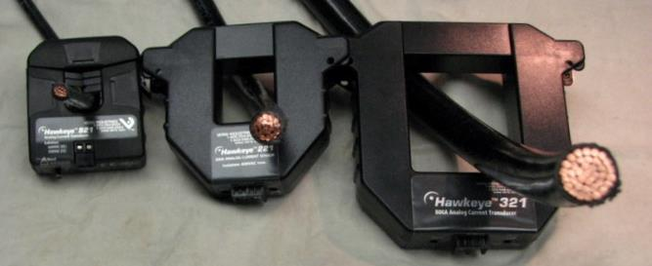
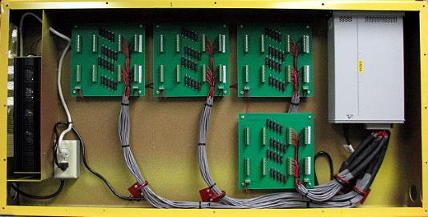
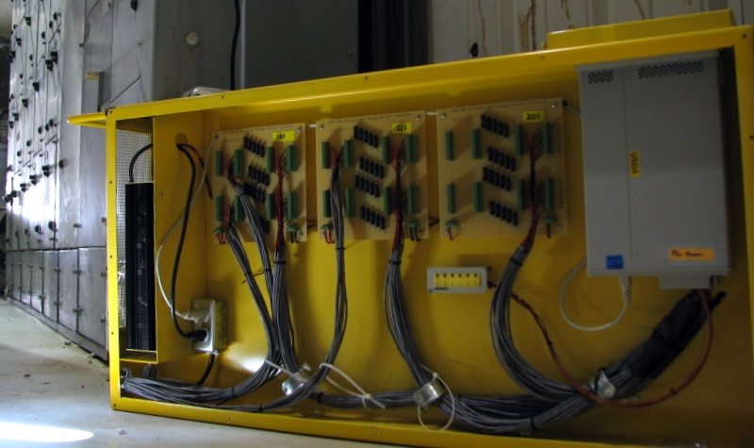
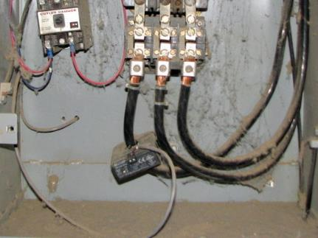
Electricity: Monitoring Methods
Ammeter transmits current signal
Logger records values

Slide 11
Electricity: Results
Electrical Energy Consumed (kWh/b)
1962 1982 2009
Seed Cotton Cleaning 2.6 5.4 2.9
Saw Ginning 8.5 7.0 6.4
Lint Cleaning 7.7 4.6 2.4
Bale Packaging 5.8 4.0 4.7
Materials Handling 22.9 31.0 23.2
Per Bale Total 47.5 52.0 39.5
Connected Power (hp) 764 1,709 3,030 ^ 4x

Slide 12
Electricity: Results
Electrical Energy Consumed (kWh/b)
1962 1982 2009 2009
Seed Cotton Cleaning 2.6 5.4 2.9 7%
Saw Ginning 8.5 7.0 6.4 16%
Lint Cleaning 7.7 4.6 2.4 6%
Bale Packaging 5.8 4.0 4.7 12%
Materials Handling 22.9 31.0 23.2 59%
Per Bale Total 47.5 52.0 39.5
Connected Power (hp) 764 1,709 3,030

Slide 13
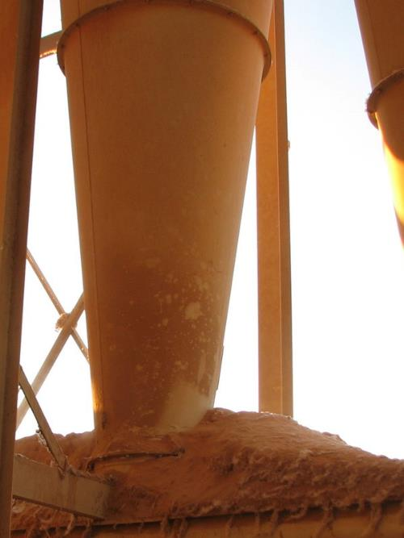
Electricity: Results
Plug leaks
Seal covers and access doors
Repair vacuum dropper flashings

Slide 14
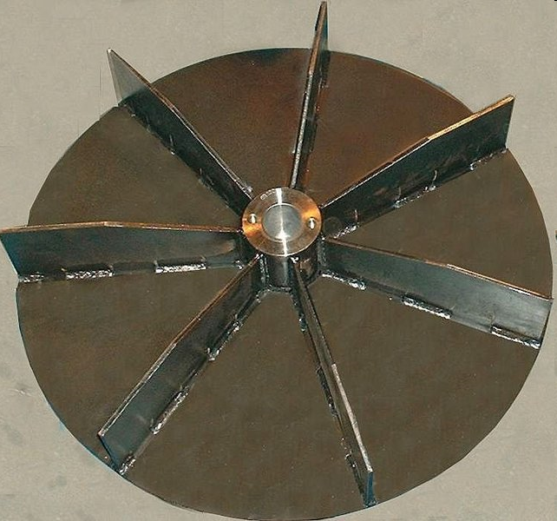
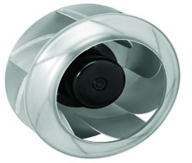
Results - ELECTRICITY
Upgrade fans (that handle air only)

Slide 15
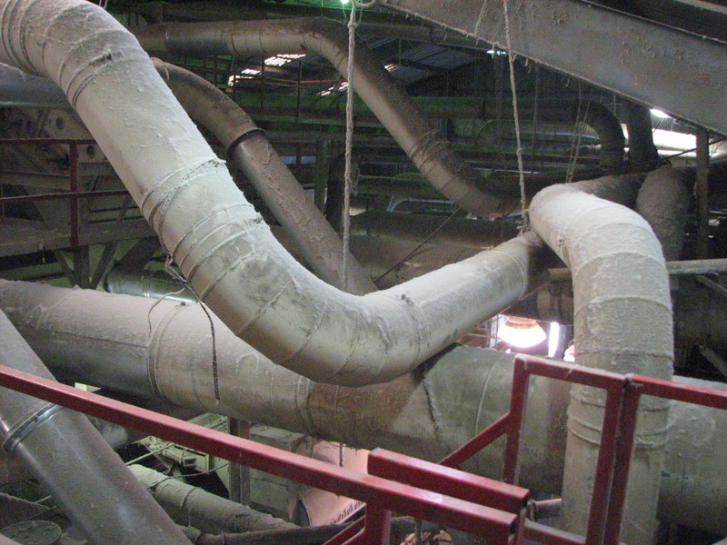
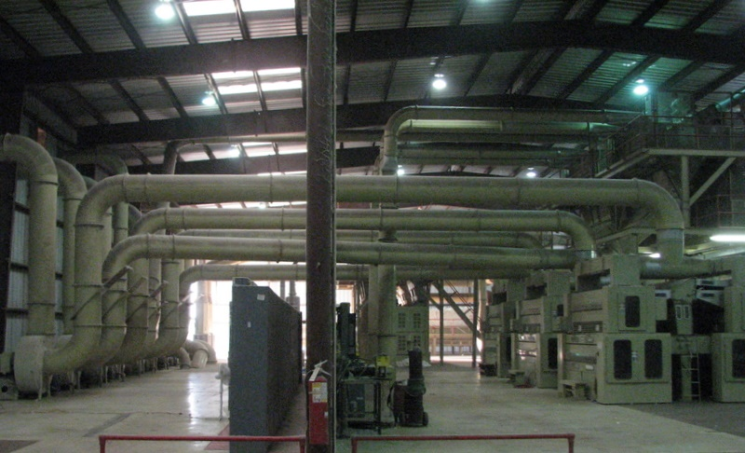
Electricity: Results
Simplify ductwork

Slide 16
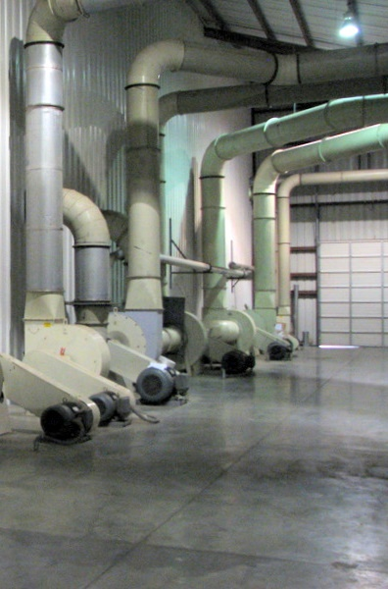
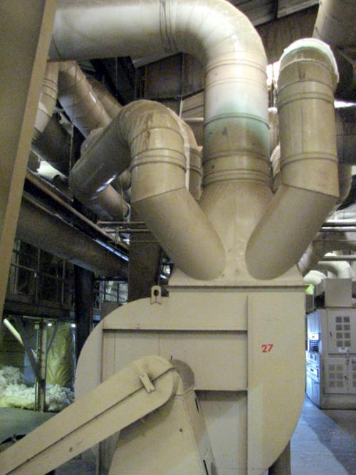
Electricity: Results …avoid chaos

Slide 17
Electricity: Results - Reduce Fan Turbulence in/out
Flow Fights Rotation
Flow Compliments Rotation
Long Sweep Elbows
Long
Sweep
Elbows
Turbulent Inlet
Laminar Flow Inlet

Slide 18
Rectangular evasé
Radial evasé
Spin Cap

Slide 19
Electricity: Results
Match motor sizes to loads
Buy high efficiency motors, but only when replacement is needed

Slide 20
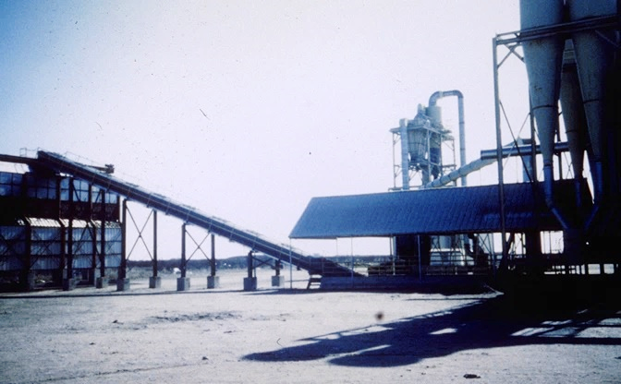
Electricity: Results
Mechanical conveying wherever practical

Slide 21
Electricity: Impacts
Industry has responded to rising costs by increasing efficiency
Electricity consumption per bale has decreased 0.6 kWh each year
Improved sustainability and environmental stewardship
National savings about $10 million each season

Slide 22
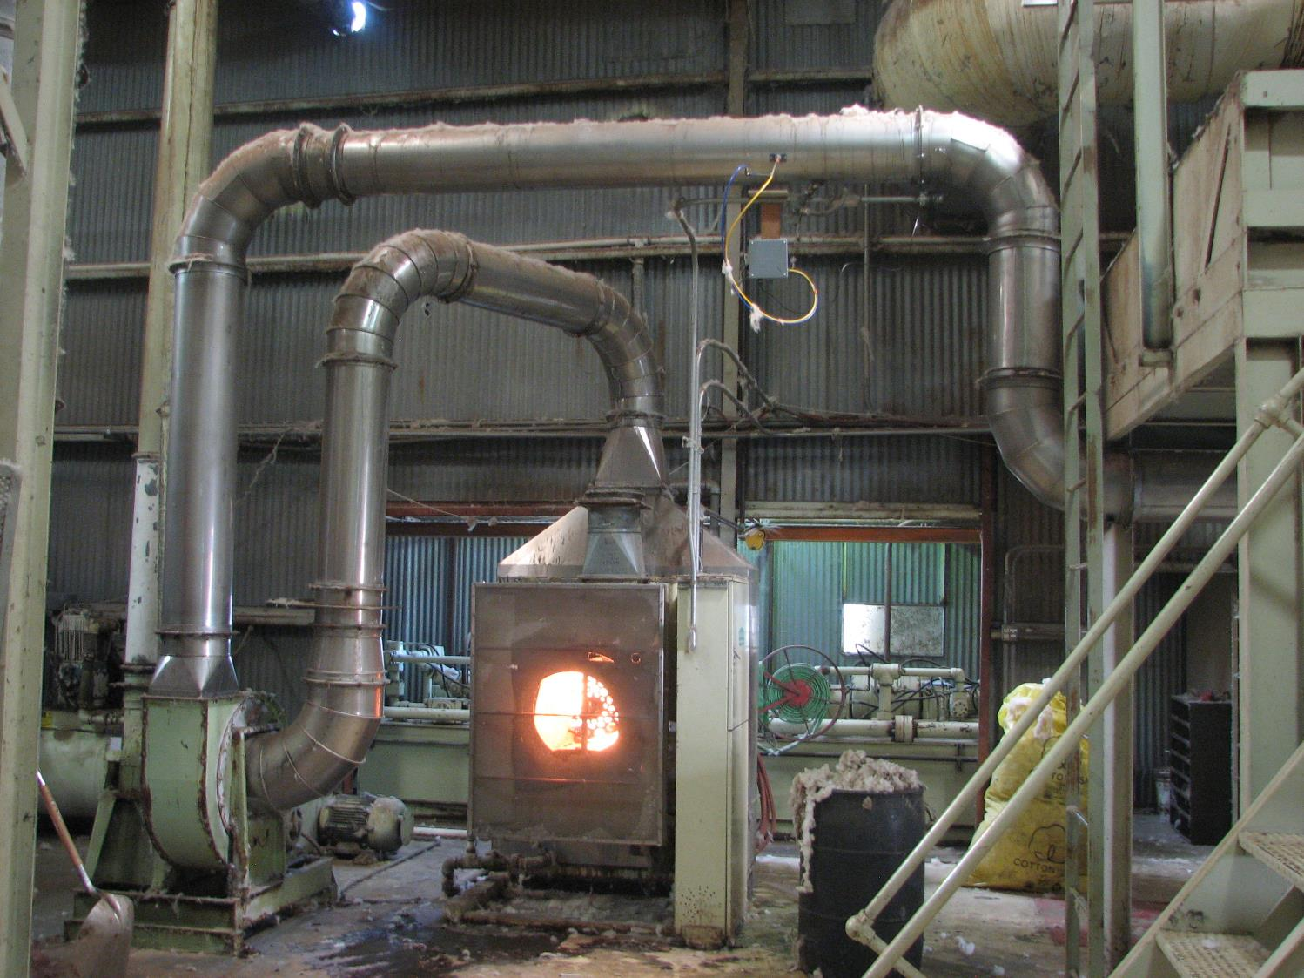

Slide 23
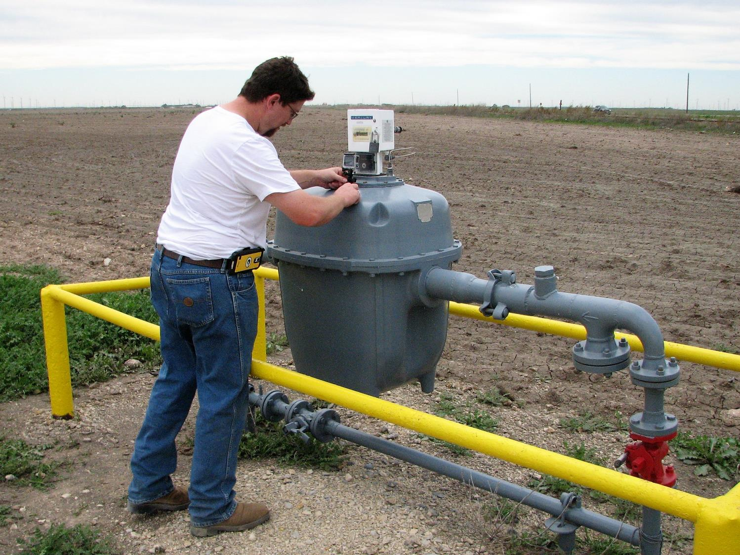
Fuel: Rationale …big gas meter

Slide 24
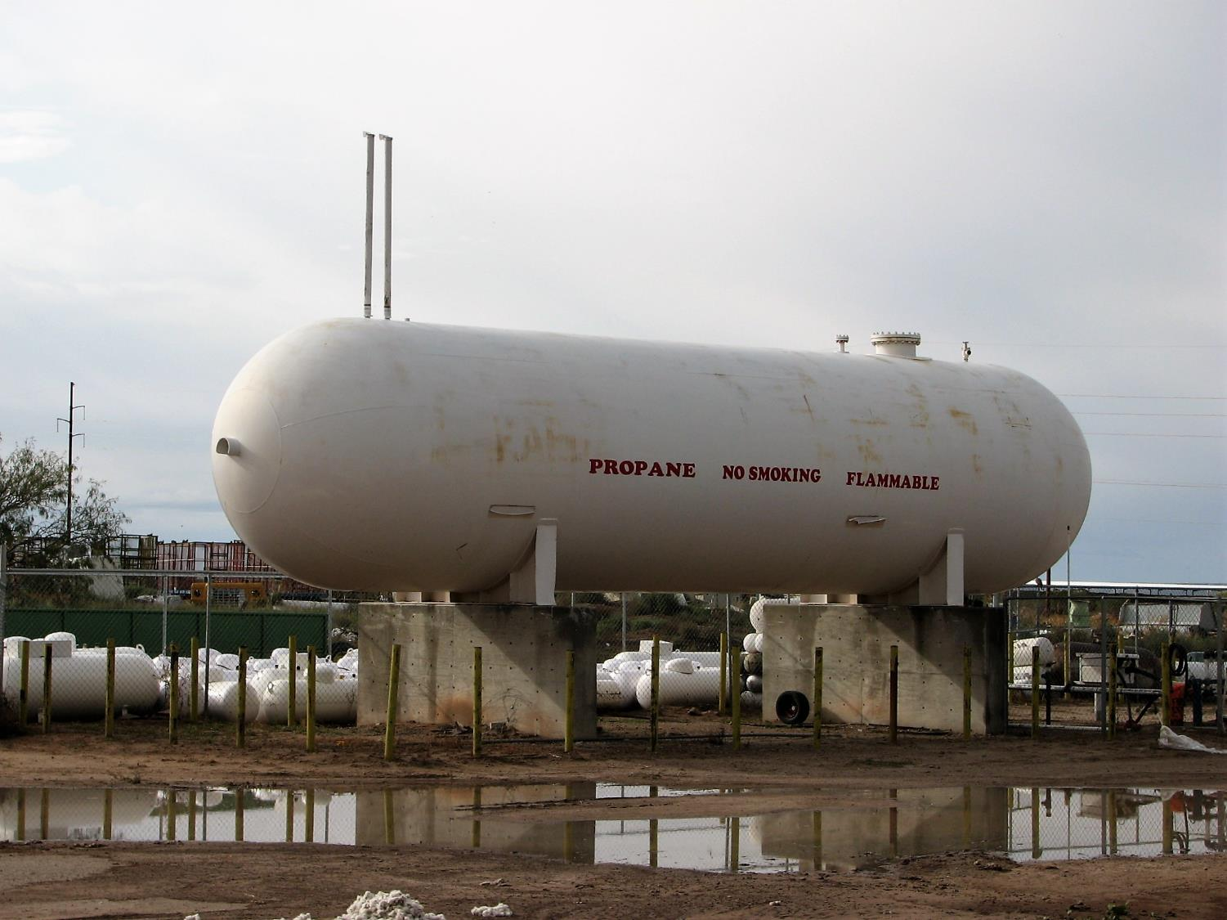
Fuel: Rationale …big propane tank

Slide 25
Fuel: Rationale
Fuel = 6½ % to 8½ % of ginning cost
Prices volatile, propane doubled in 10 y; can’t control cost of fuel
Weather unpredictable; can’t control drying amount needed
Fuel = most variable cost = biggest threat to profitability

Slide 26
Fuel: Rationale
Fuel = 6½ % to 8½ % of ginning cost
Prices volatile, propane doubled in 10 y; can’t control cost of fuel
Weather unpredictable; can’t control drying amount needed
Fuel = most variable cost = biggest threat to profitability
Can we improve utilization?

Slide 27
Fuel: Rationale
Fuel Use Audits in Commercial Gins: in-season
It would be disruptive to cut gas flow to install a meter on each burner while the gin is running
Fuel Use Audits in Commercial Gins: repair-season
It would be expensive to install meters on every burner in every cooperating commercial gin

Slide 28
Fuel: Methods
Proxy fuel use: velocity pressure and air temperatures
Velocity pressure & density → velocity
Velocity & pipe diameter → volumetric flow
Volumetric flow & density → mass flow
Mass flow, temperature change, & burner efficiency → fuel used
$$P_{in}=\left(ρπr^{2}0.92\sqrt{\frac{2p_{v}}{ρ}} \right)C_{p} ΔT η^{−1}$$

Slide 30
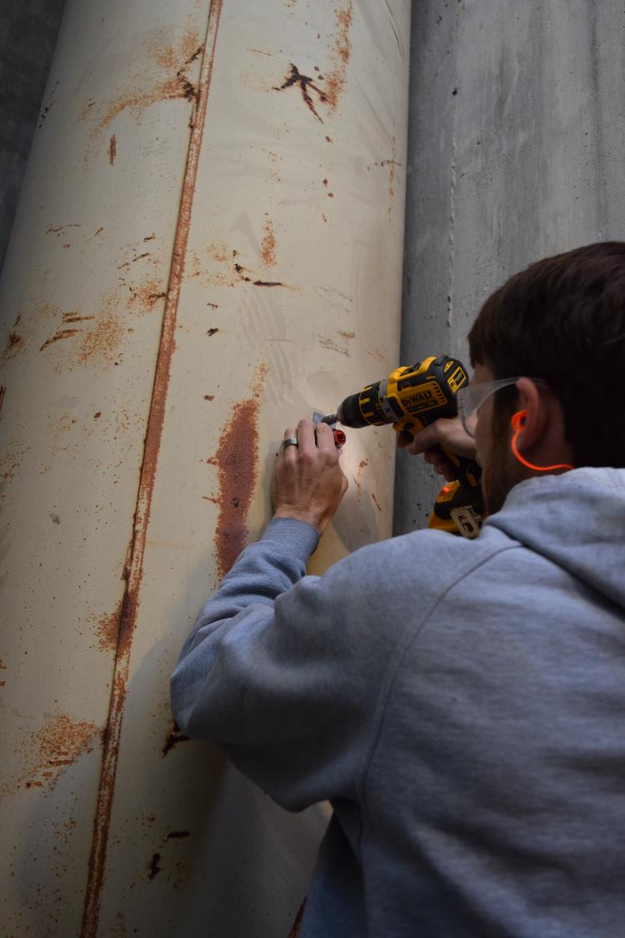
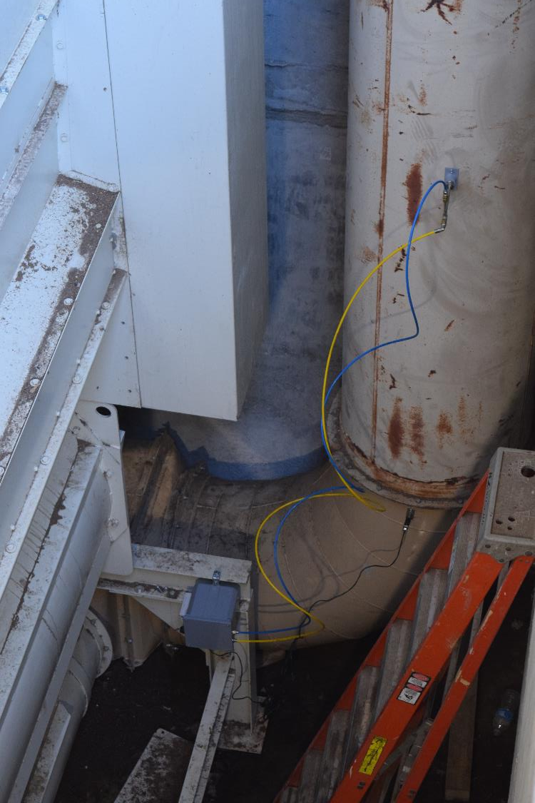

Slide 31
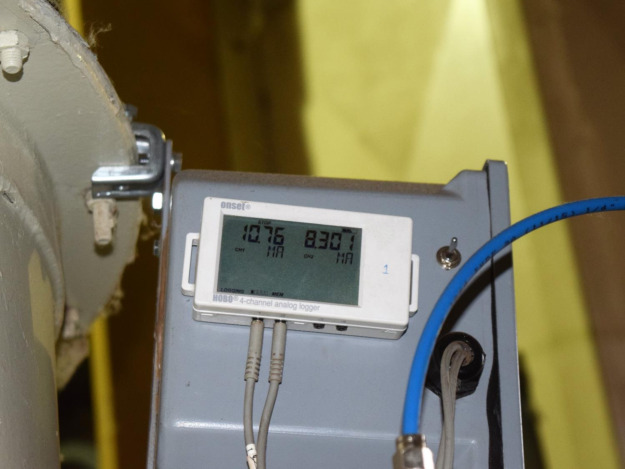

Slide 32
Fuel: Methods
Quantify fuel consumption
Quantify effective drying
Bales per hour & turnout → seed cotton mass flow rate
Change in moisture content of that mass flow → water evaporated
Enthalpy of vaporization & rate of evaporation → benefit (kW)

Slide 33
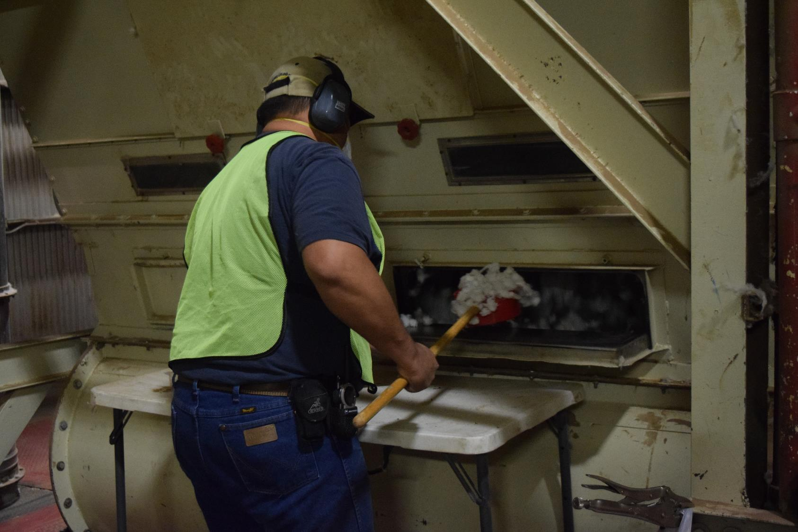

Slide 34
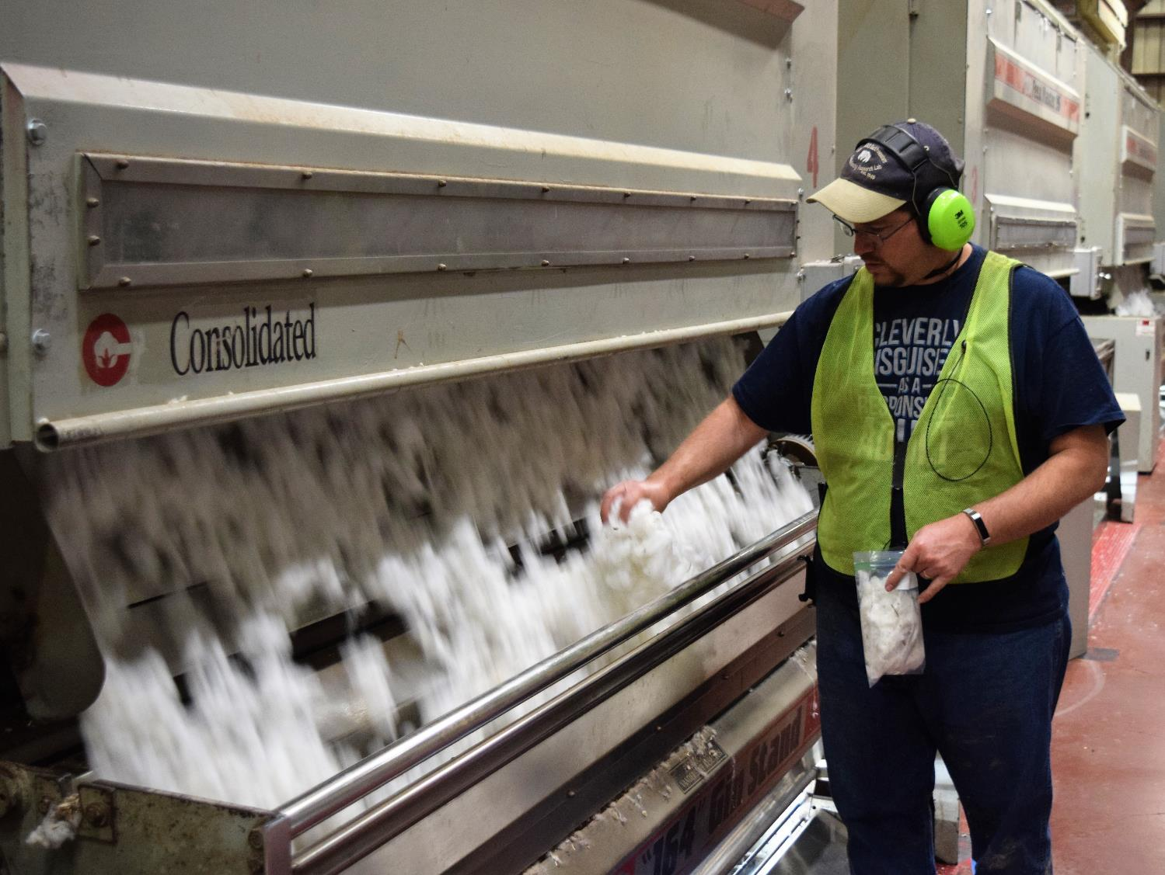

Slide 35
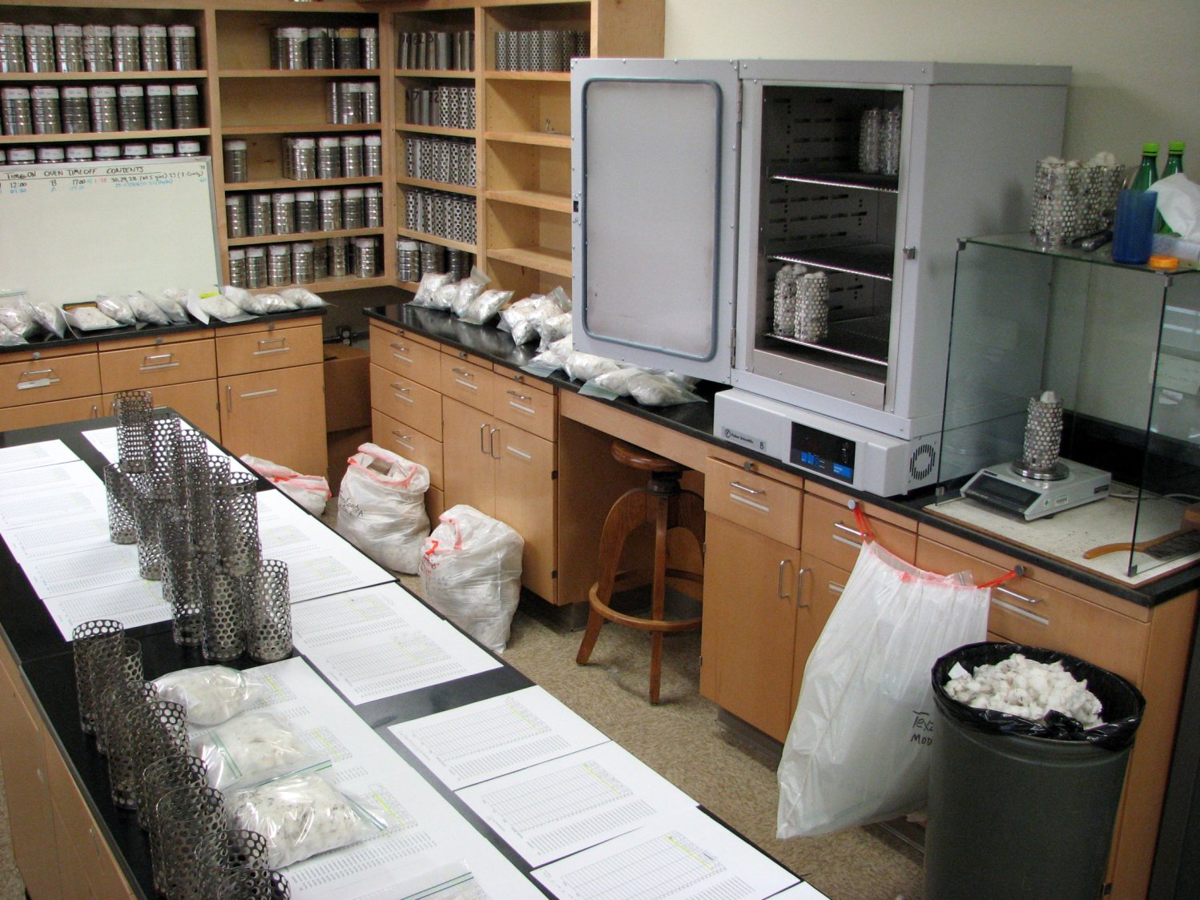

Slide 36
Fuel: Methods
Quantify fuel consumption
Quantify effective drying
Estimate portion of energy used for drying (fuel use efficiency)
Drying benefit/Fuel used cost → efficiency

Slide 37
Fuel: Methods
Quantify fuel consumption
Quantify effective drying
Estimate portion of energy used for drying (fuel use efficiency)
Find operating strategies, equipment selections, and facility designs that use fuel more efficiently

Slide 38
Fuel: Results
Find operating strategies, equipment selections, and facility designs that use fuel more efficiently
…hasn’t been as easy as it first looked
Weather
Crop condition
Unmeasured factors

Slide 39
Notes:
Two stages of drying each with their own burners were nearly equal in effectiveness. Each stage used about the same amount of fuel. This provides the gin with more drying capacity if conditions require it. Both of these examples ginned at 5.5% moisture content, wet mass basis.

Slide 40
Notes:
Warm moist air from first stage of drying was skimmed and used to convey seed cotton to the second stage of cleaning. The second stage is half (40%) as effective as the first stage, but it required no additional fuel. This works fine in dry climates.

Slide 41
Notes:
This gin had the capacity to do more drying than it needed to at the time of our sampling, so they had turned down the second stage and turned off the third stage burners. Even without any heat, a little bit of drying took place in the third stage from ambient air conveying the seed cotton.

Slide 42
2017, 1st Stage: 26%
2017, 2nd Stage: 15%

Slide 43
Low efficiency ascribed to long, uninsulated pipe from burner to seed cotton pickup

Slide 44
High efficiency ascribed to burners being close to dryers,
with insulated pipe from burner to pickup point
2016, 1st Stage: 43%
2017, 1st Stage: 55%

Slide 45
Fuel: Results
Easy fruit to pick: Operation
Ambient temperature dry air can make cotton drier, so
Turn off the second stage when drying is not needed

Slide 46
Fuel: Results
Easy fruit to pick: Operation
Ambient temperature dry air can make cotton drier, so
Turn off the second stage when drying is not needed
Easy fruit to pick: Infrastructure
Install a burner control to save fuel when cotton is dry
Follow ASABE Standard 530.1 for sensor locations
Insulate the hottest pipe – from burner to mix point
Place the burner close to the mix point

Slide 47
Fuel: Results
Complications: Operation
Can’t skip first stage because pre-cleaning efficiency depends on moisture content being low
Complications: Infrastructure
Modification of major components may be cost prohibitive

Slide 48
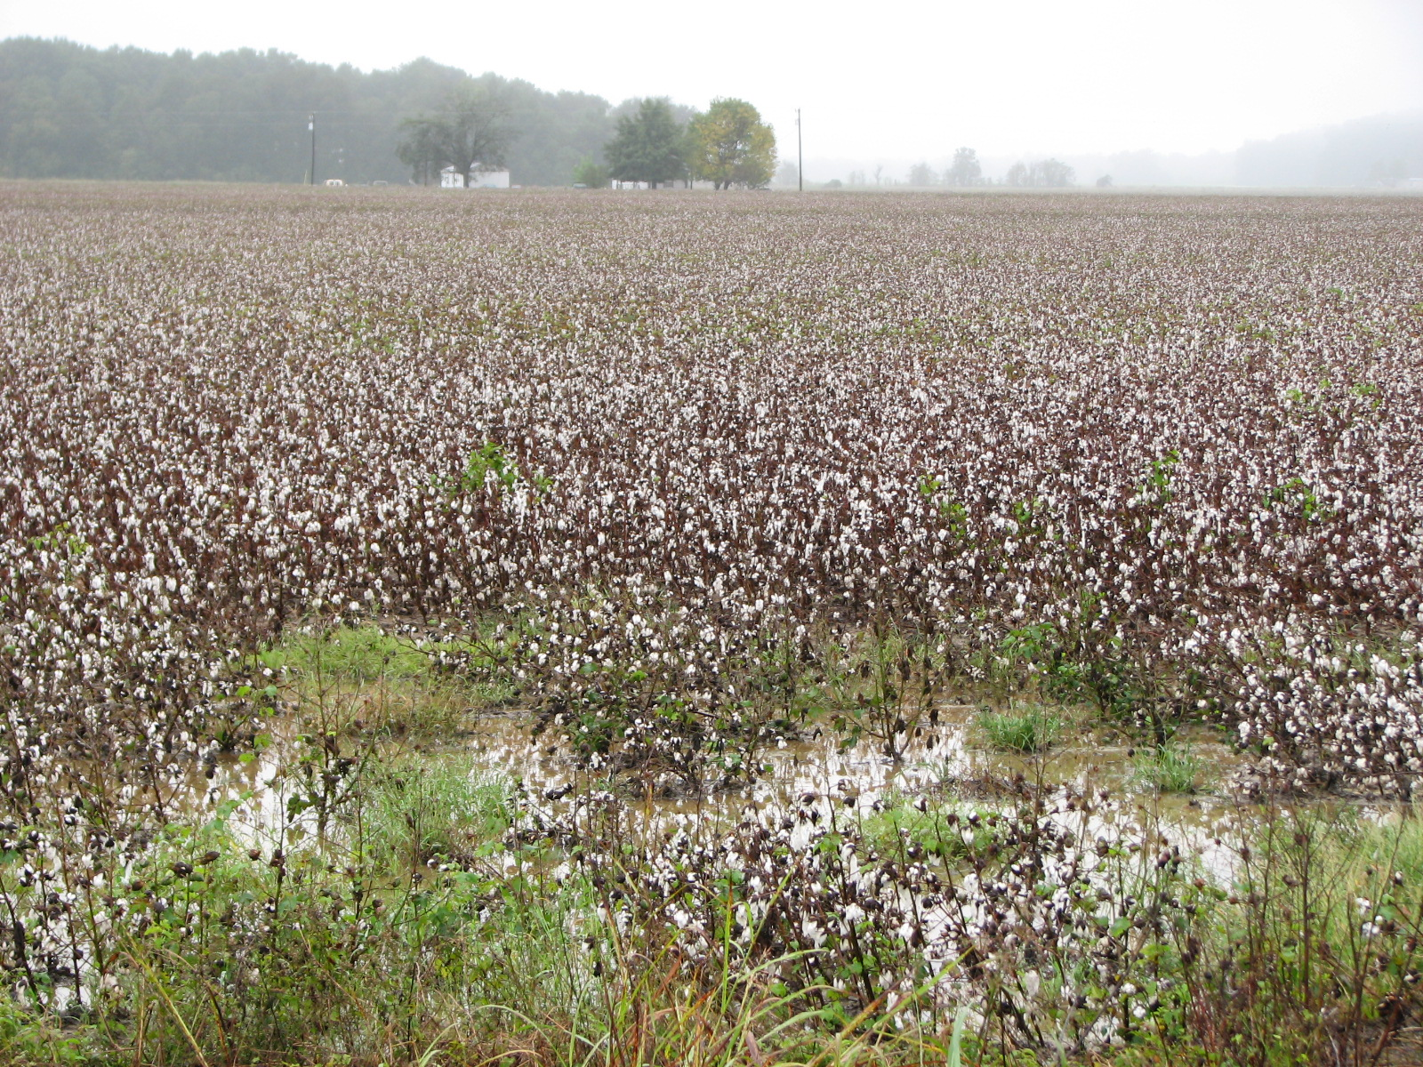
Fuel: Results
Persuade growers to harvest when cotton is dry

Slide 49
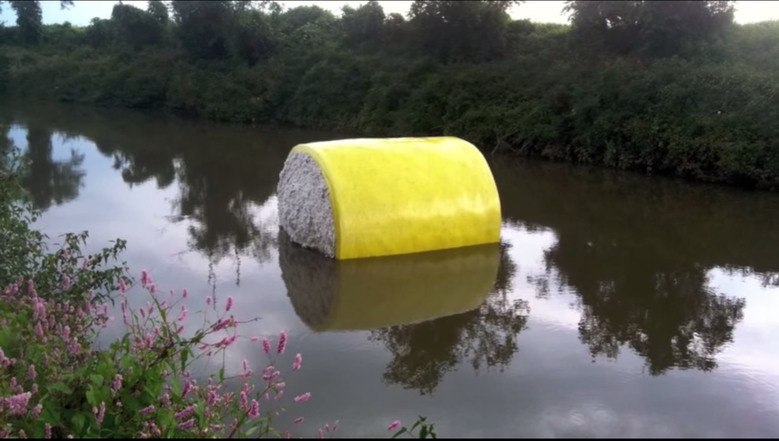
Fuel: Results
Protect covers/wraps from damage
Store cotton in dry conditions

Slide 50
USDA-Agricultural Research Service: Southwestern Cotton Ginning Research Lab (NM) US Cotton Ginning Research Unit (MS)

