Slide 1
Cross-Commodity Management of Silverleaf Whitefly in Georgia
Phillip Roberts, Stormy Sparks, Apurba Barman,
David Riley, and Mike Toews
Department of Entomology
Notes:
Good morning. I’m Phillip Roberts, Extension Entomologist with the University of Georgia and today we will discuss management of silverleaf whitefly in south Georgia. I would like to thank my co-authors, Drs. Stormy Sparks, Apurba Barman, David Riley, and Mike Toews.

Slide 2
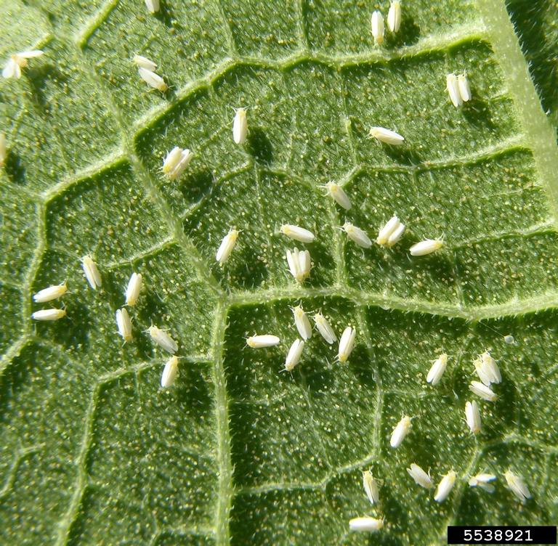
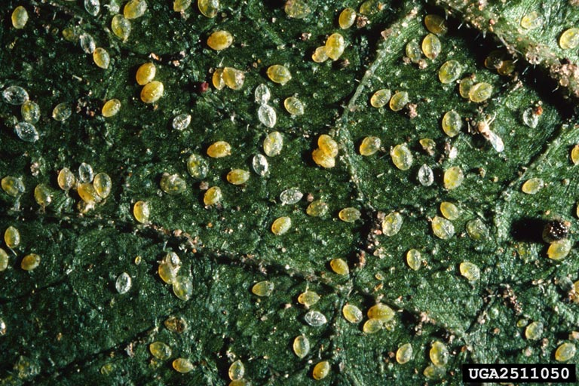
Silverleaf Whitefly
Sweet Potato Whitefly, Bemisia tabaci
a.k.a. “Silverleaf Whitefly”
Economic pest of numerous crops in Georgia
Cotton
Vegetables
Others
Sucking mouthparts
Feeds within vascular tissues and removes plant sap.
Excretes honeydew
SLWF adults (above) and nymphs (below).
Notes:
Sweetpotato whitefly, Bemsia tabaci, a.k.a. the silverleaf whitefly is an economic pest of numerous crops in Georgia, including cotton and a wide variety of vegetable crops. Both adults and immatures have sucking mouth parts and damage crops by feeding within vascular tissues and removing plant sap. As they feed, they excrete honeydew which is a sticky, sugary solution that accumulates on plants. Honeydew serves as a food source for sooty mold, which can cover the plant and block sunlight resulting in reduced photosynthesis. In cotton, accumulation of honeydew on lint can have negative impacts on fiber quality and spinning efficiency at mill. In some vegetable crops silverleaf whitefly is a vector of viral diseases that can decimate fields, particularly in the fall.

Slide 3
SLWF and The Green Bridge
Cole Crops
Cole Crops
Collards
System
Drivers
Cucurbits
Cotton
Tomato
Tomato
Locally Important
Snap Bean
Snap Bean
Sweet Potatoes
Soybean
Non-crop hosts
Wide host range.
Remains active year-round in south Georgia.
SLWF populations can increase rapidly.
150+ eggs per female.
Generation less than 20 days in heat of summer.
Notes:
Silverleaf whitefly has a wide host range, over 500 known plant hosts, and remains active year-round which makes the south Georgia farmscape and ideal location for this pest. Winters are typically mild enough to maintain populations of silverleaf whitefly on cultivated crops and weedy plants. Silverleaf whitefly populations can increase rapidly. Females lay 150-200 eggs and a generation can be completed in less than 20 days during the summer months. Silverleaf whitefly development slows during cooler temperatures cut it does not stop. The chart above includes selected crops produced and Georgia and illustrates the fact the cultivated crops are available for silverleaf whitefly reproduction year round. In general, silverleaf whitefly populations move from winter vegetables to spring vegetables to cotton to fall vegetables and then back to winter vegetable vegetables. The system drivers include cole crops in the winter, cucurbits in the spring and fall, and cotton during the summer months.

Slide 4
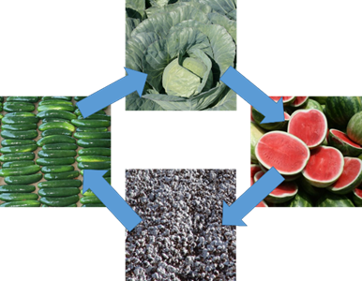
Cross-Commodity Management
Management of SLWF in these individual cropping systems affects infestations in subsequent crops as SLWF move from one cropping system to the next.
Failure to properly manage SLWF in any one of these systems can have negative consequences in subsequent cropping systems!
Notes:
In general silverleaf populations increase during the year and management in these individual cropping systems affects populations in subsequent crops as whiteflies move from one cropping system to the next. Failure to properly manage silverleaf whitefly in any one of these systems can have negative consequences in subsequent crops. Cross-commodity cooperation and management with the objective of minimizing overall populations of silverleaf whitefly will benefit all Georgia growers.

Slide 5
Environmental Factors Influencing Populations of SLWF
Winter Freezes
Can kill adults, but likely minimal impact on eggs and immature stages.
Hard freezes eliminate host plants (cultivated and weedy) that are not cold tolerant, thus leading to lower populations surviving the winter.
Tropical Systems
Heavy rains across large areas result in high mortality of adults, but have minimal impact on immature stages.
Timing: a tropical system moving through the area as SLWF are dispersing from one crop system to another is likely to have greater impact than when they are cycling within a crop.
Notes:
Tropical systems and winter freezes impact the potential for problems with silverleaf whitefly. Winter freezes can kill adult whiteflies in some years but has minimal impact on eggs and immature stages. However, hard freezes do eliminate cultivated crops and weedy host plants that are not cold tolerant, thus leading to lower populations surviving the winter. Tropical systems which produce heavy rains over broad areas results in high mortality of adults, but again little impact on immatures. Timing of these weather systems are more beneficial when silverleaf whiteflies are moving from one cropping system to another compared with populations that are embedded and cycling within a crop.

Slide 6
Minimize Buildup of SLWF Populations in ALL Cropping Systems
IPM programs address SLWF as a direct pest in individual crops but also aims to minimize overall populations across the farmscape.
In-Season Management
Post-Harvest Management
Destroy host crops immediately after final harvest to eliminate additional SLWF population growth!
Effective cross-commodity management reduces overall SLWF populations!
Notes:
The goal of cross-commodity management programs in to minimize buildup of silverleaf whitefly in all cropping systems. IPM programs in individual crops are designed to address whiteflies as a direct pest, but should also have the objective of minimizing overall populations in the farmscape. Cross-commodity management includes both in-season management and post-harvest management with the objective of lowering populations which move to subsequent cropping systems.

Slide 7
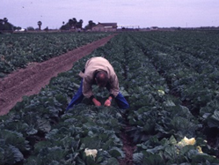
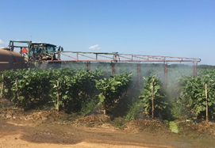
In-Season Management
Employ IPM in all cropping systems.
Conservation of natural enemies.
Timing and location of plantings.
Frequent scouting and timely applications of insecticides when thresholds are exceeded.
It is difficult to rescue a crop once a population of SLWF is established.
Notes:
IPM principles and programs should be utilized in in-season management programs. Examples include conservation of natural enemies and timing and location of plantings. The presence of robust natural enemy complexes greatly reduces the risk of silverleaf whitefly problems in cotton. Vegetable plantings, especially sequential plantings, should be separated as much as possible. Frequent scouting and timely intervention of insecticides when thresholds are exceeded is a must. It is difficult to rescue a crop once high populations of silverleaf are established in a crop.

Slide 8
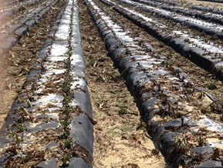
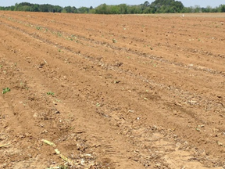
Post-Harvest Management
Thorough and timely destruction of host crops after harvest prevents population increases and movement of SLWF to subsequent cropping systems.
Notes:
Crops that maintain green foliage and are unmanaged for silverleaf whitefly after final harvest can allow for rapid population increases of silverleaf whitefly. Vegetable crops should be terminated and rendered as non-host for whitefly as soon as possible following final harvest. Preferably plant material should be disked into the soil immediately after final harvest. Cotton should be defoliated and harvested as soon as bolls are mature. Again the goal is to minimize silverleaf population buildup which will move to the next cropping system.

Slide 9
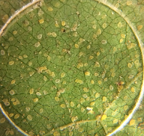
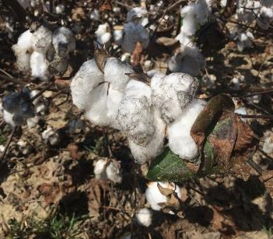
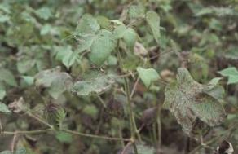
SLWF Damage on Cotton
YIELD
Removing plant sap
General leaf decline
Reduced plant vigor
Reduced plant growth
Premature defoliation
Bolls do not properly mature
Compounded by other stresses
Timing of infestation (stress)
Duration of control required
QUALITY
Honeydew
Accumulation on lint
Sooty molds
Sticky Cotton
(potential spinning problems)
Notes:
Silverleaf whitefly can be a serious pest of cotton, affecting both yield and quality. Damage symptoms from silverleaf whitefly in cotton include a general leaf decline, reduced plant vigor and growth, and premature defoliation in severe cases. These damage symptoms are compounded by other stress. Accumulation on honeydew on lint can be a serious issue in terms of fiber quality and spinning efficiency.

Slide 10
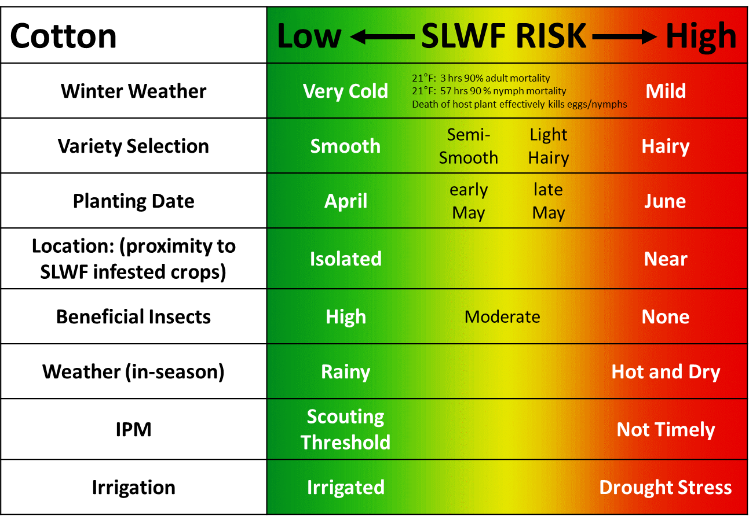
SLWF Management in Cotton
Cotton is the preferred summer host of SLWF.
All efforts should be made to minimize the risk and potential need for insecticide application in cotton.
OVERWINTERING AND COLD TOLERANCE OF BEMISIA-ARGENTIFOLII (HOMOPTERA, ALEYRODIDAE) IN COASTAL SOUTH-CAROLINA By: SIMMONS, AM (SIMMONS, AM); ELSEY, KD (ELSEY, KD), JOURNAL OF ENTOMOLOGICAL SCIENCE, Volume: 30 Issue: 4 Pages: 497-506. DOI: 10.18474/0749-8004-30.4.497, Published: OCT 1995
Notes:
Cotton is a preferred host of silverleaf whitefly during the summer months. All efforts should be made to minimize risk for silverleaf whitefly infestations. Leaf pubescence or hairiness has a significant effect on silverleaf whitefly risk. Hairy leaf cottons are preferred and support higher populations of silverleaf whitefly compared with smooth leaf cottons. Risk of silverleaf whitefly is also higher on later plantings. Proximity to silverleaf whitefly infested crops also influences risk. Conserving and maintaining beneficial insects should be a priority to minimize risk. Defoliation and harvesting cotton as soon as the crop is ready will minimize open bolls being exposed to honeydew and eliminate any additional increase in silverleaf whitefly populations within the field.

Slide 11
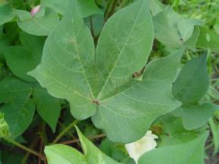
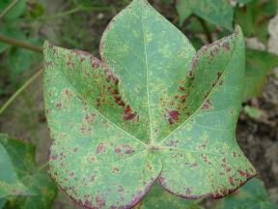
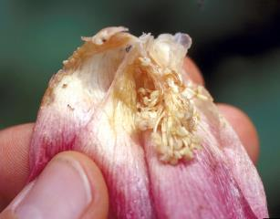
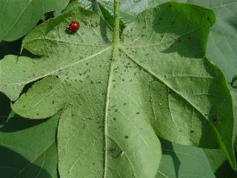
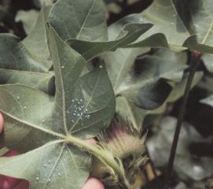
Insecticide Selection Presence Should Influence Decisions
Spider Mites
CEW/FAW (Leps)
Aphids
Whiteflies
Notes:
The presence of silverleaf whitefly should influence decisions for other pests. Do not apply insecticides for any pest unless thresholds are exceeded. Avoid use of insecticides known to flare or increase the risk of silverleaf whitefly. Early detection of silverleaf whitefly is critical so we can make proactive management decisions.

Slide 12
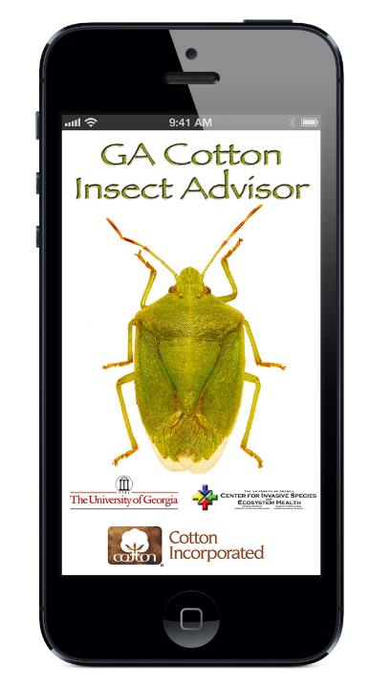
Expert System Rules Decision Aid for Stink Bugs in Cotton
Week of Bloom: treatment threshold triggers
Dynamic Threshold
Enter Percent Boll Injury
Stink Bug Species: insecticide choice
Southern Green (<25% Brown): pyrethroid
Mixed (25-75% Brown): organophosphate
Brown (>75% Brown): organophosphate
Other Pest Species: (commonly found but below established action thresholds):
Weeks 2-5 of Bloom:
Caterpillars: include pyrethroid
Aphids: include dicrotophos, avoid acephate
SLWF: use bifenthrin, avoid dicrotophos
Mites: use bifenthrin, avoid acephate
Weeks 6-7 of Bloom:
Caterpillars: include pyrethroid
Aphids: include dicrotophos, avoid acephate
SLWF: use bifenthrin
Mites: use bifenthrin
https://apps.bugwood.org/apps/gacottoninsectadv/
Notes:
Stink bugs are the most common insect pest treated with insecticide in Georgia cotton. The GA Cotton Insect Advisor is an app which assist decision makers with insecticide selection for stink bugs while considering risk of other pests such as whiteflies which may be present, but are below threshold, in the field. The goal is to minimize overall risk for silverleaf whitefly while maintaining effective control of stink bugs.

Slide 13
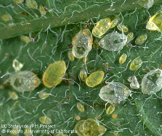
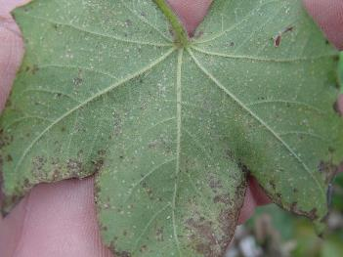
Silverleaf Whitefly Insecticides
CANNOT GET BEHIND!
Goal is to minimize in-field reproduction.
Critically important that initial insecticide application is well timed.
Area-wide management benefits all.
IGRs (Knack and Courier)
Long residual
Slow acting (targets eggs and/or immatures)
MUST be very TIMELY for maximum effectiveness.
Contact/Systemic (Assail/Strafer Max, Sivanto, and Venom)
Moderate residual
Immediate effect (targets all stages)
Preferred treatment over IGRs if not timely.
Use the correct product for the situation.
Nearly impossible to regain control if population reaches outbreak proportions.
Notes:
The goal of SLWF management is to initiate control measures just prior to the period of most rapid SLWF population development. It is critically important that initial insecticide applications are well timed, so frequent scouting is a must. If you are late with the initial application control will be very difficult and expensive in the long run. It is nearly impossible to regain control once the population reaches outbreak proportions! Knowledge of insecticides for silverleaf whitefly and how they work will allow decision makers to select the most appropriate insecticide for the situation. Timing is critical.

Slide 14
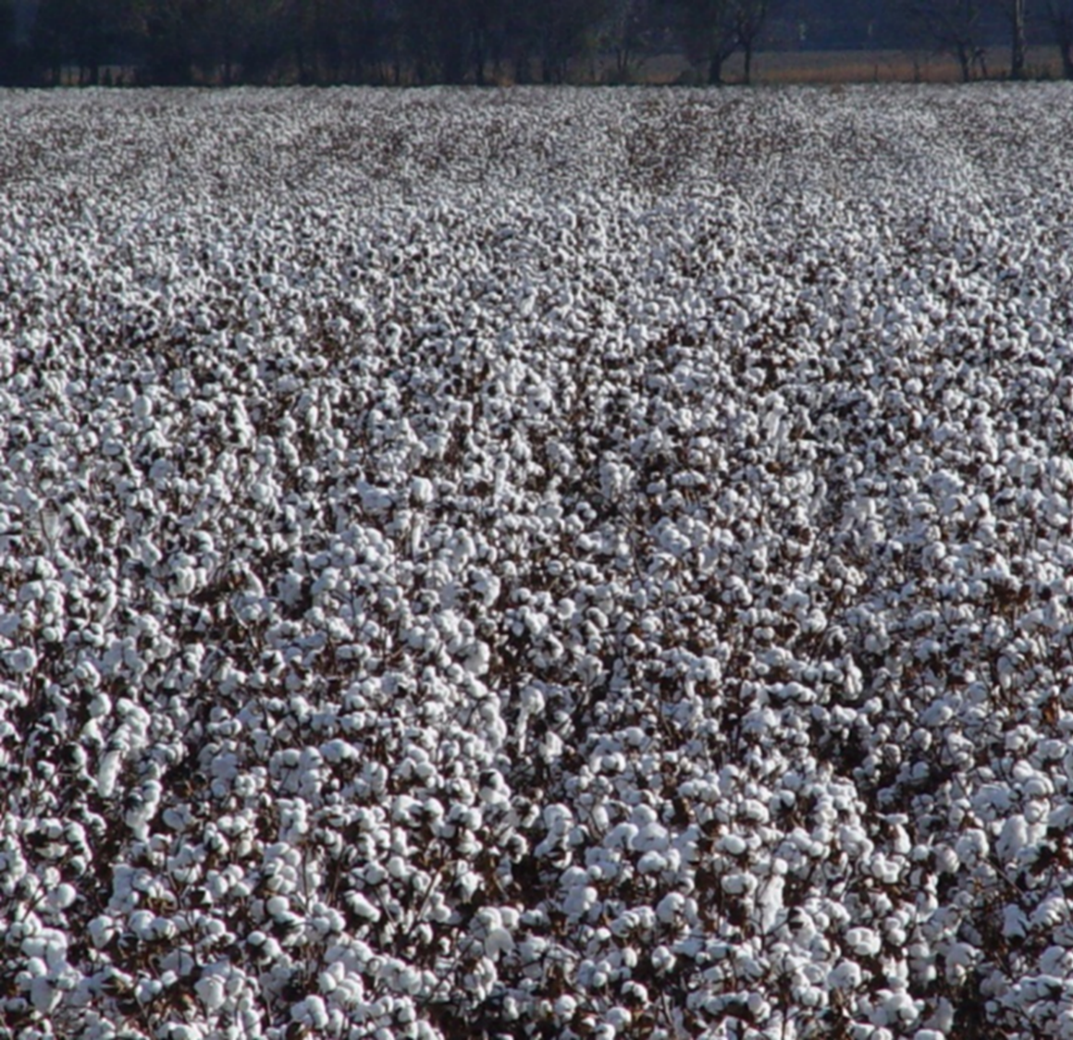
SLWF Management
Defoliate and harvest in a timely manner.
Minimize open bolls being exposed to honeydew.
Eliminate any additional SLWF population buildup.
Notes:
In closing I want to mention one more time the importance of defoliating and picking cotton in a timely manner. Late defoliation will extend the time bolls may be exposed to honeydew. Additionally late defoliation will allow the overall population of silverleaf whitefly to build prior to moving to fall and winter vegetable crops.

Slide 15
Cross-Commodity Management of Silverleaf Whitefly in Georgia
SLWF is an economic pest that requires management to preserve yield and quality.
Minimize SLWF populations moving from one cropping system to the next.
In-Season Management
Post-Harvest Management
The overall population of SLWF increases during the year, and management within each cropping significantly impacts subsequent cropping systems.
Cross-commodity cooperation management with the objective of minimizing overall populations of SLWF will benefit all Georgia growers!
Notes:
Silverleaf whitefly is an important economic pest that requires management in vegetable and agronomic cropping systems to preserve yield and quality. The best opportunity for impacting the severity of infestations is to minimize populations of SLWF moving from one cropping system to another. This can be accomplished with effective in-crop management and timely crop termination after harvest to minimize population development. Populations of SLWF increase during the year, and management within each cropping system significantly impacts subsequent cropping systems. It is important that management of SLWF is a priority in all agronomic and horticultural crops. Cross-commodity cooperation and management with the objective of minimizing overall populations of SLWF will benefit all Georgia growers.

