Slide 1
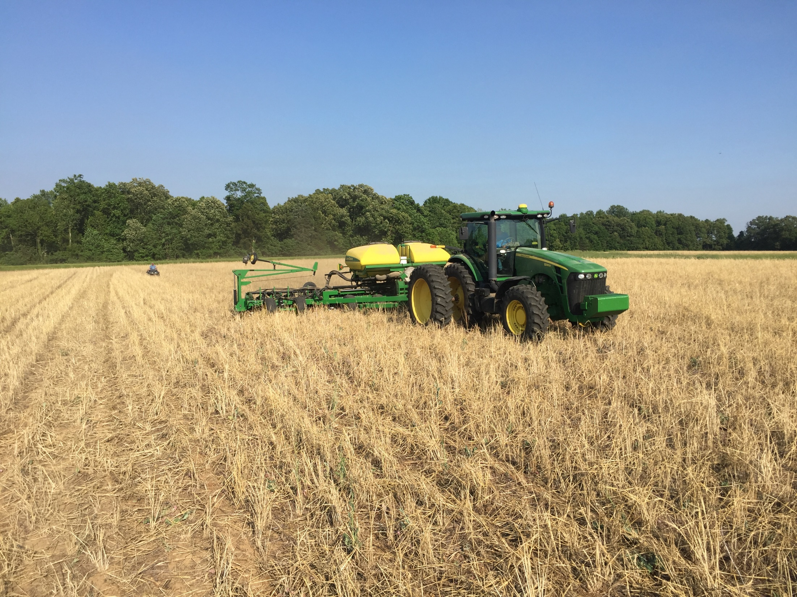


Increasing the water use efficiency of irrigated and dryland cotton with cover crops
Plant Management Network
Tyson B. Raper, PhD
Cotton and Small Grains Specialist; University of Tennessee
Notes:
My name is Tyson Raper
I am the Cotton and Small Grains specialist for the University of Tennessee.
The title of my presentation is Cotton Fertility- Wants vs Needs

Slide 2

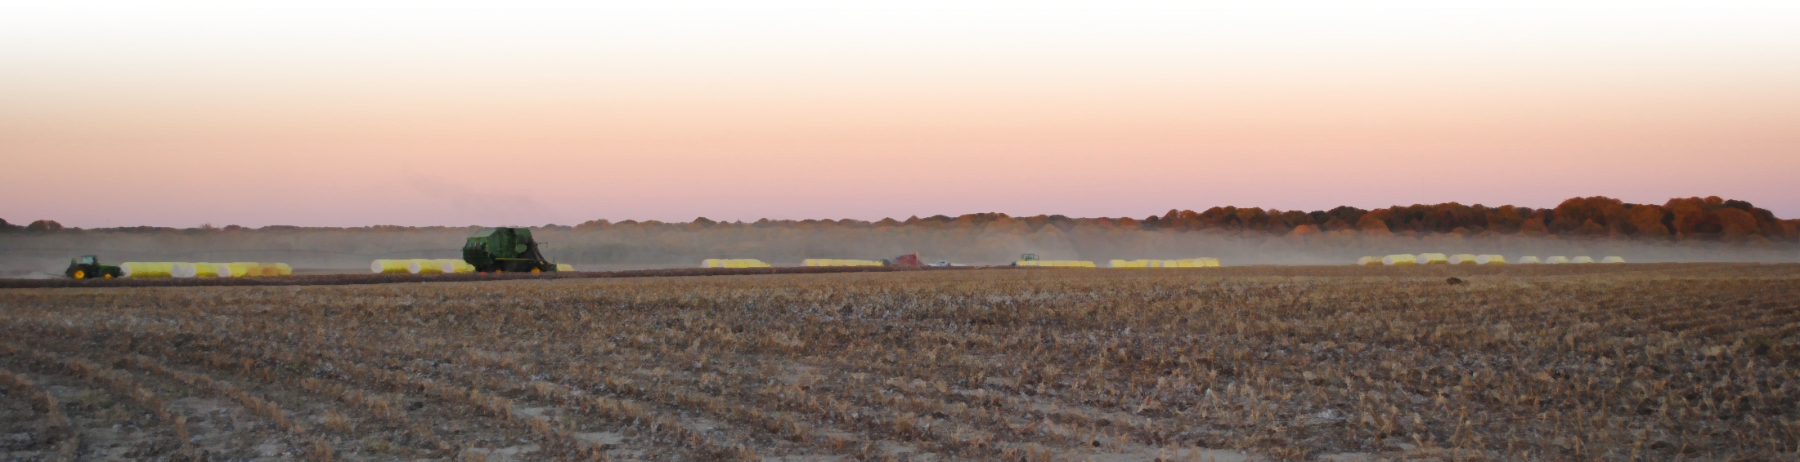
Take Home
Cotton agronomics
  Water demands of a developing cotton crop are rarely met completely by the environment.
  Cotton is an indeterminate, drought tolerant plant which does not perform well under saturated soil conditions.
Cover crop integration
  Supports increased infiltration and water holding capacity in the first year of integration
  Allows less frequent, more thorough irrigation events

Slide 3
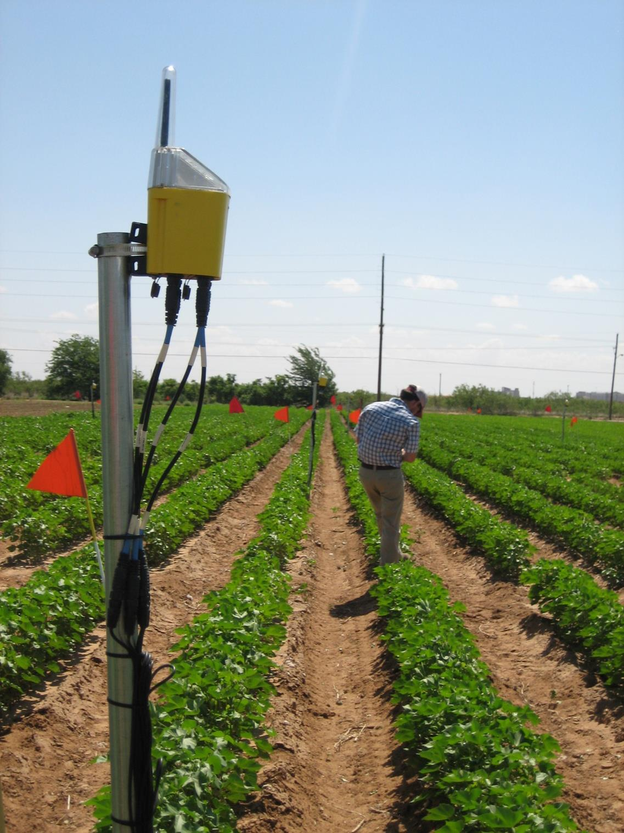
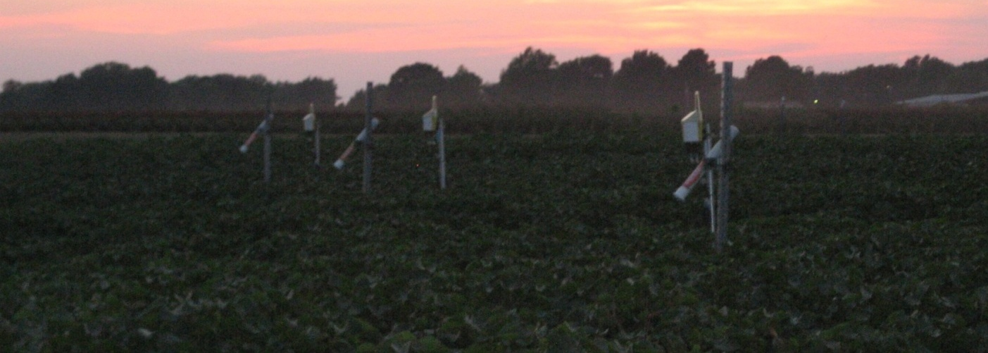
Outline
Overview of Water Management
  Cotton water use
  Rainfall patterns
  Atmospheric demand
Increasing WUE with Covers
  Experiment station research results
  On-farm experiences

Slide 4
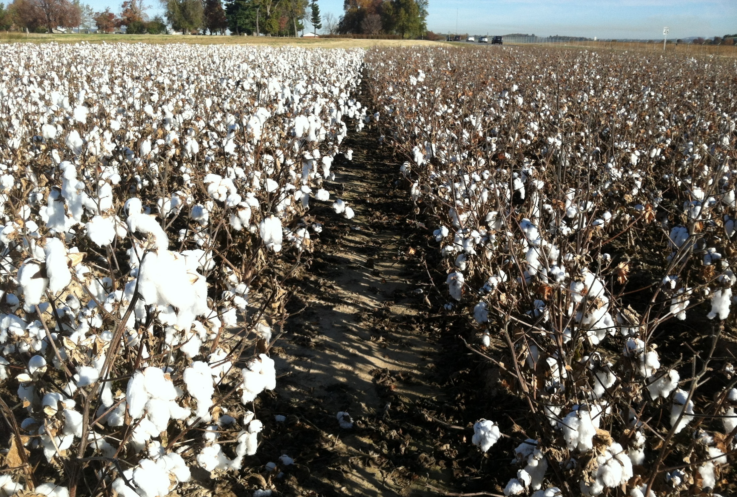
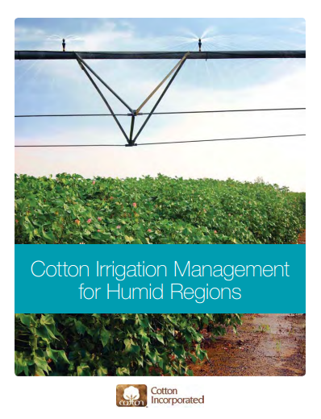
Take Home
Cotton Irrigation Management for Humid Regions

Slide 5
Crop Water Use
Framework for understanding crop water use:
  Crop Coefficient approach for estimated evapotranspiration (ET):
  Where:
    ET_{C} = estimated crop ET
    K_{C} = crop coefficient
    ET_{O} = Penman-Monteith reference ET (FAO-56)

Slide 6
Crop Water Use
1st
Square
1st
Flower
1st
Open Boll

Slide 7
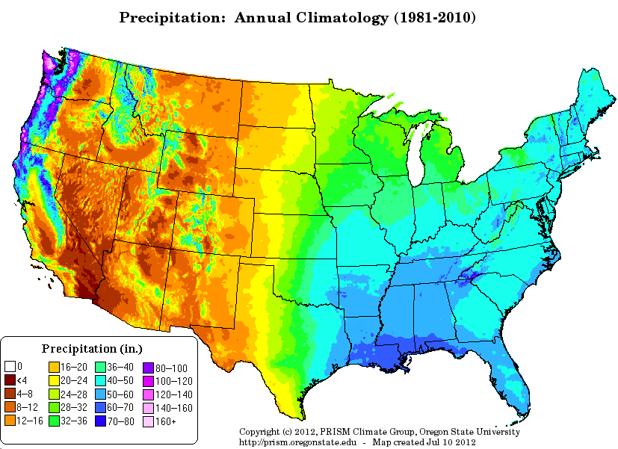
Environmental Demand
  40-50 in. per year in dry, hot environments
  20-30 in. per year in humid, moderate environments

Slide 8
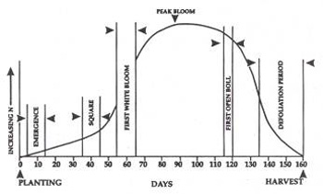
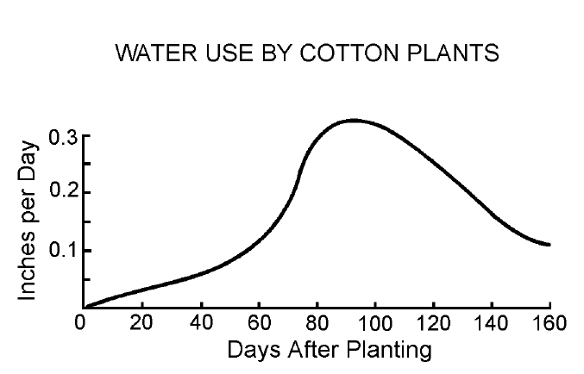
Crop Water Use
Measured crop water use from a cotton field in Louisiana over the growing season.
Water use and crop coefficient function for cotton in Stoneville, Mississippi.
University of Georgia Extension publication.

Slide 9
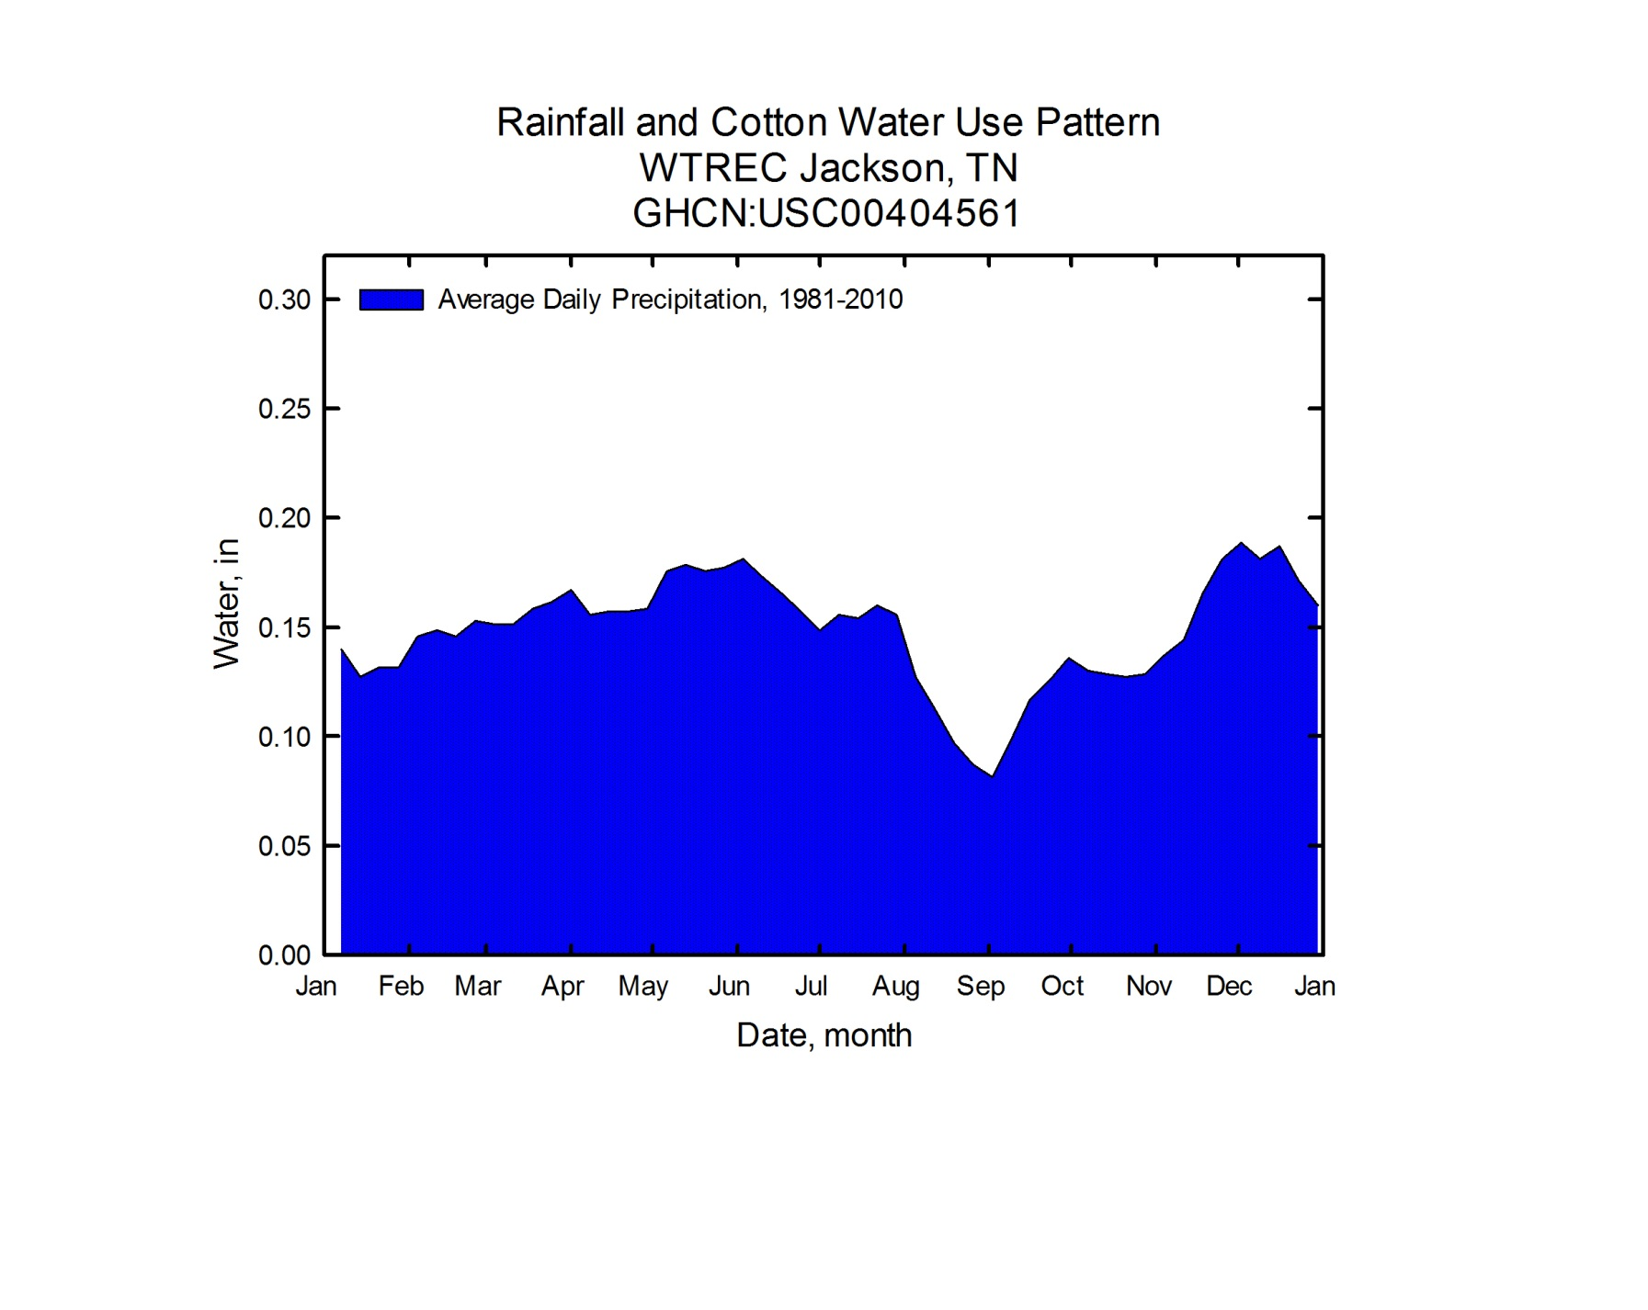
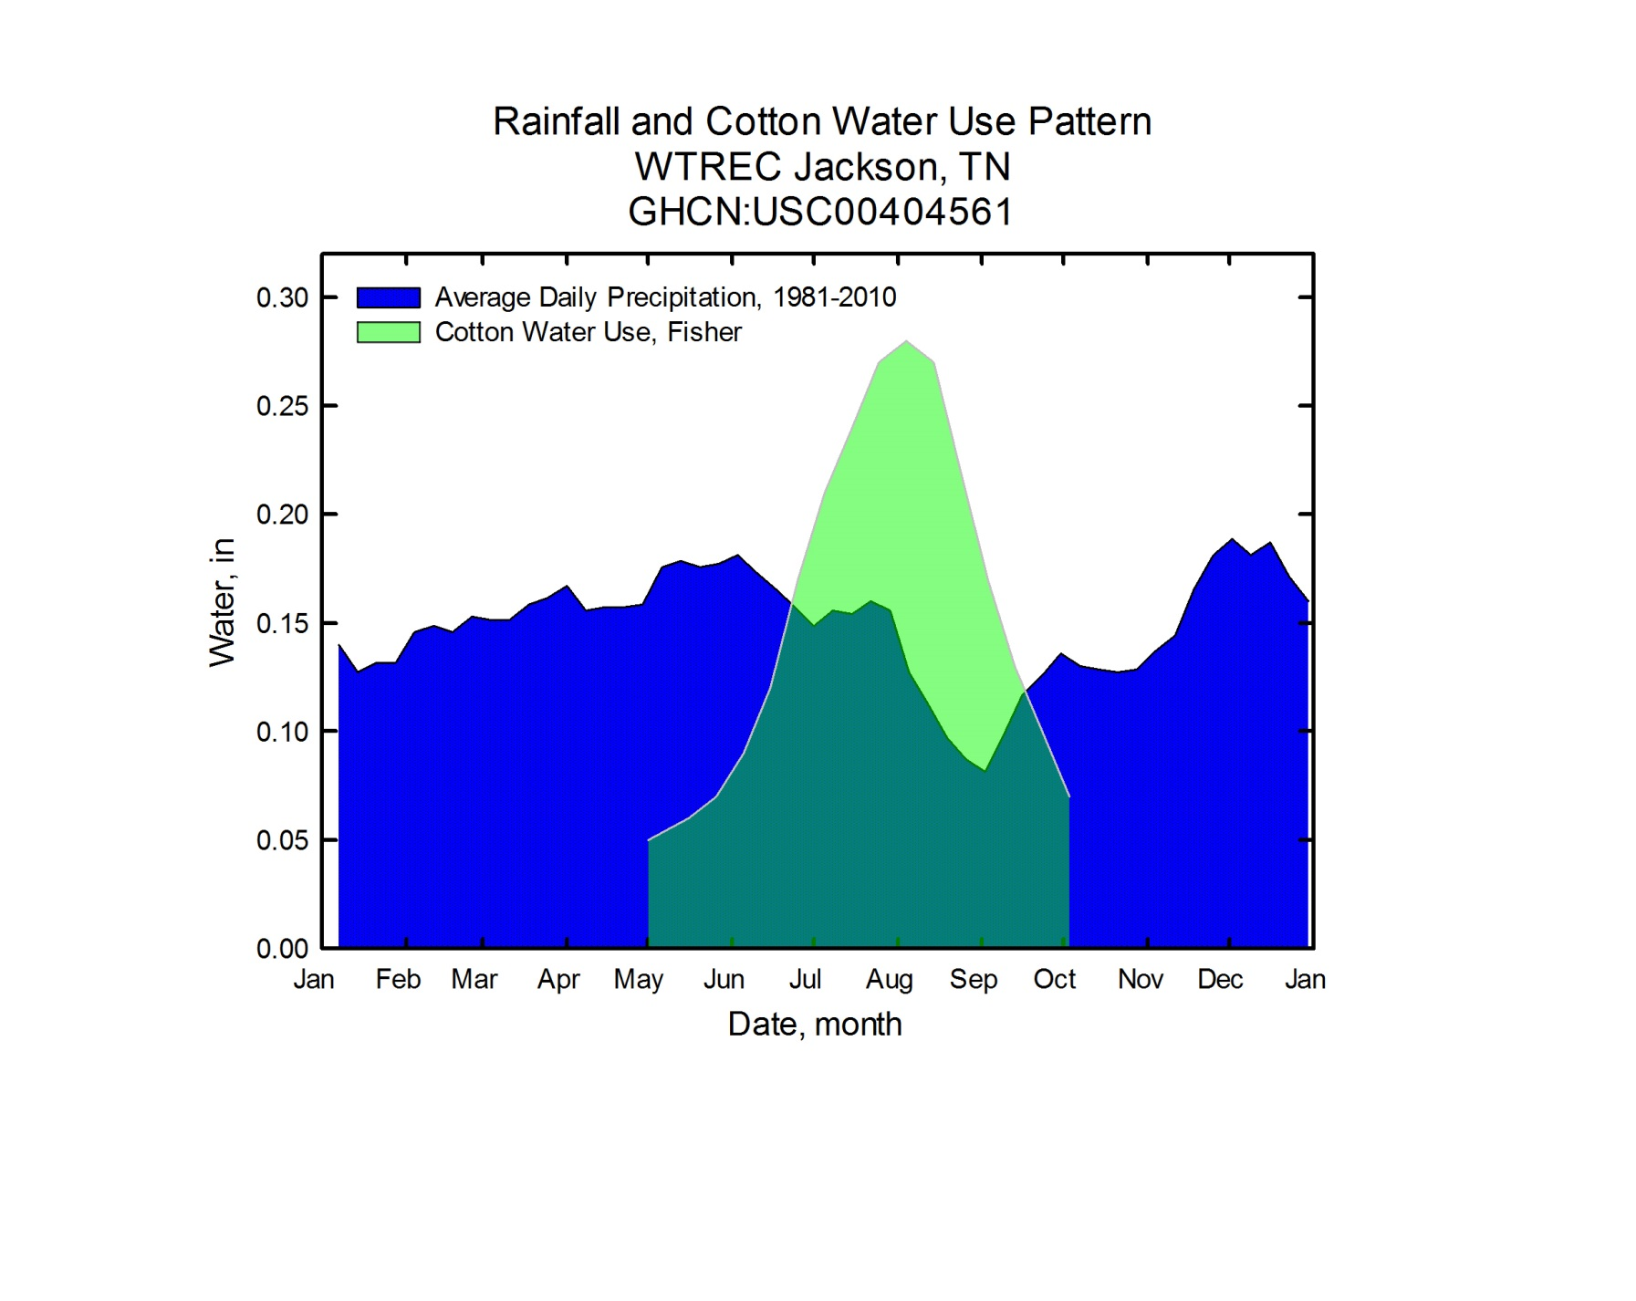
Environmental Demand
Discrepancy between rainfall pattern and crop demand

Slide 10
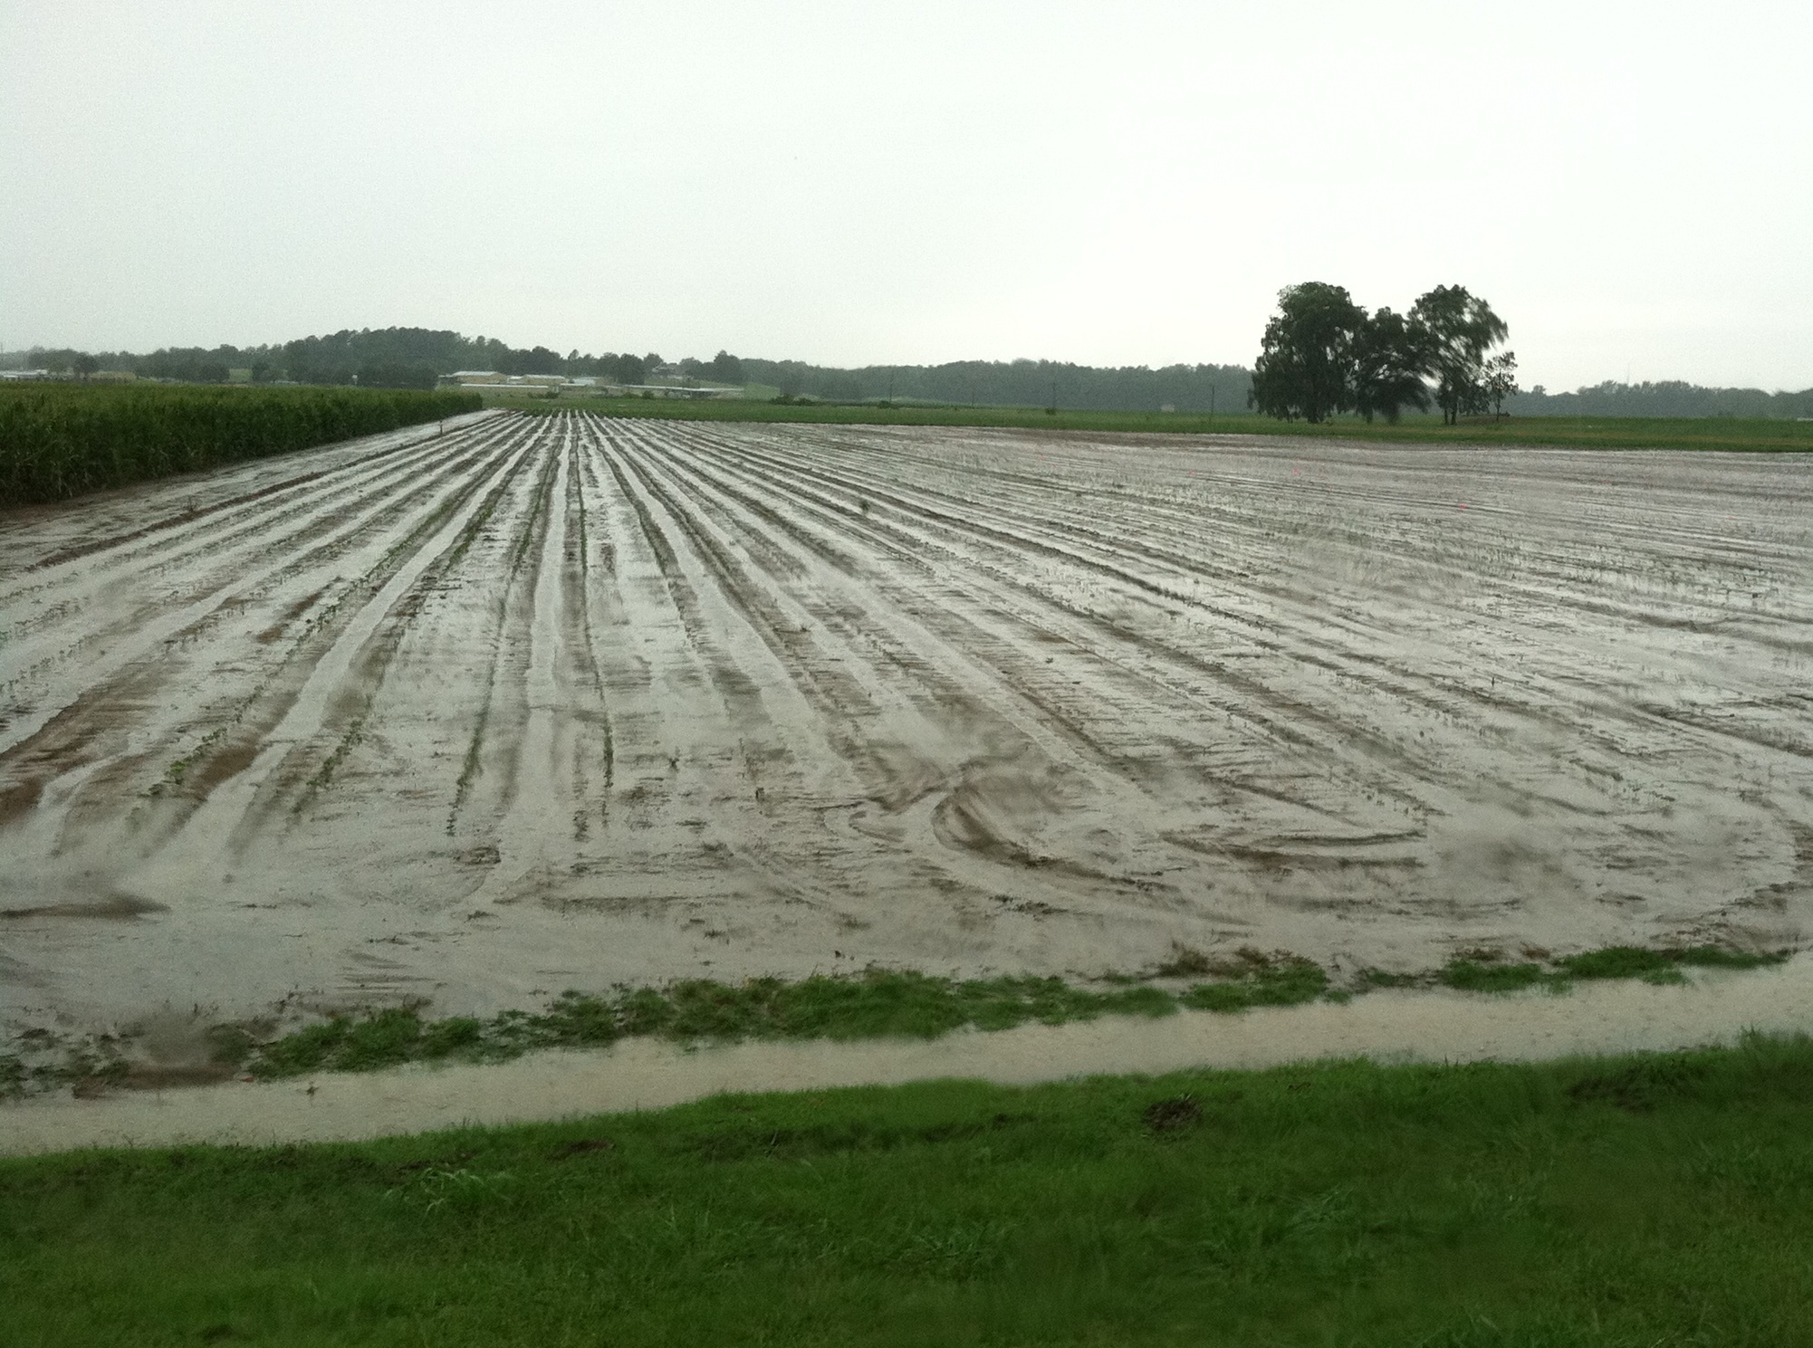
Meeting Crop Demands

Slide 11
Water and Cotton

Slide 12
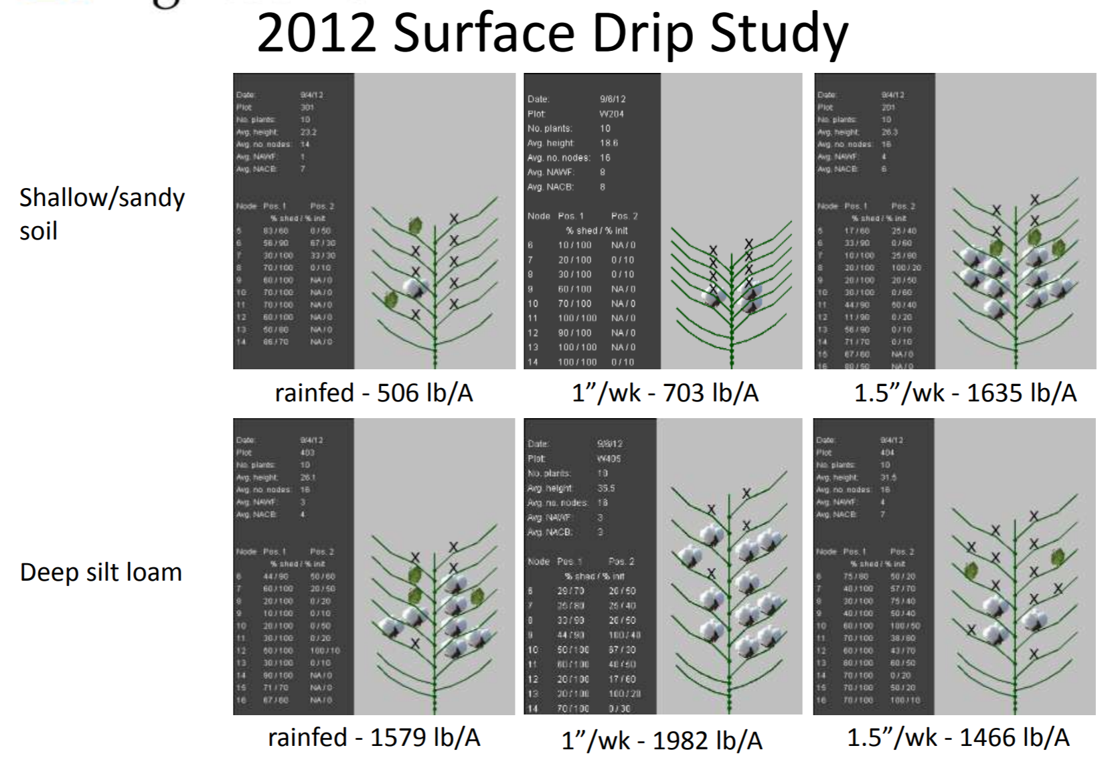
Water and Cotton

Slide 13
Water and Cotton

Slide 14
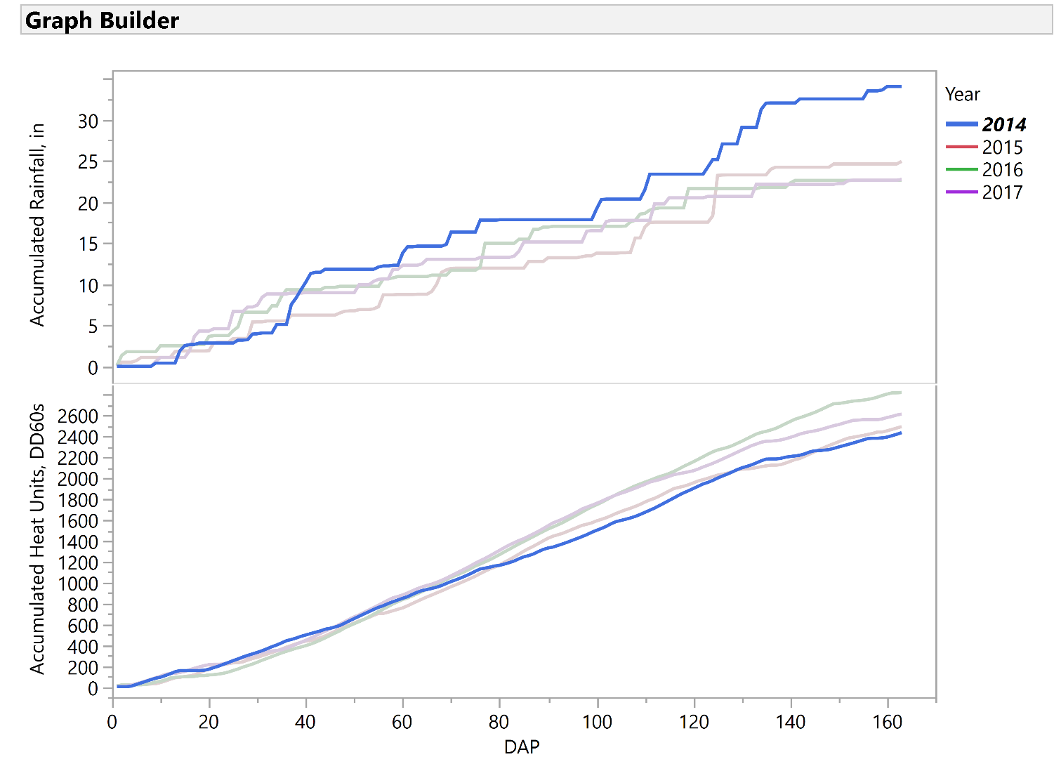
Water and Cotton

Slide 15
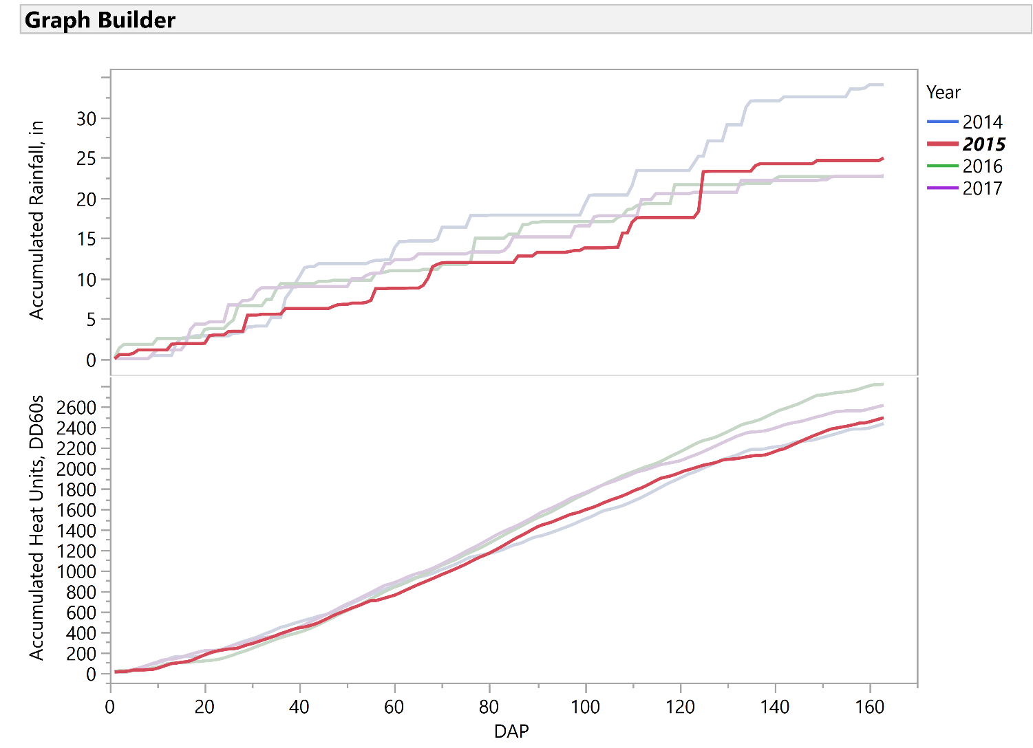
Water and Cotton

Slide 16
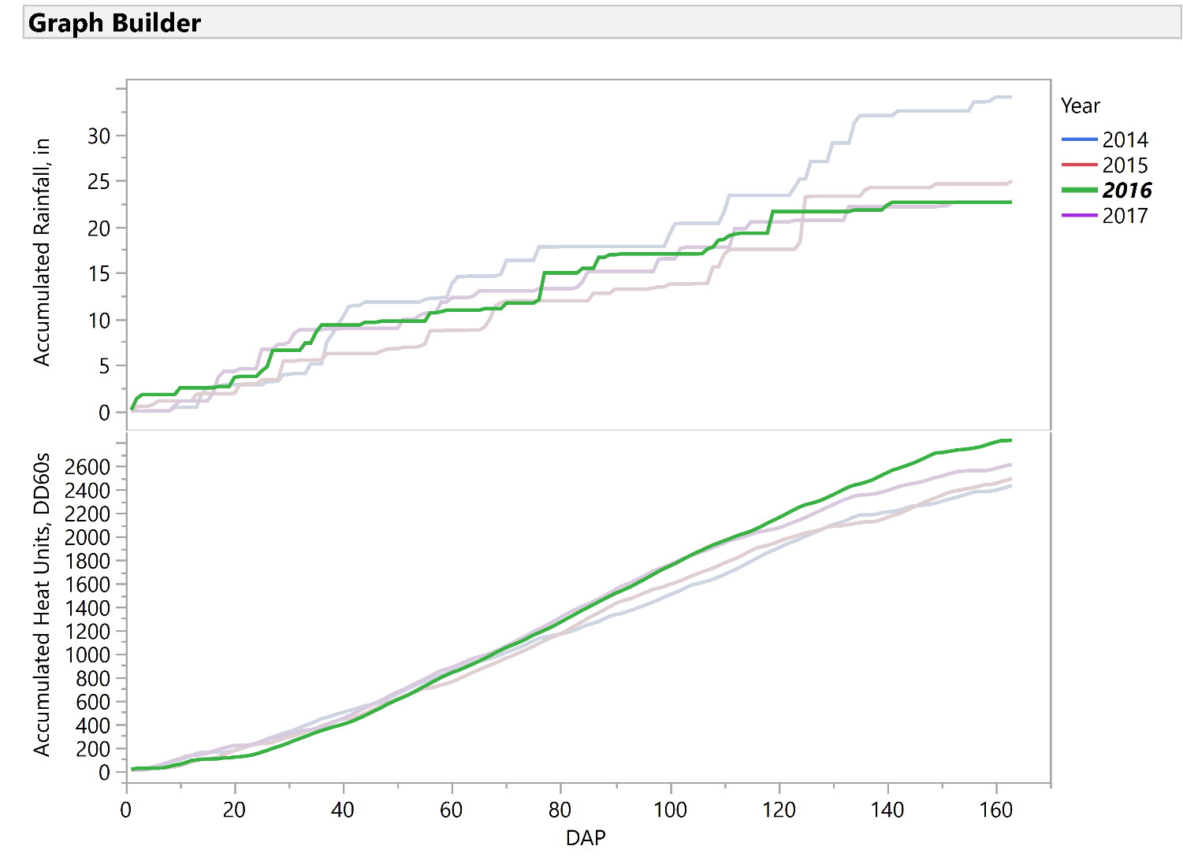
Water and Cotton

Slide 17
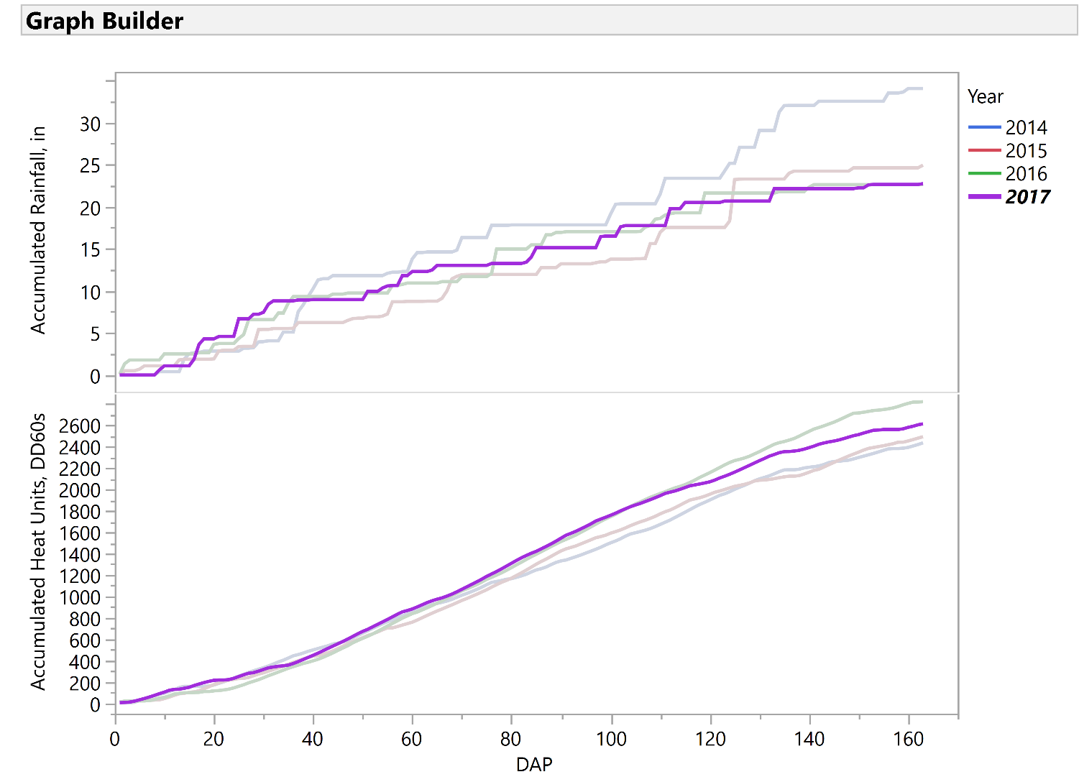
Water and Cotton

Slide 18
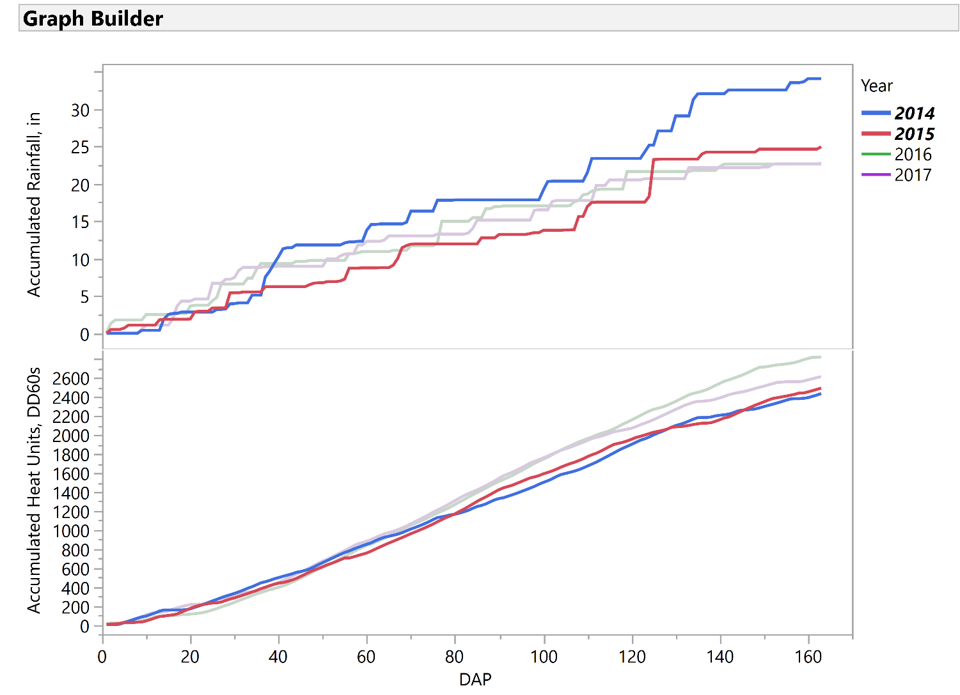
Water and Cotton
Year | Yield (lb/ac)
2014 | 878
2015 | 1,046
2016 | 1,104
2017 | 1,065

Slide 19
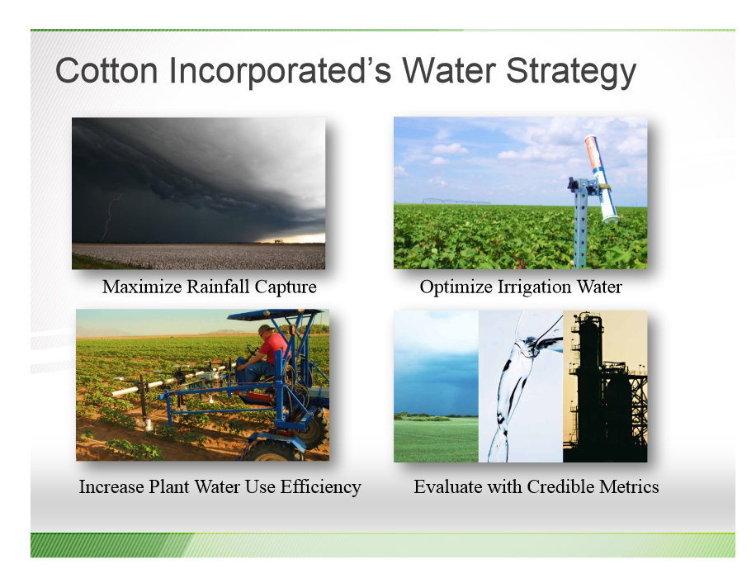
Cotton Inc’s Water Strategy

Slide 20

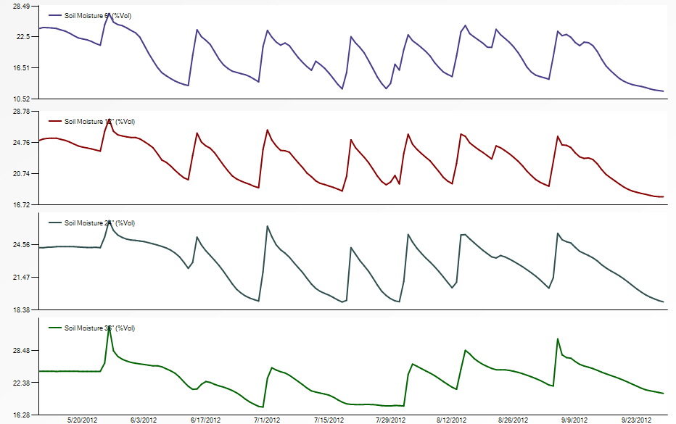
Maximize Water Capture
MARICOPA, AZ
VOLUMETRIC WATER CONTENT (%)
TIME

Slide 21
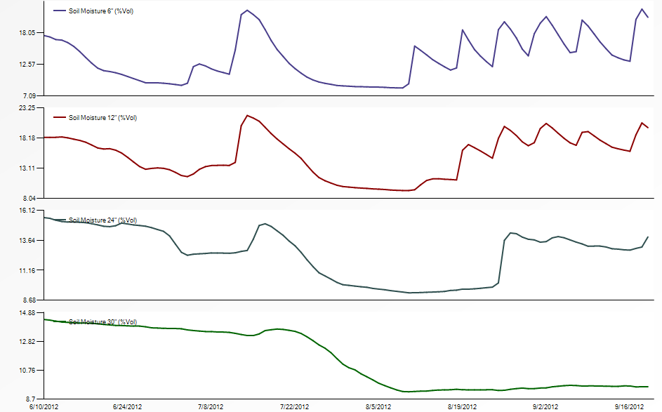
Maximize Water Capture
MARIANNA, AR
VOLUMETRIC WATER CONTENT (%)
TIME

Slide 22
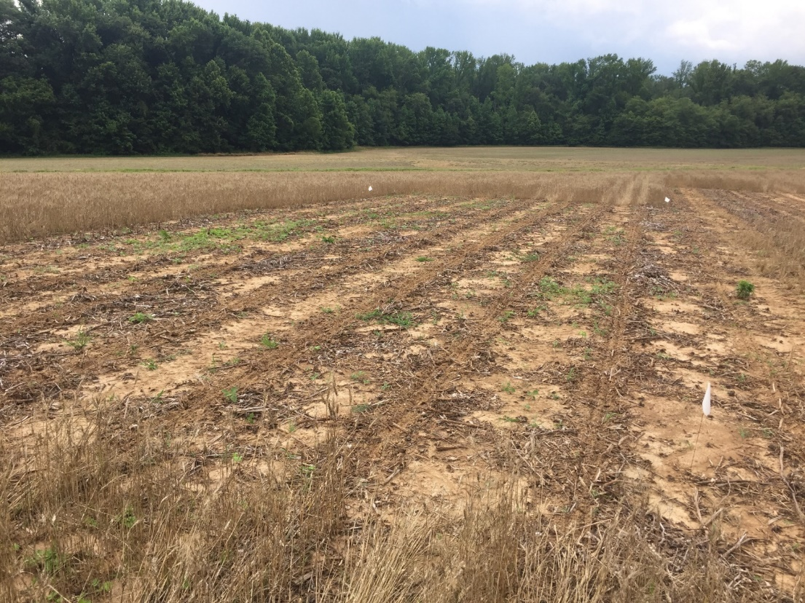
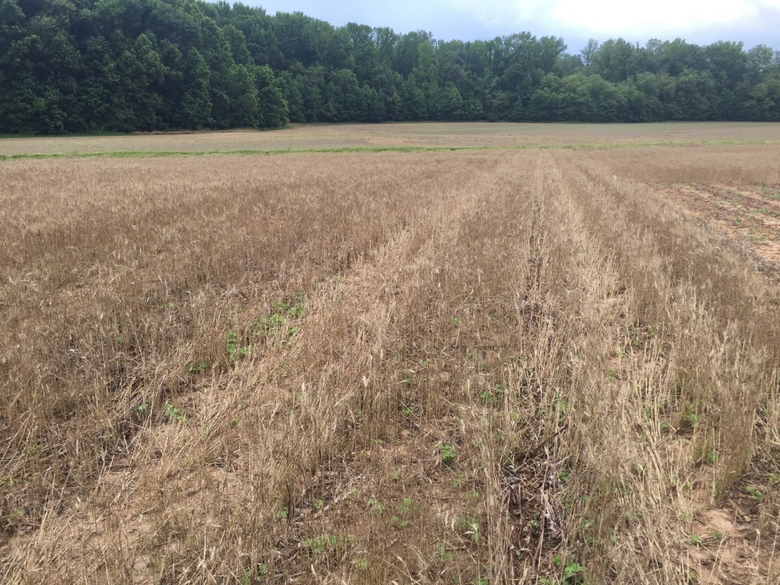
Maximize Water Capture

Slide 23
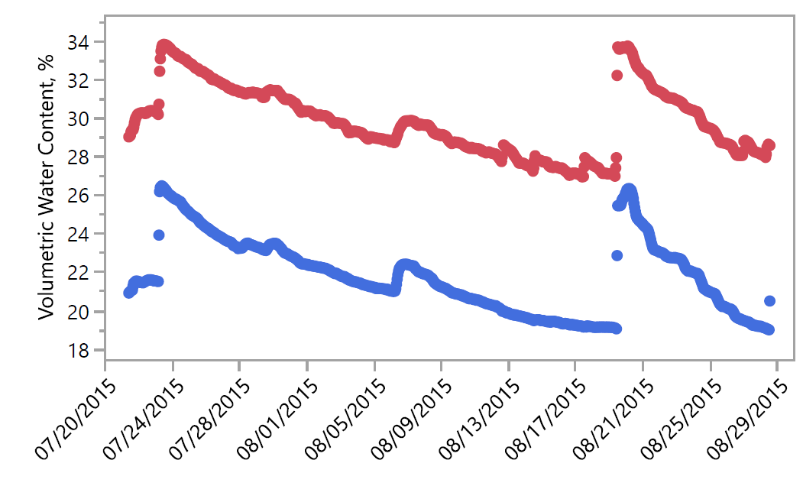
Maximize Water Capture
Wheat cover crop
Fallow (no cover)

Slide 24
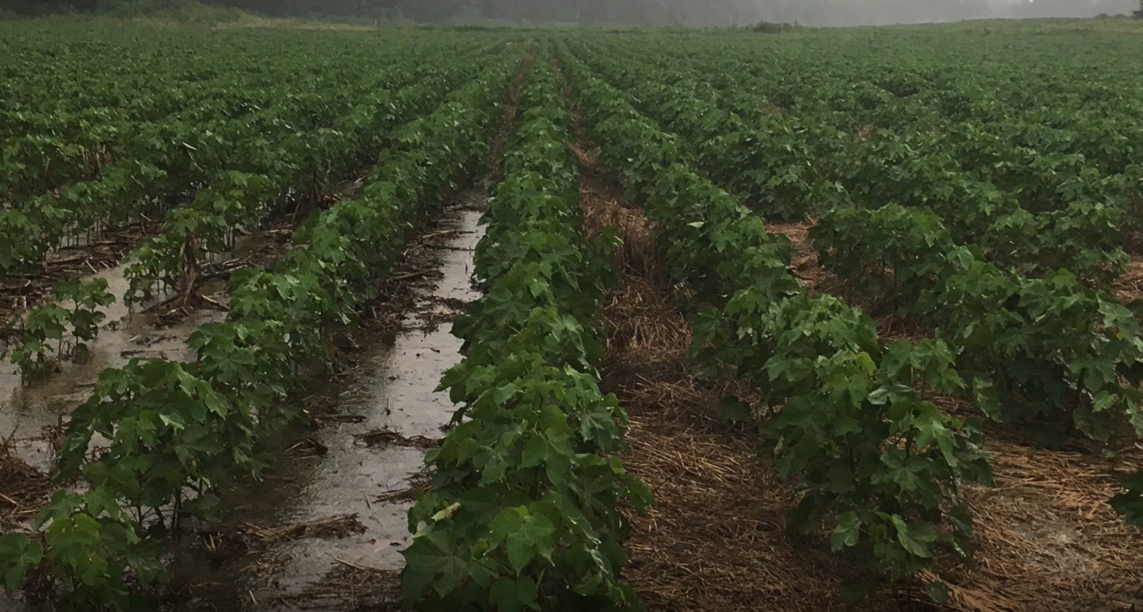
Maximize Water Capture
Matt Griggs, 2017

Slide 25
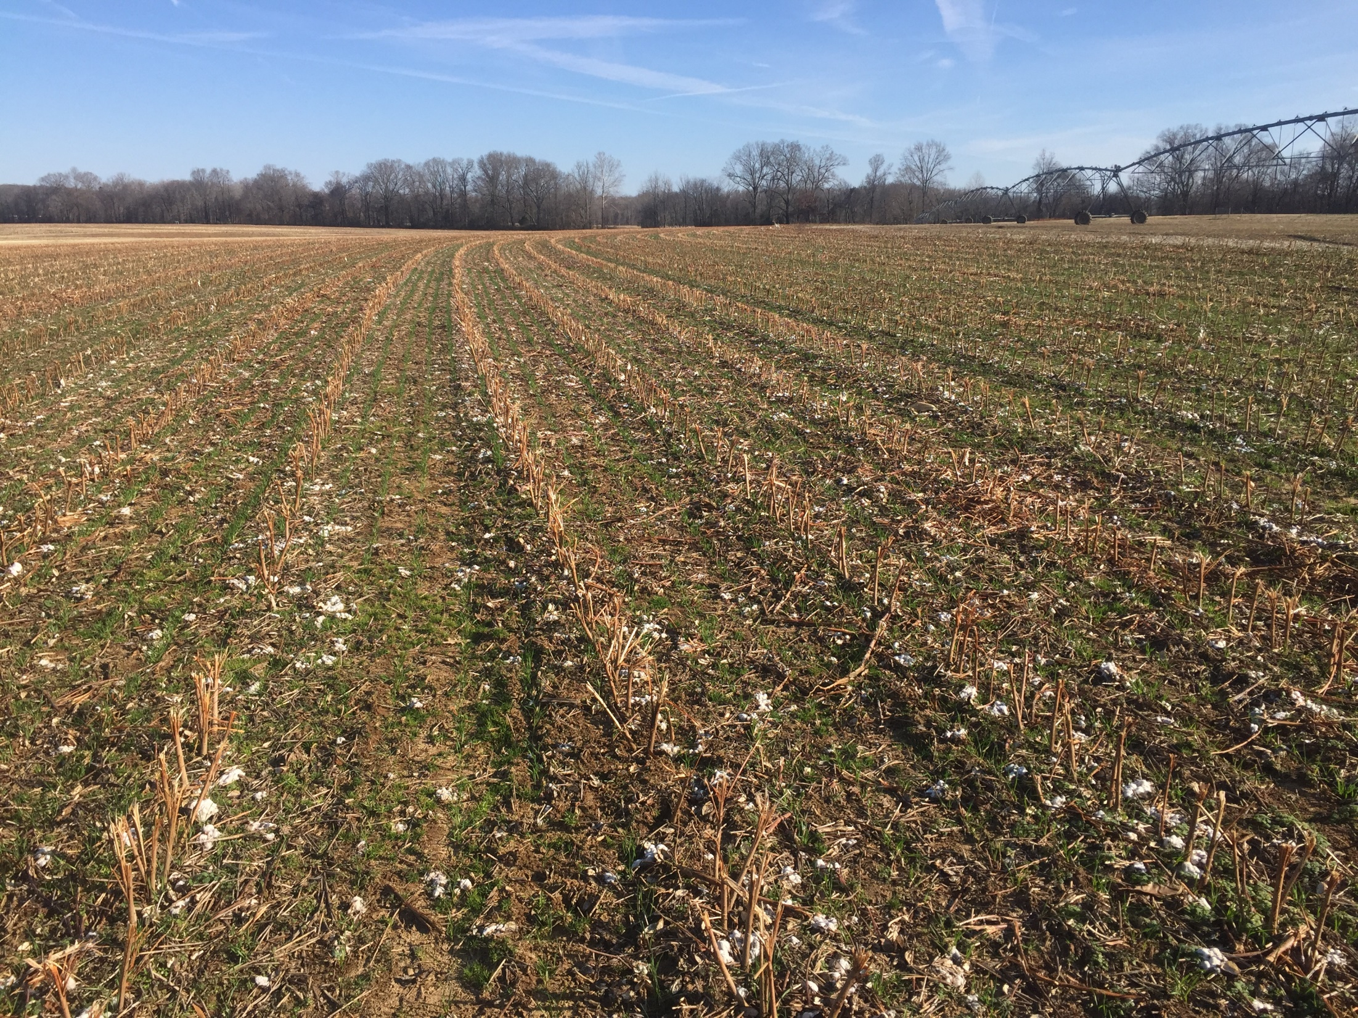
Maximize Water Capture
Dryland Production
  Increased infiltration and water holding capacity IN YEAR ONE
Irrigated production
  Reduce time in which soil stays saturated after irrigation
  Increase the quantity of water in which you can apply in each turn
Species
  Heavy monocot mixtures. . . Greater C:N ratios

Slide 26
Take Home
Cotton agronomics
  Water demands of a developing cotton crop are rarely met completely by the environment.
  Cotton is an indeterminate, drought tolerant plant which does not perform well under saturated soil conditions.
Cover crop integration
  Supports increased infiltration and water holding capacity in year one
  Allows less frequent, more thorough irrigation events

Slide 27
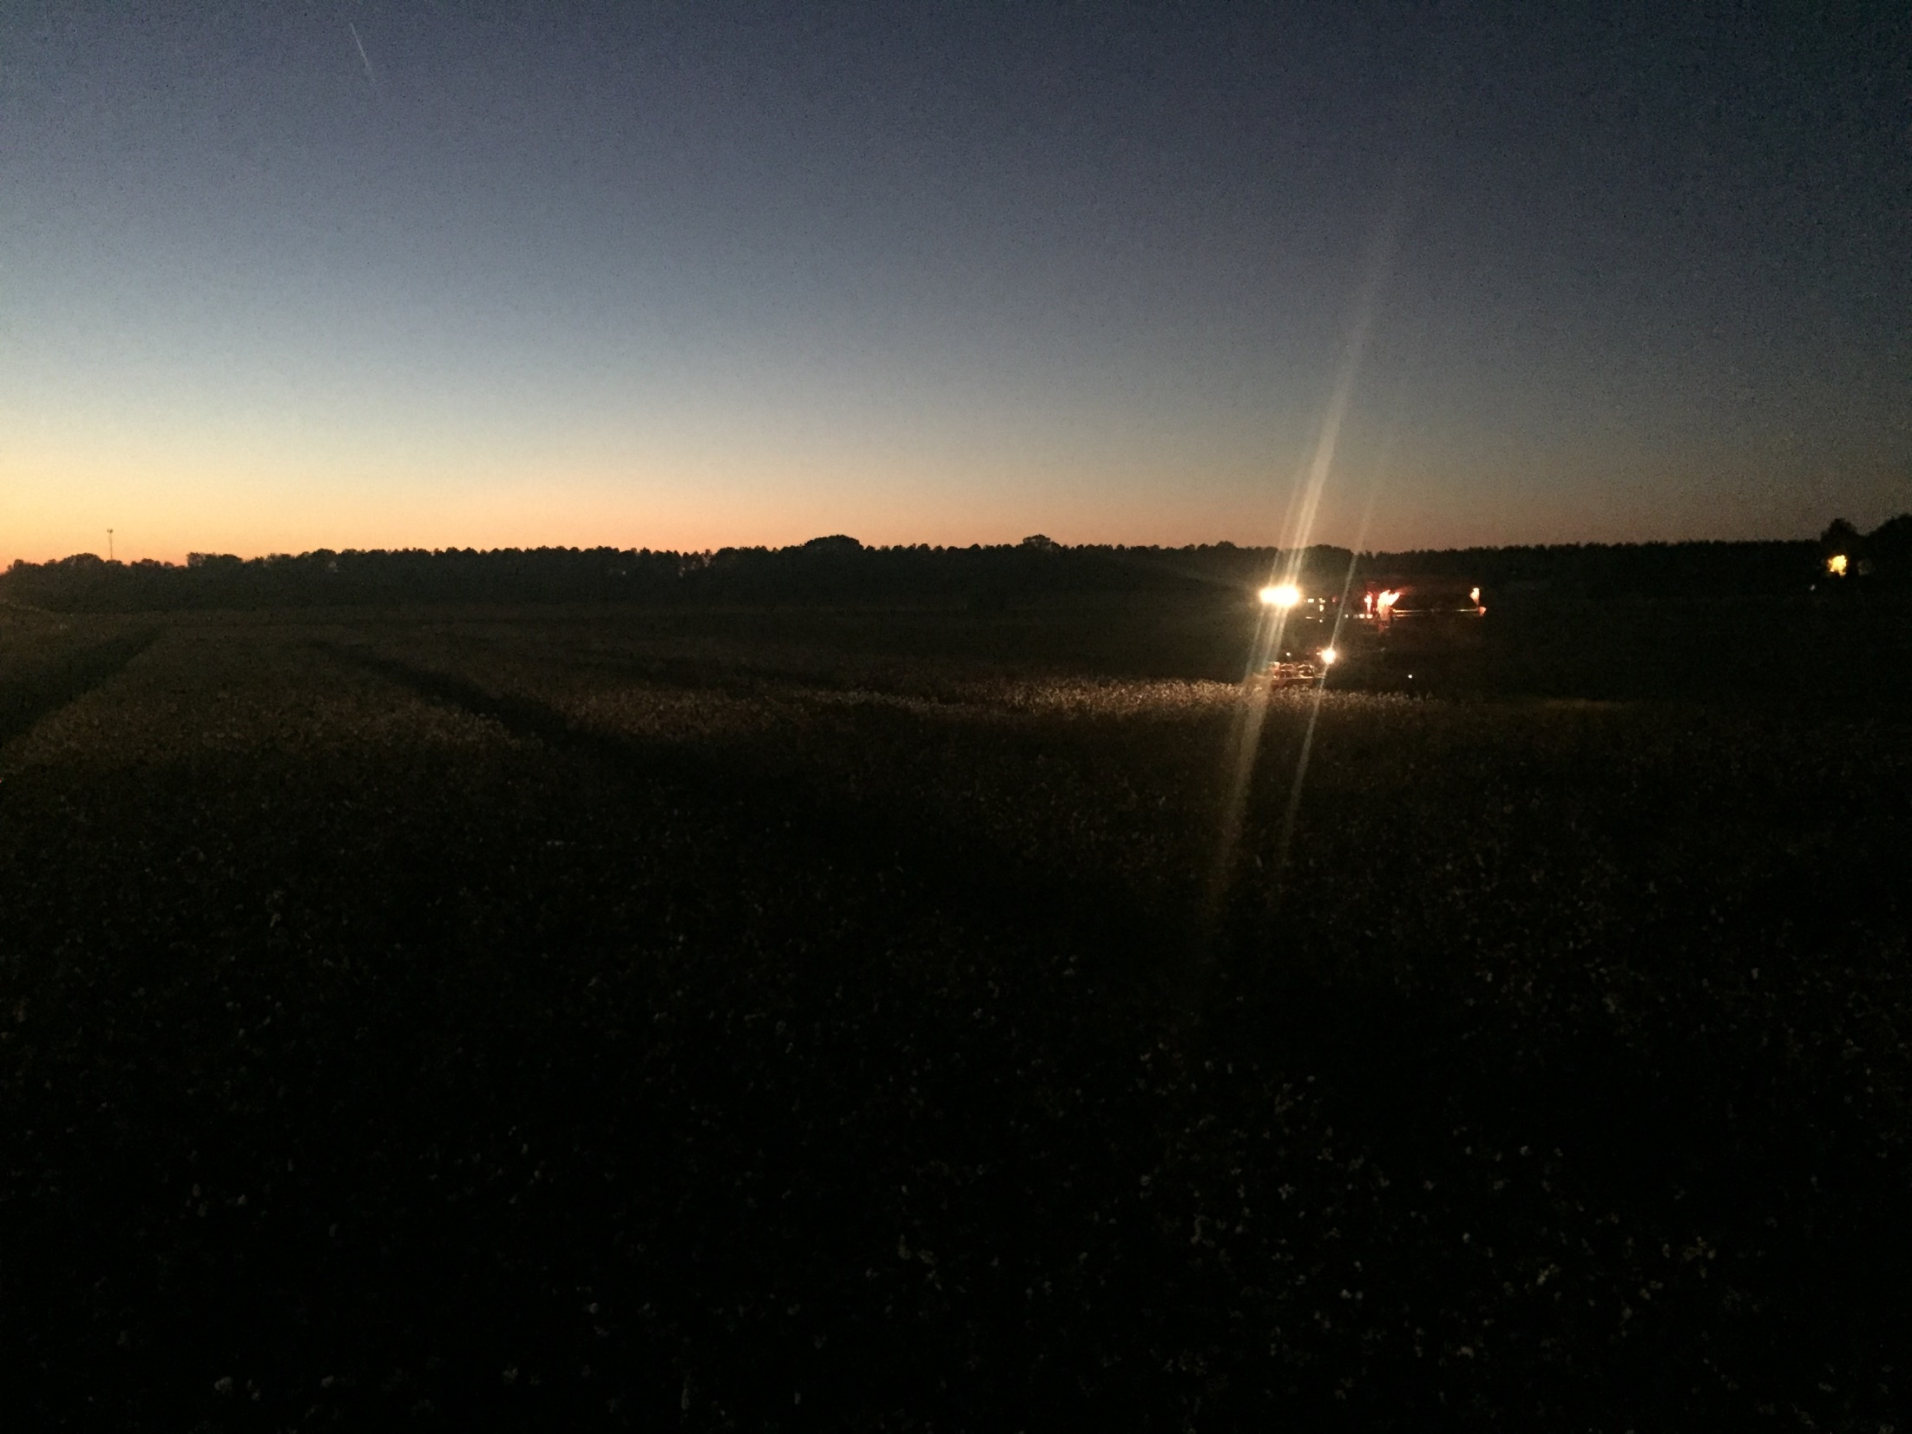
Tyson B. Raper, PhD
Assistant Professor, Cotton and Small Grains
University of Tennessee- Dept. of Plant Sciences
West Tennessee Research and Education Center
605 Airways Blvd. Jackson, TN 38301
@TysonRaper
traper@utk.edu
news.utcrops.com

