Slide 1
Cotton Blue Disease Caused by Cotton leafroll dwarf like virus Identification, Symptomology, and Occurrence in Alabama
Kathy Lawrence¹ and Judith K Brown²
¹Auburn University, Auburn, AL
²University of Arizona, Tucson, AZ

Slide 2
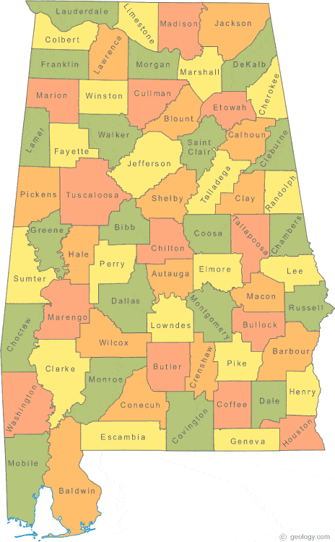
Cotton symptoms reported by Drew Schrimsher AGRI AFC
August 29, 2017
Deformation of younger leaves
Notes:
Hello, I am Kathy Lawrence Plant Pathologist in the Dept of ENT & Plant Path at Auburn University. In this web cast we will cover the initial observations andspread of this new virus through it’s identification with Dr. Judy Brown at the University of Arizona.
Drew Shrimsher, alumni of my program and currently the Agronomist with AGRI AFC called me August 29, 2017 and said we have a problem something new is going on in the cotton in the southern regions of our state.
Symptoms consisted of foliar distortion, leaf curling or rolling.
Initial thoughts were herbicide but with further investigation that did not seem possible. There were an estimated 50,000 acres affected.
Please note the disease appeared in the field at the end of the growing season in 2017 after full bloom. Thus plants were probably infected later in development

Slide 3
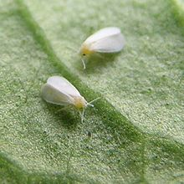
Barbour County, AL
August 31, 2017
First samples collected. Leaves and white flies tested.
Whitefly identification: Bemisia tabaci B type
Notes:
White files were abundant in 2017. As we walked through the fields, white flies would swarm. Symptoms were on the young tissues consisted of foliar distortion, leaf curling or rolling, and notice the leaf veins were a yellowish discoloration. There were no cotton bolls on the symptomatic portion of the plant.

Slide 4
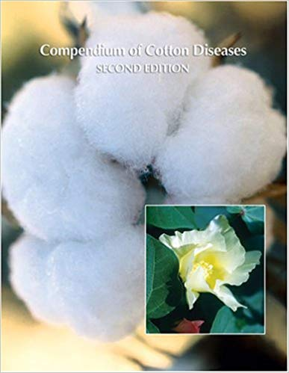
Cotton Compendium - Viruses of Cotton
Disease | Vector | Geographical Distribution
Cotton leaf crumple | Bemisia tabaci | USA - southwest
Cotton blue disease | Aphis gossypii | Africa & S America
Cotton leaf curl | B. tabaci | Africa, Pakistan, India
African cotton mosaic | B. tabaci | Africa
Cotton anthocyanosis | A. gossypii | Brazil & S America

Slide 5
Known Cotton Viruses
Alabama cotton symptoms
White fly severe infestation
Arizona cotton leaf crumple (CLCV)
White fly transmitted virus
Notes:
Cotton leaf crumple (CLCV) is a geminivirus transmitted by whiteflies
Known to occur in the southwest cotton region
Mr. John Murphy our virologist suggested contacting Dr. Judy Brown because gemini viruses occur in the southwest and she is the expert on those.

Slide 6
Cotton virus symptoms
August 29, 2017
September 25, 2017
Notes:
Please note the symptom severity as it advance over the one month time frame.
In August - symptoms consisted of foliar distortion, leaf curling or rolling.
By September symptoms advanced to include distorted juvenile leaves with severe foliar distortion, stunting of the internodes, vein reddening, a dark bluish coloration of some leaves and leaf lesions?
We collected samples, this time placing them in liquid nitrogen and shipped them to Judy Brown.

Slide 7
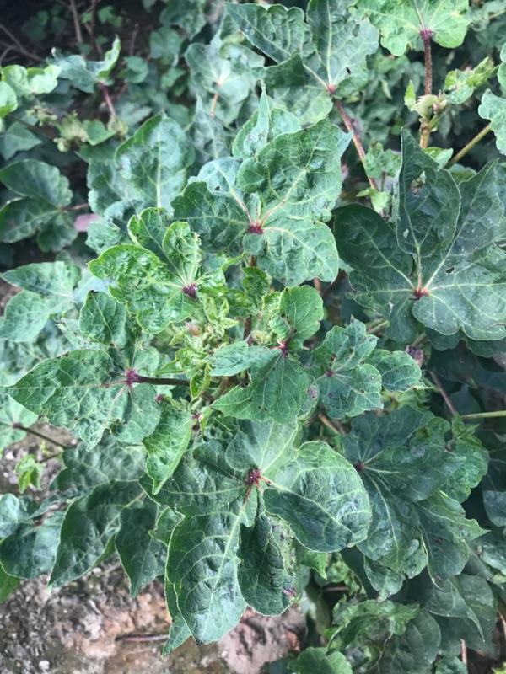
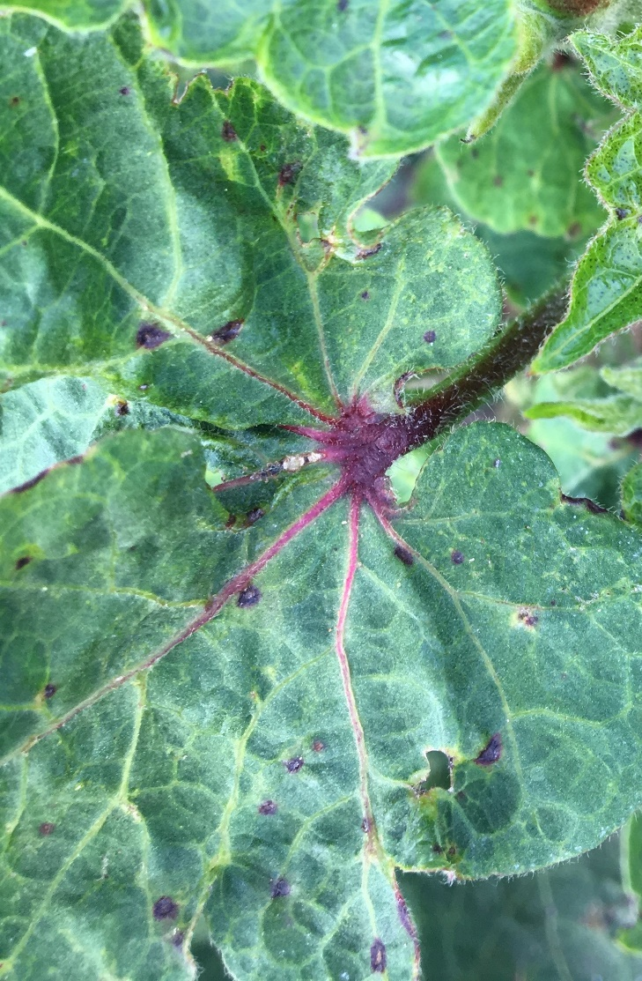
Cotton virus symptoms
Notes:
Symptoms can be seen on the entire plant on the left
The apical leaves are in the center
And a close up of the interveinal areas on the right with the red spreading down the veins and then turning yellow.
We waited for Dr. Brown to id the Plant virus: No begomovirus detected - PCR, cloning and DNA sequencing for begomovirus/universal primers and cotton leaf crumple virus-specific primers. Amplicons to be identified for closet match using BLASTn search of GenBank database.
Whitefly identification: Bemisia tabaci B type mtCOI primers (Frohlich et al., 1999); Brown lab mtCOI reference database search/comparative DNA sequence analysis

Slide 8
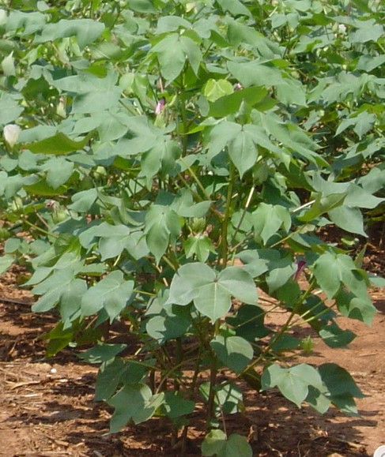
Cotton virus symptoms vs healthy plant
Notes:
A further look at symptoms we see the symptomatic plant on the left compared to a healthy cotton plant on the right.

Slide 9
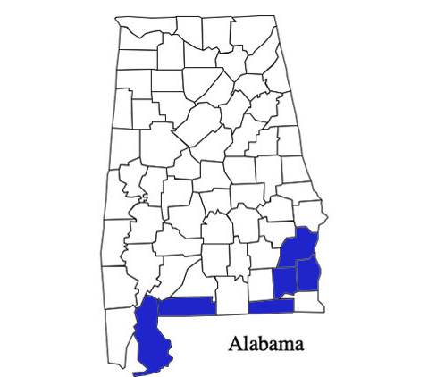
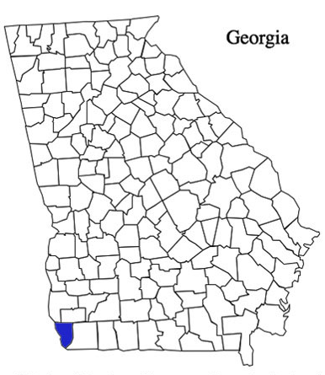
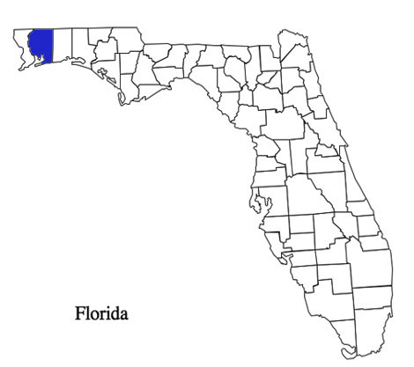
2017 locations of the virus symptoms on cotton
Notes:
At the end of 2017 we had shipped Dr. Brown samples 3 separate times before the cotton was harvested.
At this time we knew it ws not
Cotton leaf crumple (CLCV) is a geminivirus transmitted by whiteflies
Dr. Brown had new ideas of how to identify this virus.

Slide 10
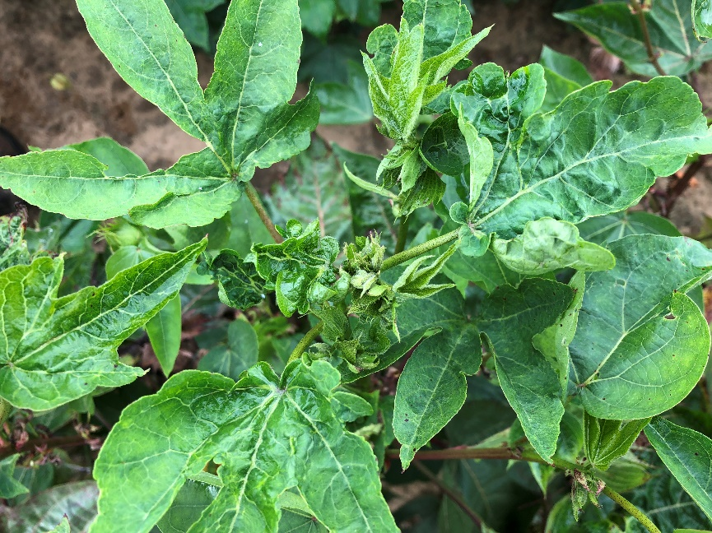
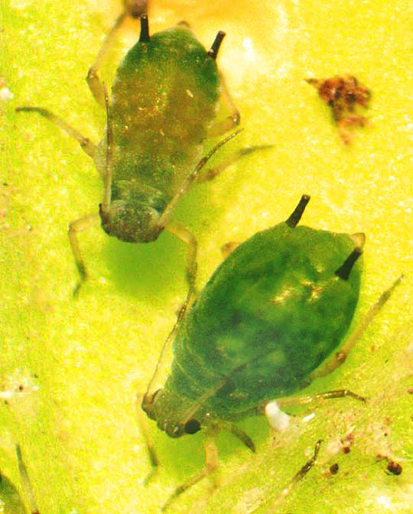
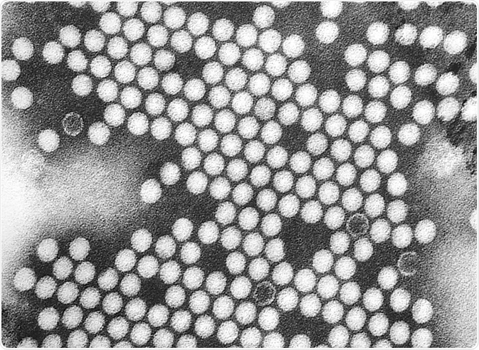
Cotton Blue Disease
Cotton leafroll dwarf like virus (CLRDV)
CLRDV belongs to the genus, Polerovirus (family, Luteoviridae)
Aphid-transmitted
Positive-sense single stranded RNA viruses
Genome size of ~5.8 kb
Individual virus particles – spherical
APHIS was notified
Notes:
March 16, 2018
Dr. Judy Brown of Arizona called
Identified Cotton Leafroll Dwarf Virus (CLRDV) commonly known as cotton blue disease.
Aphid transmitted and has not previously occurred in the US.
It is known to occur in areas of Africa and Brazil. In Brazil they reported the virus is phloem limited, persistent and circulative in the aphid.
Dr. Brown’s lab identified the virus by illumine sequencing and are now working backward with primers for this specific virus to confirm their findings.
Dr. Brown contacting the Dept. of Agriculture APHIS to report the new disease.
Bob Nichols Cotton Inc & Don Parker Cotton Foundation

Slide 11
Cotton Blue Disease in Brazil
Management recommendations in the field in Brazil:
Weed control - eliminate reservoir hosts
Elimination of cotton regrowth or volunteer cotton plants from the previous season
Cultivar selection - no resistant cultivars available for the Atypical CLRDV
Chemical control of aphids - 5-10% of cotton plants with aphids
Additional applications of insecticides to keep low population levels of aphids. Satisfactory control but problems with insecticides efficacy!!
Notes:
(genetic breeding programs have been facing a hard time separating the pathogens that cause viruses or keeping infested aphids populations, in order to breed for resistance).

Slide 12
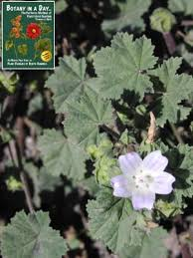
April 2018 Weed host collection
Malvaceae plant family
244 genera
4225 species
Barbour, Russell, and Henry Co.
Dandelion, Prickly side, Red Clover with aphids
Maypop, Mares tail, Iron weed ,Wild gourd, Evening primrose, Curley doc and Verbena, Mint, Smartweed, Evening primrose, Blackberry, Golden Rod, Crimson clover, Sweet gum tree
Notes:
These are the weeds we found in the fields were the virus symptoms were present in 2018.
We sent the weed samples to Dr. Brown who was not able to find the virus.
This does not mean these are not host and does not eliminate them as hosts. Timing and virus concentration (titer) affects our ability to detect the virus.

Slide 13
June 7, 2018
Aphid outbreak began in June this year.
We collected these samples in Barbour County
Placed leaves immediately in liquid N
Shipped to Judy Brown for PCR
No virus found

Slide 14
June 25, 2018
Aphids were severe by late June.
We collected these samples in Barbour County
No virus found

Slide 15
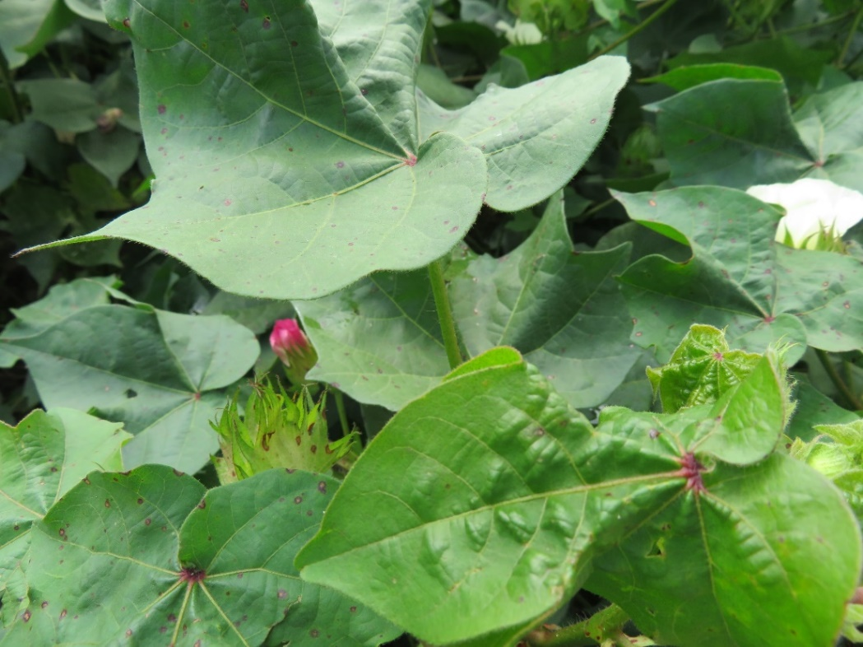
Aug. 16, 2018

Slide 16
Elmore Co. symptoms August 24,2018
Notes:
Symptoms observed in Pima cotton PHY 800 and PHY 72
Samples sent to Judy Brown AZ and Kassie Conner in AL
Both positive for CLRDV
APHIS was notified

Slide 17
First report of Cotton leafroll dwarf virus associated with cotton blue disease symptoms in Alabama
Sofia Avelar, Drew W Schrimsher, Kathy S Lawrence, and Judith K Brown
^{1, 4} School of Plant Sciences, University of Arizona, AZ , ²AGRI AFC, ³ Department of Entomology and Plant Pathology, Auburn University AL, 36849
https://doi.org/10.1094/PDIS-09-18-1550-PDN

Slide 18
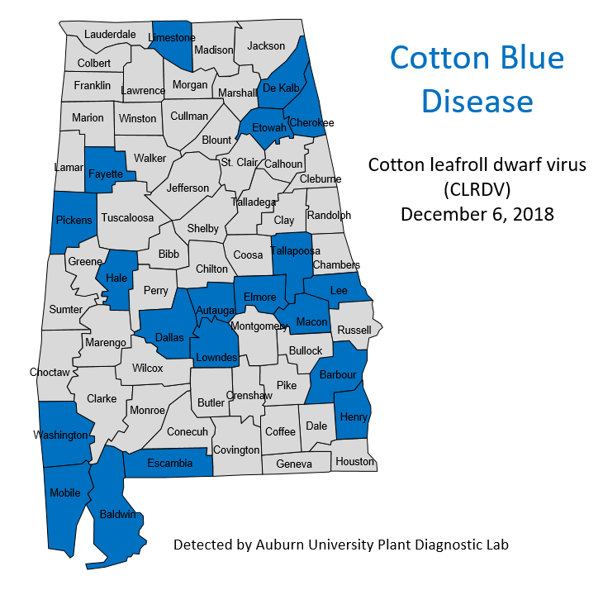
Map courtesy of Dr. Kassie Conner
Notes:
In September through November 2018 we (Researchers, AGRI AFC, Extension folks) collected symptomatic samples and send them in to both labs for id
Kassie Conner from AL put together this map to indicate the counties with positive PCR results for CLRDV on cotton for our samples.
Please note Limestone county

Slide 19
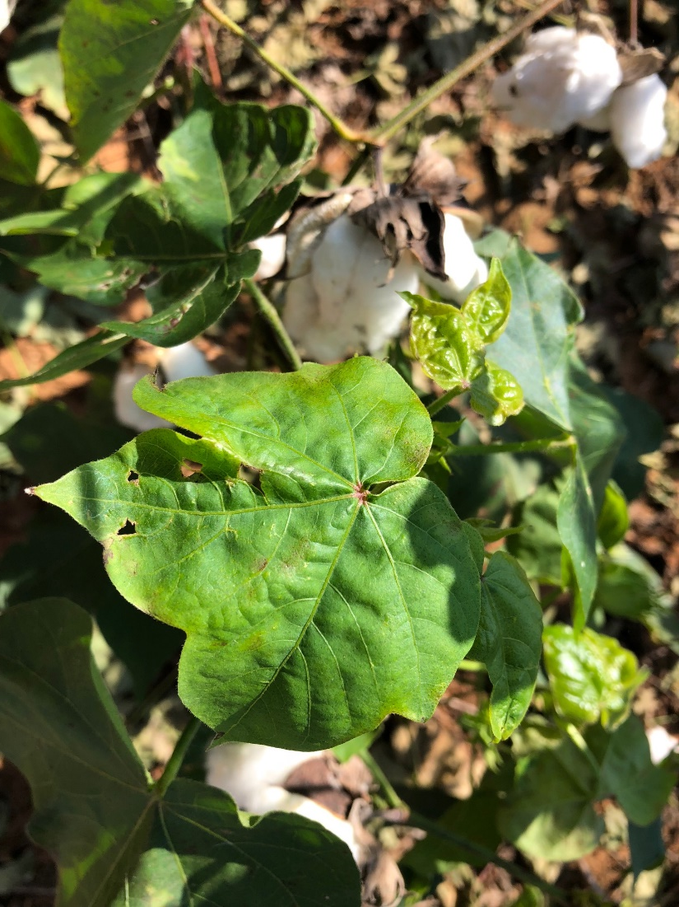
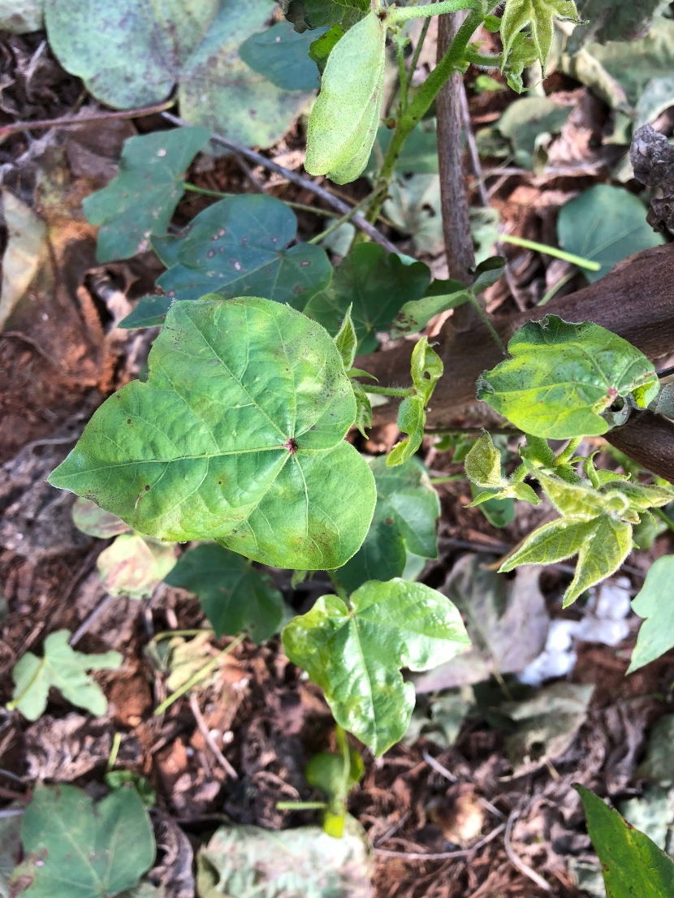
Limestone Co. Reniform field Oct. 5, 2018
Notes:
Cotton field had been defoliated and we observed foliar symptoms on the regrowth. Cotton leaves were tested positive for CLRDV.
Brazil management indicated termination of cotton stalks to eliminate the virus reservoir.

Slide 20
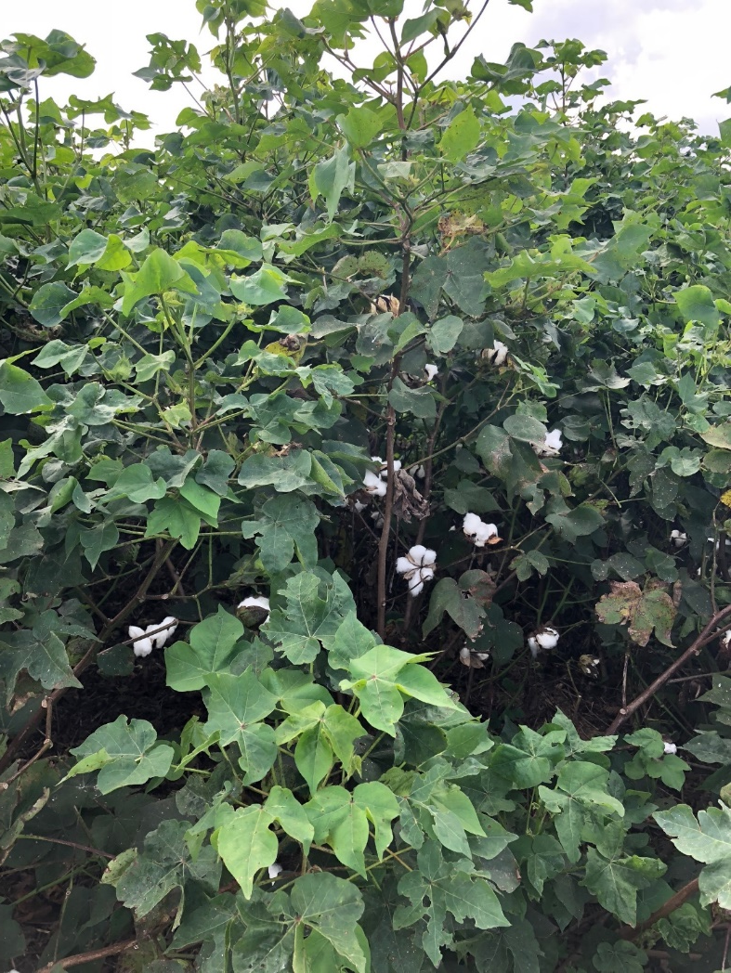
Baldwin Co. Cotton Root knot nematode variety trial
CLRDV incidence Oct. 2018
 | RK | No RK
CG 3885 B2XF | 100 | 100
CG 9608 B3XF | 100 | 100
DP 1747NR B2XF | 100 | 100
DP 1558NR B2RF | 100 | 100
DP 1646 B2XF | 100 | 100
DP1851 B3XF | 100 | 100
PHY 480 W3FE | 100 | 100
PHY 430 W3FE | 100 | 100
ST 6182 GLT | 100 | 100
ST 5818 CLT | 100 | 100
Notes:
Planted May 16, 2018 5 inches of rain over the next week
Replanted June 9, 2018
Samples nematode in July – no virus symptoms
Root knot nematode numbers were low with this second planting.
Total numbers of Rk eggs or Rk eggs per gram of root show identical results.
Velum total reduced Rk numbers in ST varieties.
Velum total did not further reduced RK numbers in the NR varieties in 2018

Slide 21
Baldwin Co. Cotton Root knot nematode variety trial, 2018
2219 lb/a & 2135 lb/a RK
Notes:
Average yield over all cultivars was 2177 lb/A acceptable
This area lost an additional 84 /lb/A with the additional stress of the root knot nematode.

Slide 22
2017 CLRDV symptoms
Severe
2018 CLRDV
Symptoms
severe
Notes:
Disease incidence ranged from 3-30% per field, resulting in ~560 kg/ha loss, and affecting 25% of the 50,585 ha cotton crop in Alabama, with a loss of ~50,000 bales valued at $19 million dollars.
In 2018 Disease incidence ranged from 3- 100% per field but only 1 % if the field were affected

Slide 23
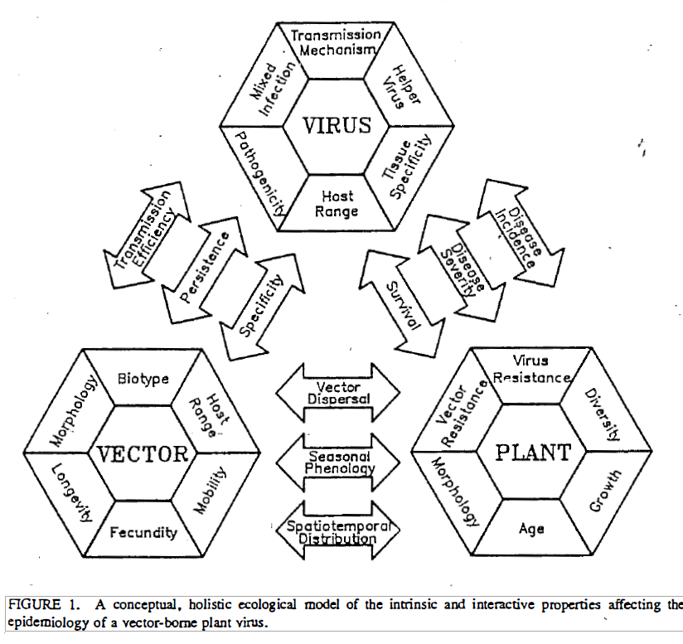
Cotton Blue Disease Atypical Cotton leafroll dwarf like virus (CLRDV)
Notes:
Aphid transmitted and has not previously occurred in the US.
In Brazil they reported the virus is phloem limited.
In the aphid it is persistent and circulative.
This disease triangle between the plant the aphid and the virus is complicated. So many factors affect this disease that the symptoms we see will be variable. We have much to learn

Slide 24
Cotton Blue Disease
Atypical Cotton leafroll dwarf like virus (CLRDV)
2019 - No change of cotton management is recommended at this time
Sporadic
Transmitted by flying vector
Crop age affect disease severity
Symptoms have begun in late August and intensify until harvest.

Slide 25
Contact Information
Kathy Lawrence, Ph.D.
Professor of Plant Pathology Department of Entomology & Plant Pathology 209 Life Science Building Auburn University Auburn, AL 36849
Office: 334-844-1956 Cell: 334-329-9277 Email: lawrekk@auburn.edu
Judith K. Brown, Ph.D.
Professor School of Plant Sciences 1140 E. South Campus Dr. University of Arizona Tucson, AZ 85721
Office: 520-621-1402 Lab: 520-621-1230 Cell:520-490-2109 Email: jbrown@ag.arizona.edu

