Slide 1
Implementing No-till and Cover Crops in Texas Cotton Systems
Paul DeLaune
Texas A&M AgriLife Research-Vernon
pbdelaune@ag.tamu.edu

Slide 2
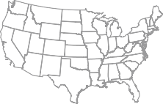
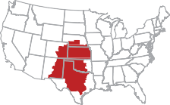

Conservation Agriculture
USDA-ERS (Claassen et al., 2018; Economic Information Bulletin #197, Sept. 2018)
Conservation tillage practices include no-till, strip-till, and mulch tillage
Conservation tillage was used on roughly:
  70% of soybean
  65% of corn
  67% of wheat
  40% of cotton
Conservation Tillage in Cotton by Region
†
≈68%
≈27%
Less than 3% of continuous tilled cotton acres adopt conservation crop rotation
† Figures adapted from Claassen et al., 2018; USDA-ERS Bulletin No. 197

Slide 3
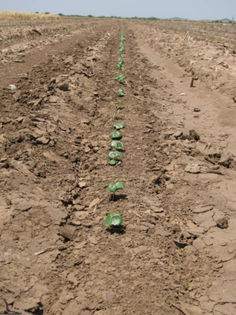
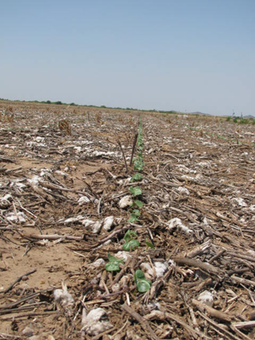
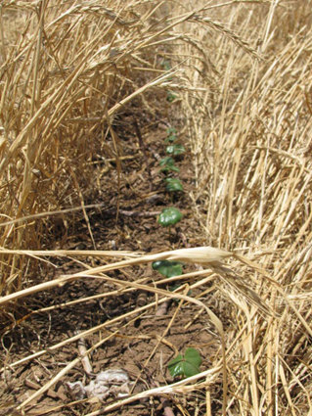
Residue Management
Cotton is a low residue crop
Continuous cotton systems…is no-till “enough”
Can cover crops add beneficial residue?
Conventional Till
No-Till
No-Till with Cover Crop

Slide 4
No-Till & Cover Crops in Cotton
No-till acreage has increased in cotton.
Strip-till vs. No-till
Cover crops - what is your goal? (residue, weed control, erosion control, nutrient cycling?)
When & how to plant/terminate cover crops?
  Late summer/early fall using modified drill or broadcasting; drilling after harvest
  Termination timing/method

Slide 5

Cover Crop Management in Our Research
Not trying to produce an award winning ‘crop’.
Do not seed at “full” seeding rates (not trying to match what we see in a farm magazine).
Do not fertilize cover crops.
Typically do not irrigate cover crops.
Apply in-season herbicides to cover crops as needed and feasible. Mix vs. single species cover crop.
Hope to keep management as low as possible.

Slide 6
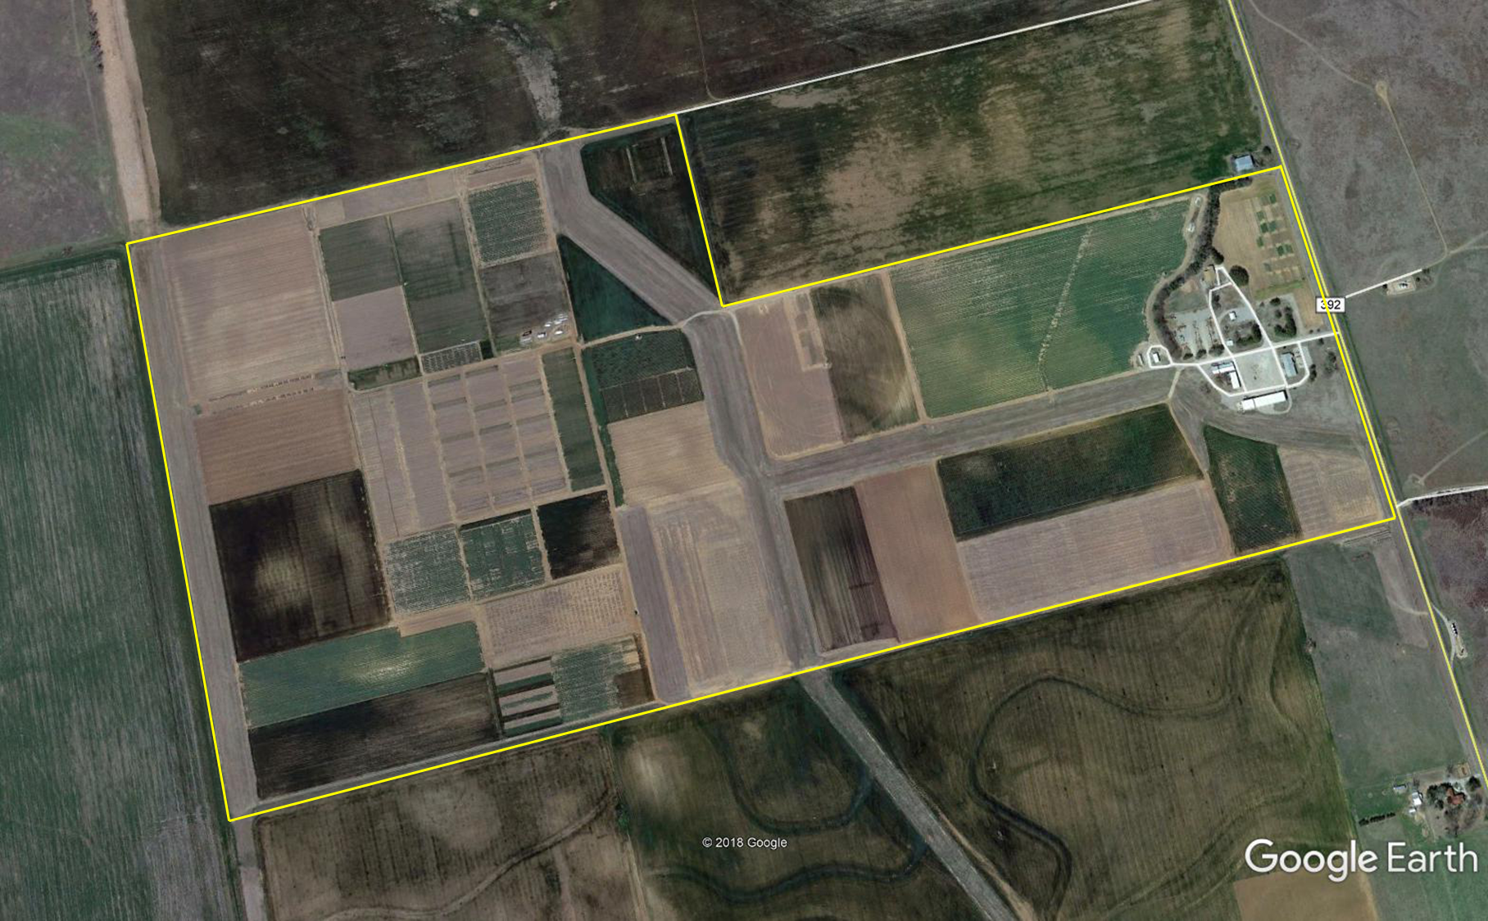
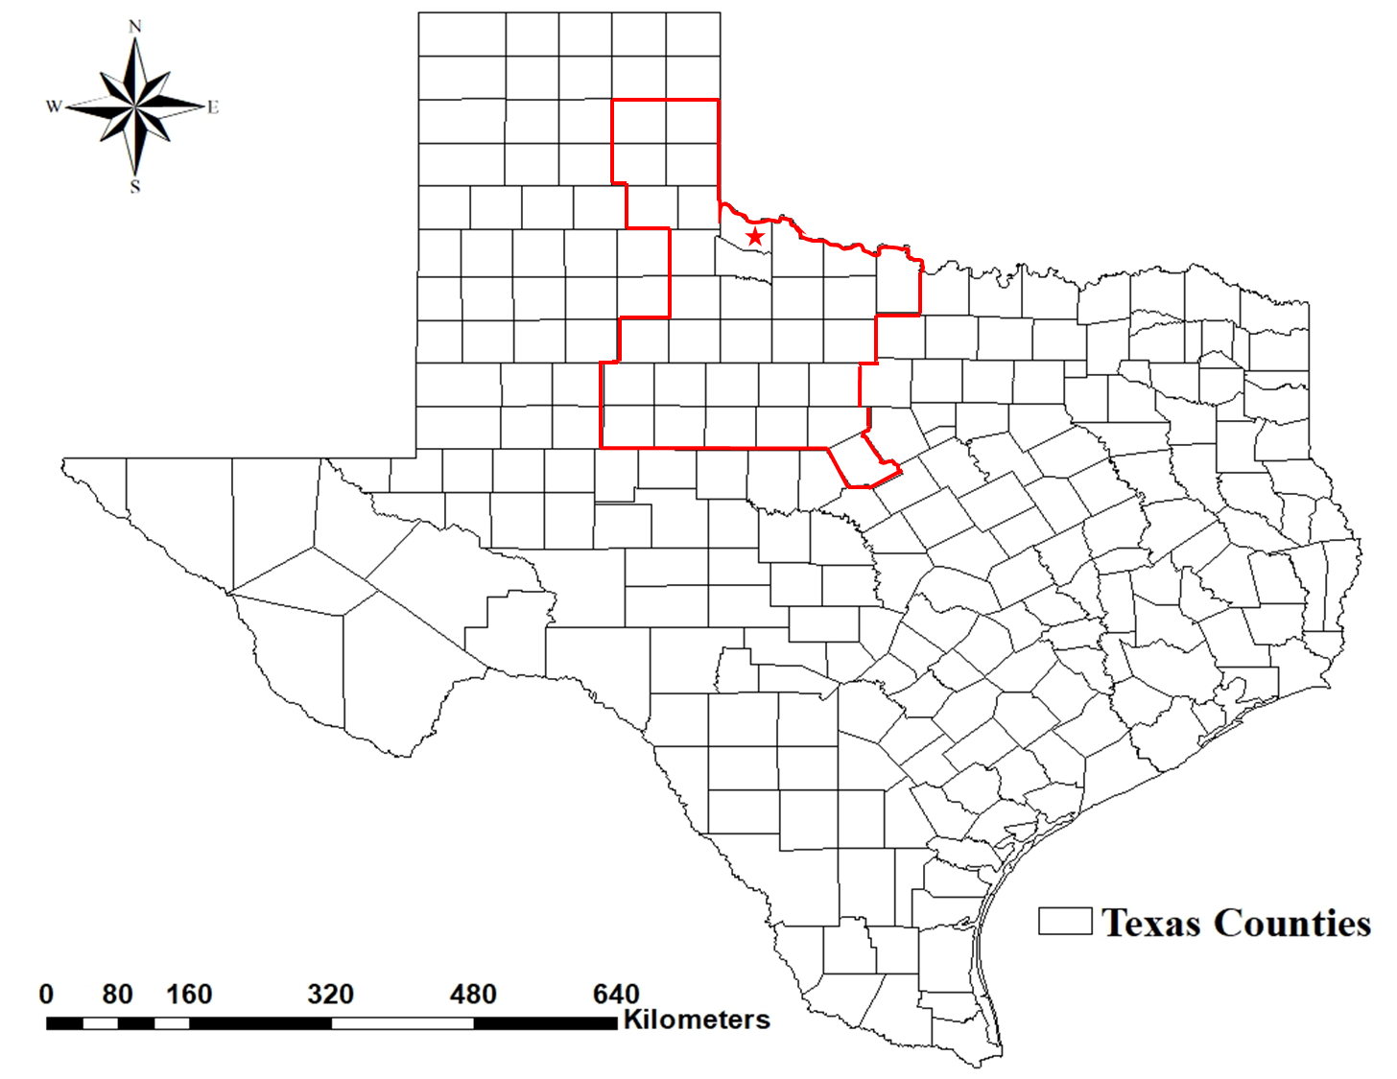
Chillicothe Research Station
Clay Loam/Sandy Loam Soils
Research trials from 1-12 yrs
Subsurface Drip Irrigation
  Crop rotation, cover crops
Pivot Irrigation
  Cover crops
Dryland
  Crop rotation, cover crops

Slide 7
White et al. 2019 Beltwide Cotton – No difference in cover crop biomass between 30 and 60 lb/ac for wheat and rye in Lubbock, TX.

Slide 8
Canopy
*No cover crop control = 0%

Slide 9
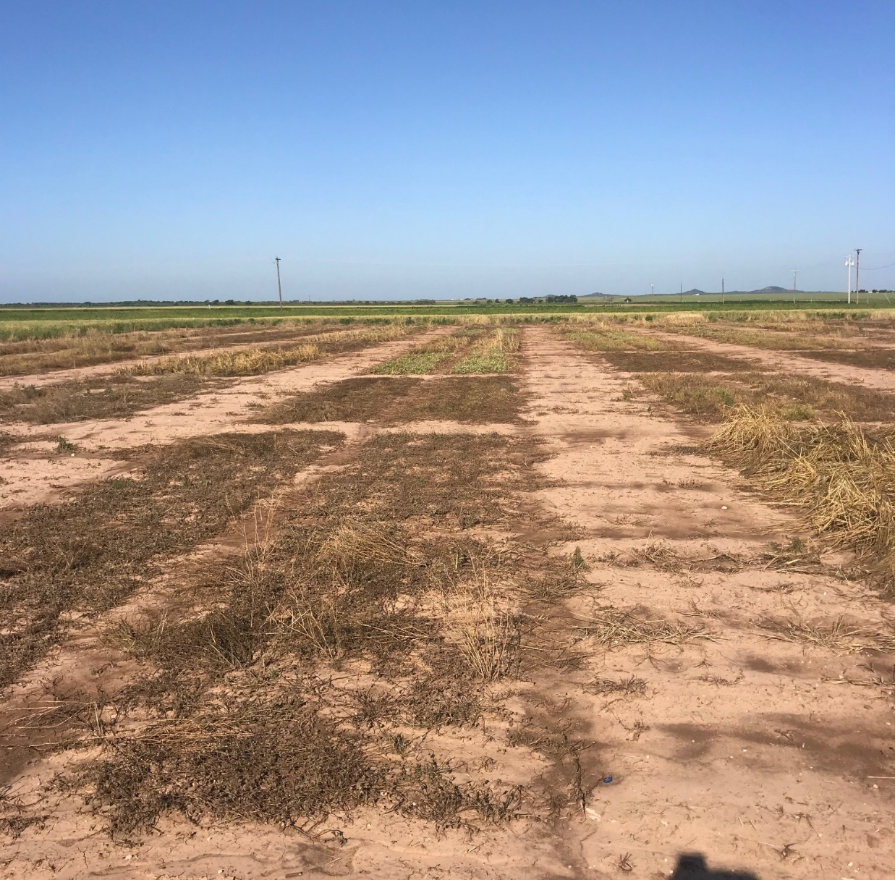
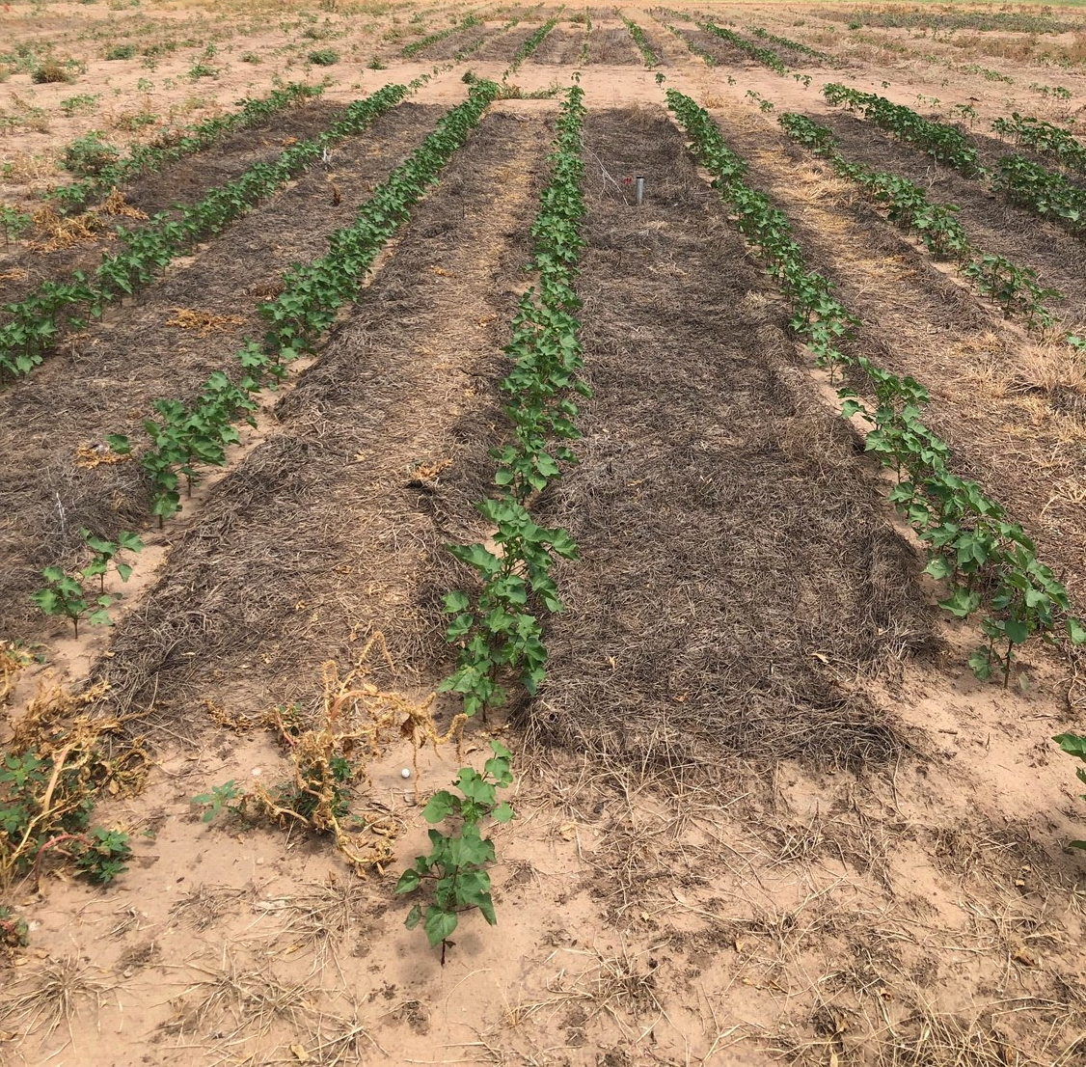
May 15, 2019

Slide 10
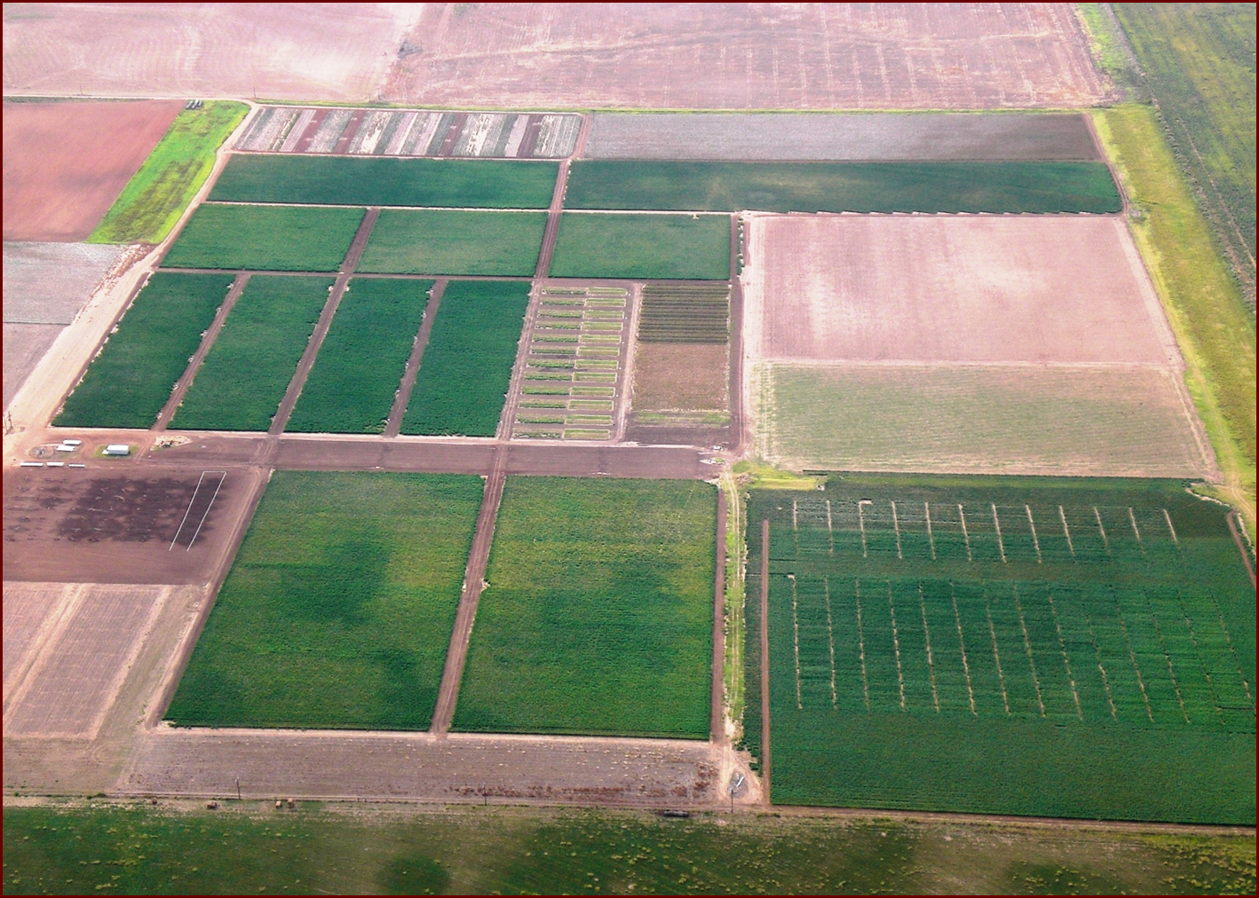
Subsurface Drip Irrigation
Clay Loam Soil

Slide 11
3-yr Average 2008-2010
ET Replacement (%)

Slide 12
Net Return 2008-2010

Slide 13
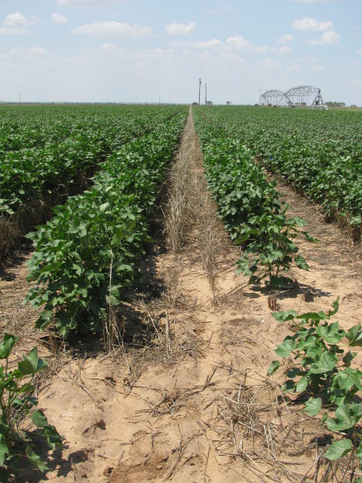
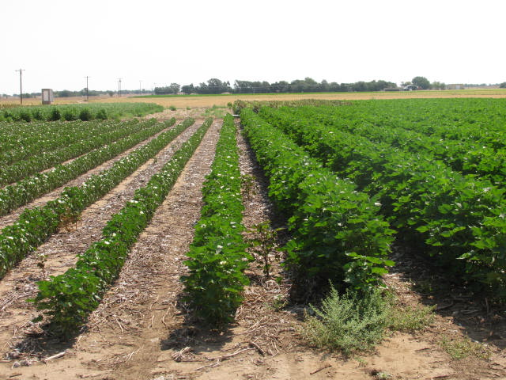

Slide 14
Crop Rotation

Slide 15
Soil Health Assessment – Haney Test
Water Extractable Organic C (mg/kg)

Slide 16
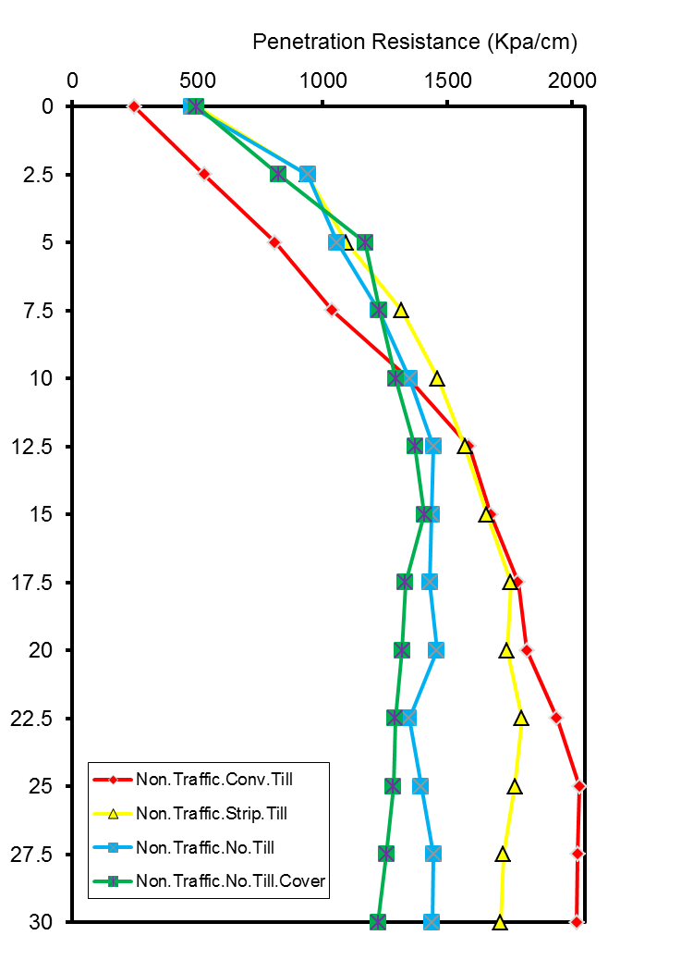
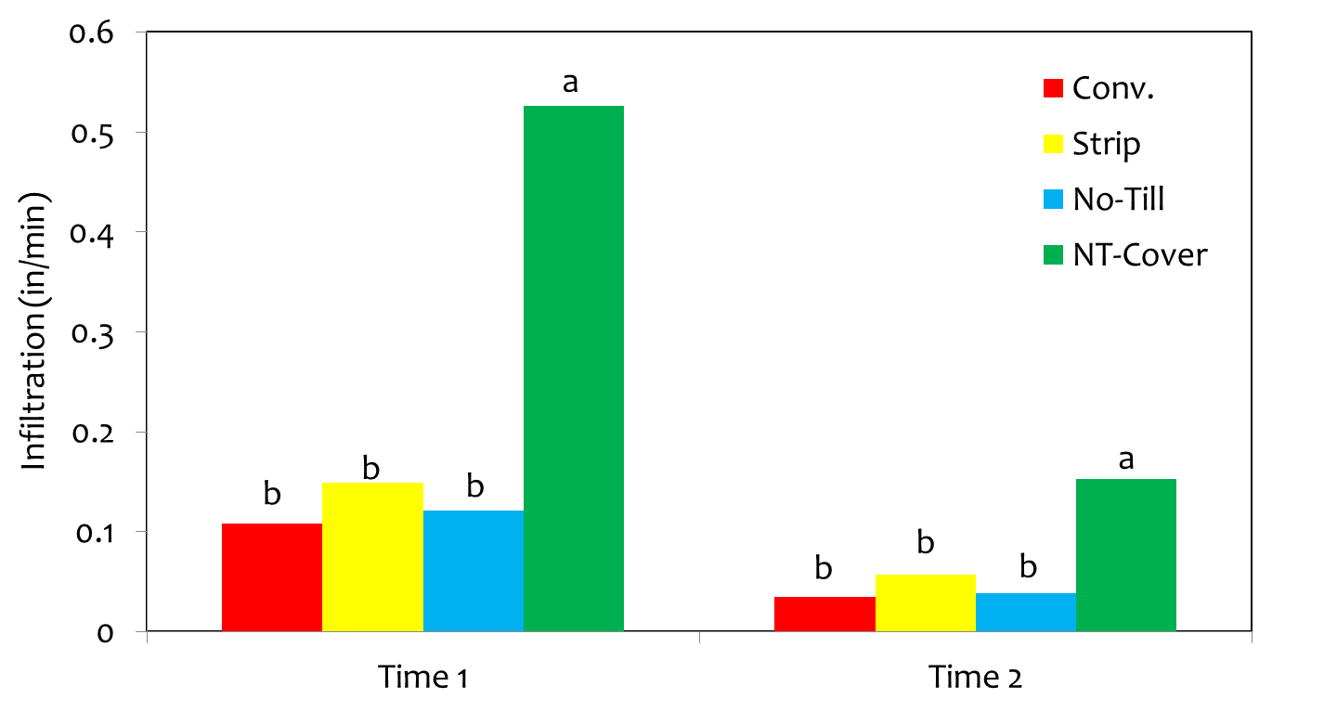
Physical Properties
Depth (cm)

Slide 17
Stored Soil Moisture – 2 ft
Low/Med Irrigation Initiated
Stored Soil Moisture (mm)
High Irrigation Initiated

Slide 18
Yield 2013-2018
Lint Yield (lb/ac)

Slide 19
IWUE 2013-2018
Lint Yield (kg/mm)

Slide 20
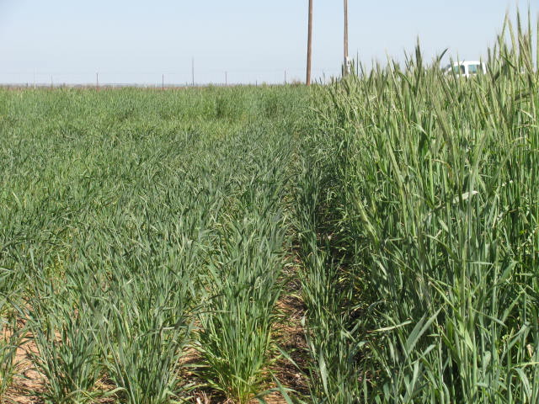
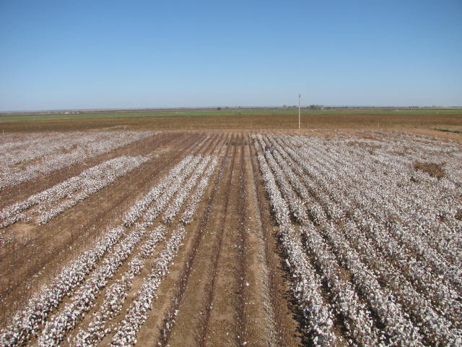
Pivot Irrigated Cotton
  Cover Crops - Wheat & Mix (30 lb/ac)
  LESA Pivot Irrigation, irrigated at
≈85% Crop ET Replacement
Cover Crop Species | 2012 | 2013 | 2014 | 2015 | 2016
Rye | 10 | 5 | 5 | 6 | 12
Wheat | 10 | 9.5 | 9 | 9 | 9
Austrian winter pea | 10 | 8 | 8 | 12 | 6
Hairy vetch | 5 | 4 | 4 | 3 | 3
Crimson clover | 3 | 2.5 | 2.5 | - | -
Turnip | 2 | 0.5 | 0.5 | - | -
Radish | - | 0.5 | 1 | - | -
Total | 40 | 30 | 30 | 30 | 30

Slide 21
Lint Yield – 2013-2018
Lint Yield (lb/ac)

Slide 22
Pivot: 2013-2018

Slide 23
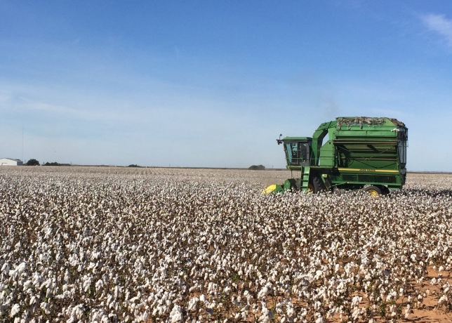
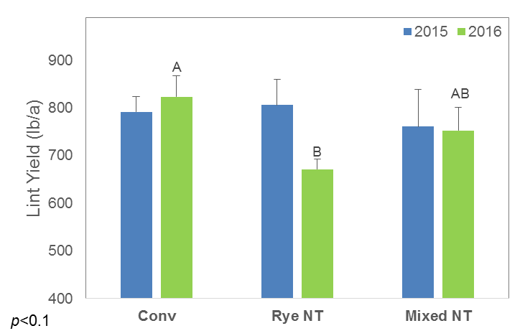
Lint Yield
(DP 1321 B2RF)
Katie Lewis, Lubbock; Agron. J. 110:1616-1623
Notes:
There has not been a consistent yield benefit.
Wind protection

Slide 24
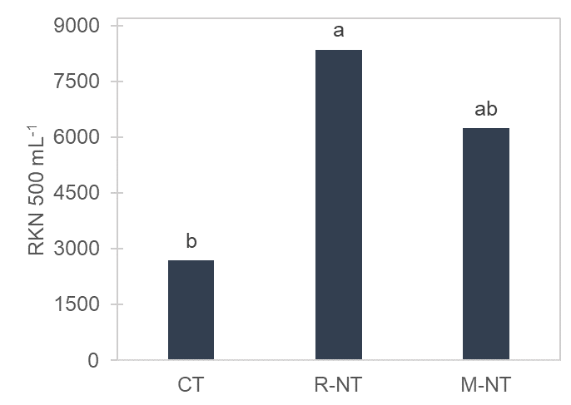

Possible Reasons for Reduced Yield
Root-knot nematode
Samples collected October 2018 by Dr. Terry Wheeler

Slide 25
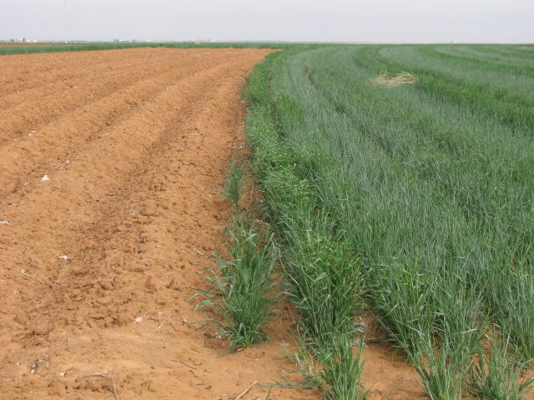
Lamesa

Slide 26
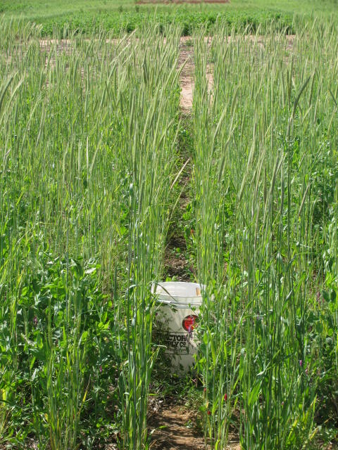
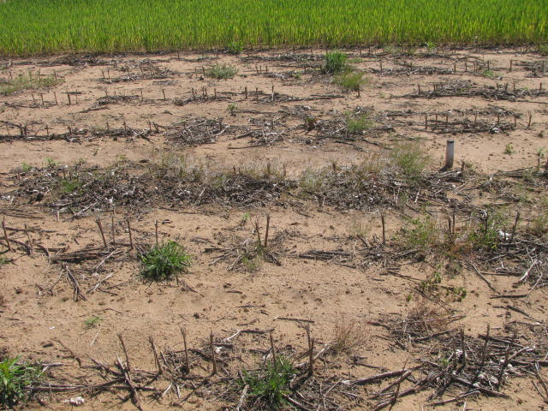
Dryland Cotton
No-Till without a cover
Conventional Till without a cover (bedded)
No-till with cover (2011*)
  *Austrian winter field pea (35 lb/ac)
  *Crimson clover (15)
  *Hairy Vetch (20)
  *Wheat (30)
  Mix (30)
Chemically terminate in April
No Fertilizer

Slide 27
Stored Soil Water in Top 2 ft
Stored Soil Moisture (mm)

Slide 28
Stored Soil Water in Top 2 ft
*
*
*
*
*
*
*

Slide 29
Infiltration

Slide 30
Lint Yield (2013-2016)
Lint Yield (lb/ac)

Slide 31
Net Return (2013-2016)
Cover Seed Costs ($22.65) ($26.35) ($8.10) ($19.95) ($32.85)

Slide 32
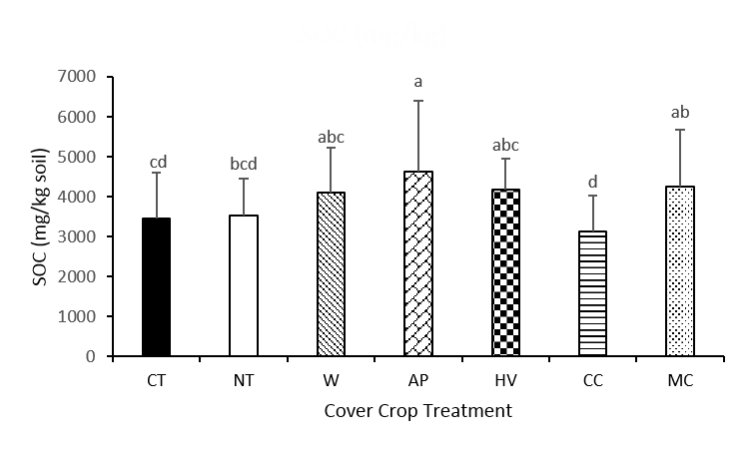
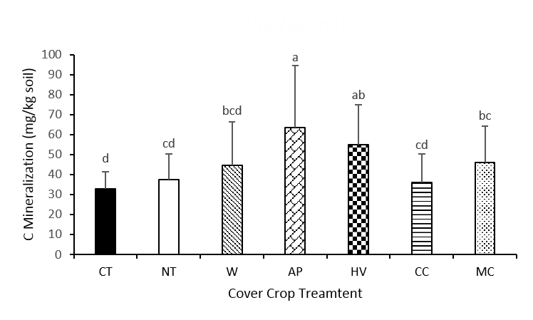
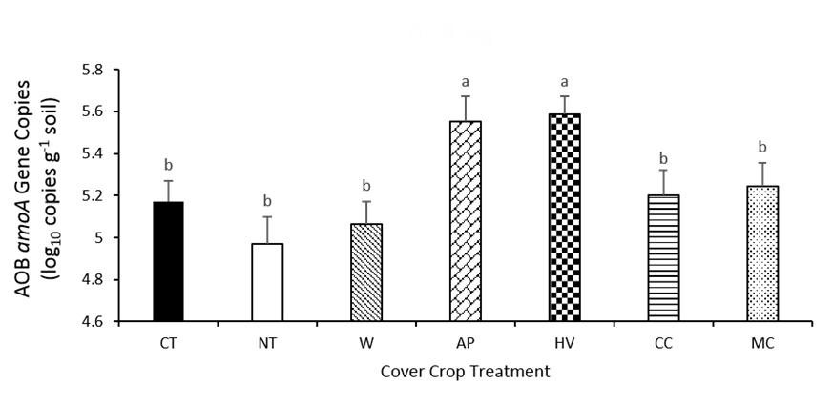
Soil Health

Slide 33
Soil Nitrate
*0-4 inches

Slide 34
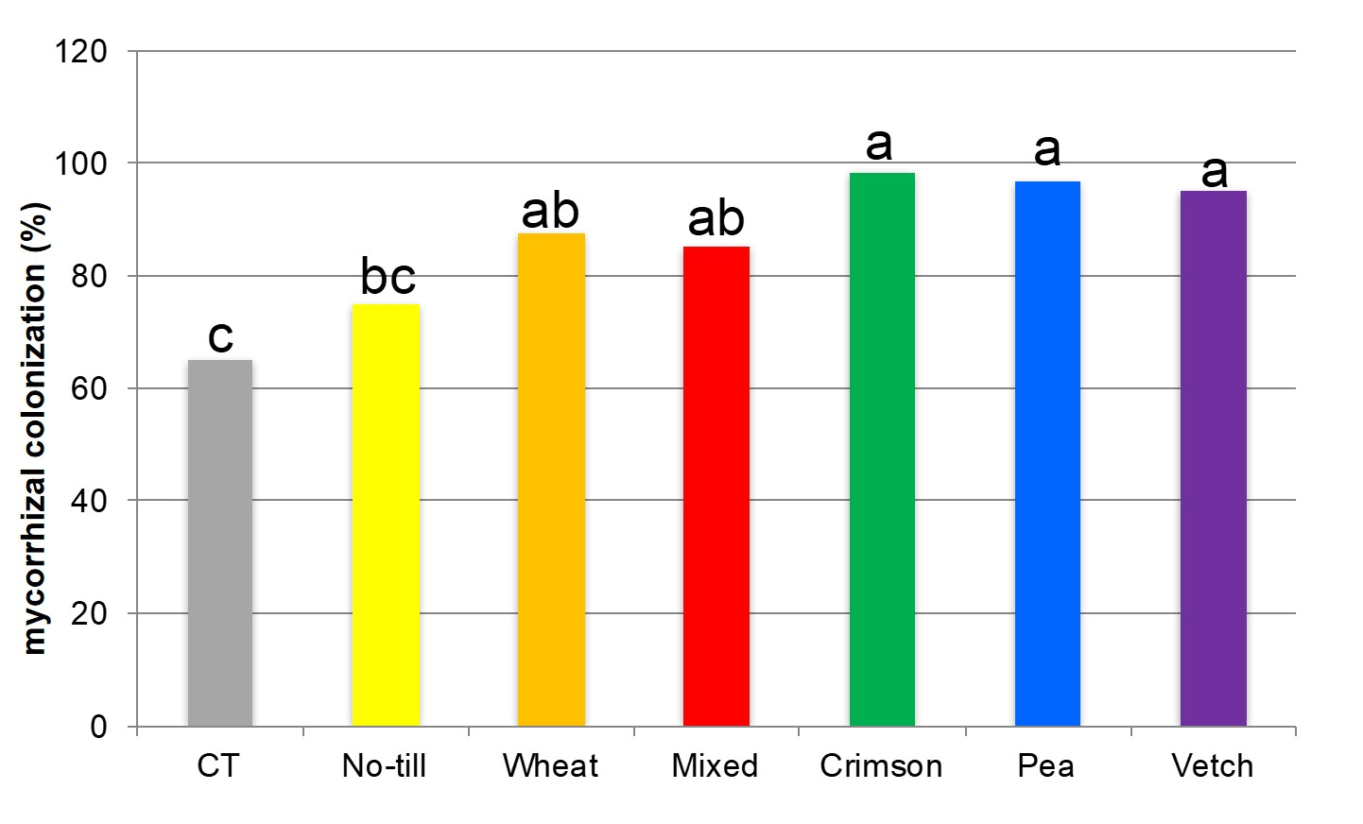

Slide 35
Conclusions
Over the long-term, no-till systems have resulted in improved yields.
Cover crops and crop rotation can be an important management tool in cotton systems.
Stored soil moisture can be significantly lower due to cover crops by the time of termination. However, stored soil moisture is restored by cash crop planting IF adequate rainfall is received.
Manage for your system and goals! Cover crops must be managed for respective systems.

Slide 36
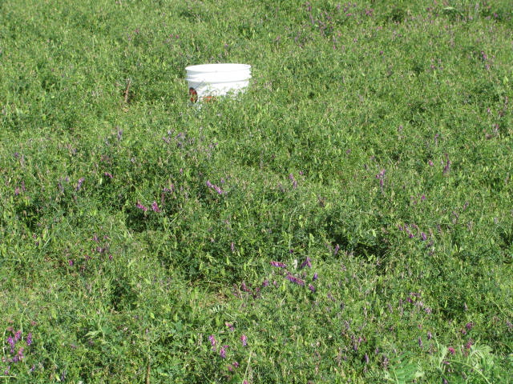
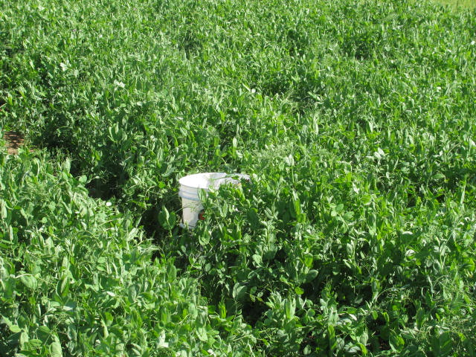
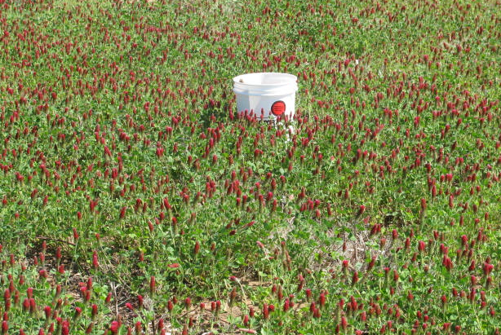
Questions?
Paul DeLaune
pbdelaune@ag.tamu.edu

