Slide 1
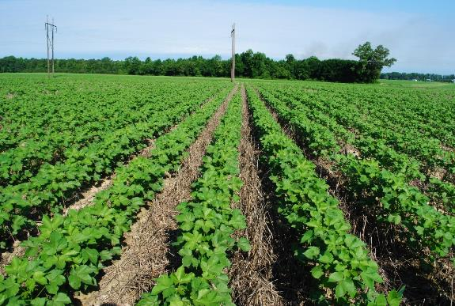

Healthy Soils for Sustainable Cotton
A Project of the Soil Health Institute in partnership with Wrangler Jeans and The Walmart Foundation
David Lamm,
Project Manager
Notes:
As you all know- Soil Health is a term that is showing up in articles presentations, advertisement and journals. To ensure all producers, partners, and the general public understand and support what NRCS and our partners will accomplish through our focus on “Soil Health,” each employee must ensure their understanding of the Guiding principless and how each principles builds on and complements the rest. When these principless are followed, we should monitor key Indicators to track our soil health regeneration. We then should be able to use them in all communications and planning.
We have a great responsibility to broaden and strengthen this foundational understanding through a consistent message and sound logic

Slide 2
Objectives
What is soil health
What is the Soil Health Institute
Cotton industry sustainability goals
Private sector views
What is a soil health management system
How does that link to sustainability
What the project is about

Slide 3
Soil Health Institute
Mission: Safeguard and enhance
the vitality and productivity of soil
through scientific research and advancement
Non-profit; Samuel Roberts Noble Foundation

Slide 4
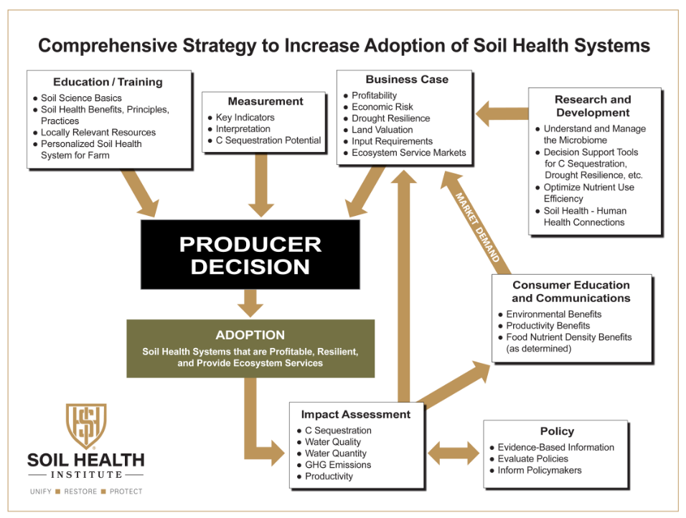

Slide 5
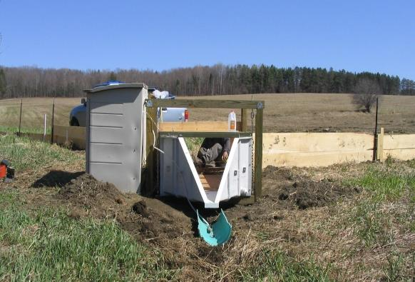
Soil Health Relationships with Water Quality in the Mississippi River Basin
Objective: Evaluate soil health - water quality relations
Stone Environmental, Inc.
Notes:
USDA & LGU that are measuring edge of field water quality. Doing soil health assessments, trying to link to water quality measurements. 10 sites

Slide 6
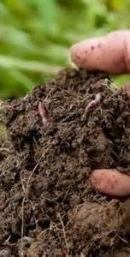
Assessing & Expanding Soil Health for Productivity, Economic, and Environmental Benefits
Collaborators: Soil Health Institute; Soil Health Partnership; The Nature Conservancy
SHI Objective: Develop soil health measurements that relate soil health to yield, economic, and environmental outcomes

Slide 7
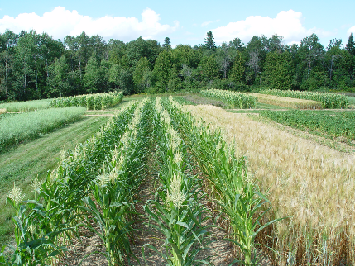
Evaluate soil health indicators on long-term agricultural research sites
Identified 31 SH indicators
3 Programs to evaluate
Blue Ribbon Panel identified methods for all 31
120 long term sites
Notes:
2000 samples being taken

Slide 8

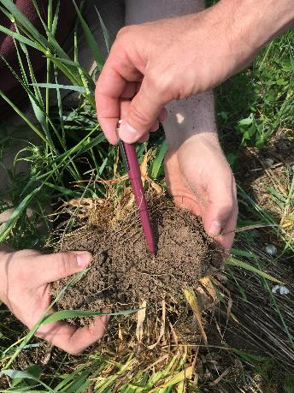
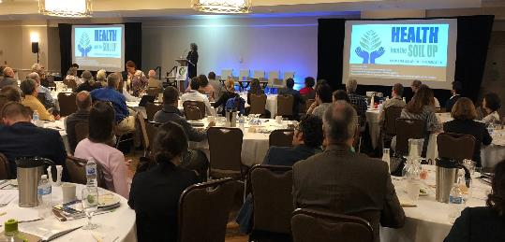
Soil Health and Human Health
Notes:
Comparing soil micro biology to human micro biology
Looking at nutrient density
Medical profession

Slide 9
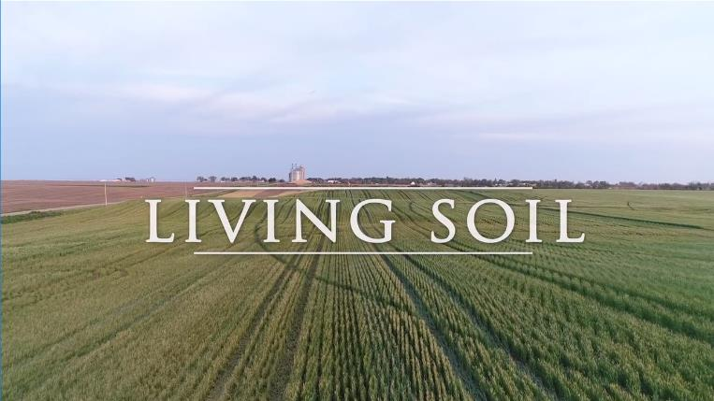
Soil Health Documentary “Living Soil”
https://vimeo.com/294093065/65b2bb191a

Slide 10
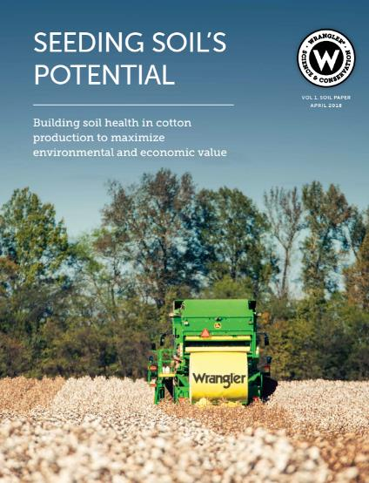
Wrangler
“ Wrangler believes that our supply chain does not begin with fabric or cotton. It begins with our soils and the land itself. Preserving and enhancing the health of our soil is critical and necessary to the preservation of America’s denim heritage and future generation of people who work the land.”
Roian Atwood,
Director of Sustainability at Wrangler

Slide 11
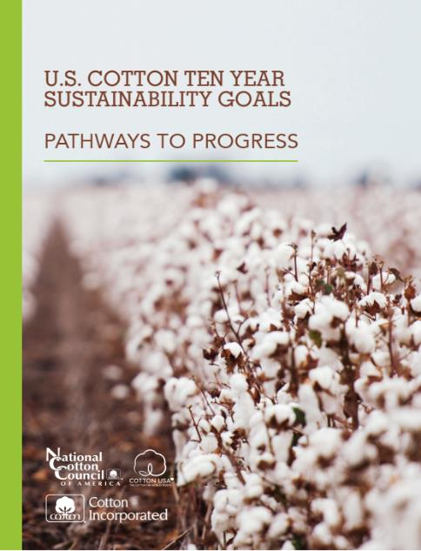

Slide 12
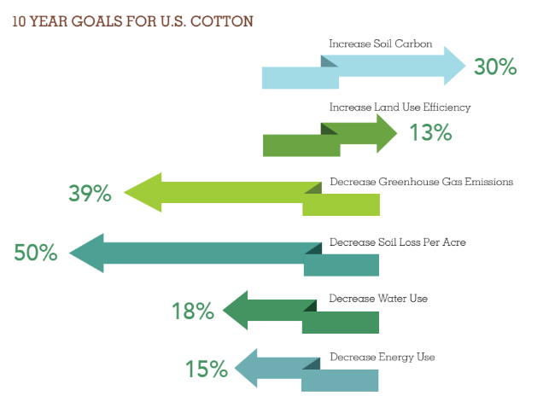
Key Performance Indicators

Slide 13


Cotton Sourcing with Purpose
“100% Sustainable Cotton” Company Goals:
Marks & Spenser’s – 2019
Ralph Lauren (Polo) – 2025
Levi’s – 2020
Wrangler - 2025
The brands that have committed to the 100% by 2025 pledge are: ASOS, EILEEN FISHER, Greenfibres, H&M, IKEA, Kering, Levi’s, Lindex, M&S, Nike, Sainsbury’s, F&F at Tesco, Woolworths, Adidas, A-Z, BikBOk, Burberry, Burton Snowboards, Carlings, Coyuchi, Cubus, Days like This, Dressmann, Hanky Panky, House of Fraser, Indigenous Designs, KappAhl, Kathmandu, Mantis World, MetaWear, Otto Group, prAna, SkunkFunk, Timberland, Urban, Volt and Wow.
https://textileexchange.org/over-36-major-brands-pledge-to-achieve-sustainable-cotton-by-2025/
Notes:
This slide helps frame the need of the US Cotton Trust Protocol. Lots of brands have sustainable cotton sourcing goals. The Protocol will help US cotton remain part of these major brand/retailers sustainable cotton sourcing strategies.
Marks and Spenser – 2019 - https://www.gq-magazine.co.uk/gallery/marks-and-spencer-sustainable-cotton
Ralph Lauren – 100% by 2025- https://www.foxnews.com/lifestyle/ralph-lauren-polo-shirts-recycled-plastic-bottles-earth
Levi’s – 100% by 2020 - https://www.levi.com/US/en_US/features/sustainability
Wrangler – 100% by 2025 - https://www.wrangler.com/sustainability.html

Slide 14

Sustainability Goals and US Cotton Trust Protocol
The Ten Year Sustainability Goals fulfilled the needs of some brands/retailers but others wanted more
Brands/retailers are demanding more data and transparency from their supply chains to support their own sustainability goals
The US Cotton Trust Protocol helps meet this demand by:
  Enrolling growers into a farm-level sustainability program
  Providing sustainability data using Field to Market’s Fieldprint Calculator
  Applying 2nd or 3rd party verification of grower practices and Fieldprints

Slide 15
What are soils made of?
Chemical
Physical
OM
Biological
Notes:
15
Biological properties - earthworm numbers, and other animal activities that are important in soil development and fertility, soil respiration, pitfall trapping, microbial biomass, cotton strip assay, soil food web structure, etc.

Slide 16
Ideal Soil Composition
25% Water
45% Inorganic (mineral materials)
{
}
Pore space 50%
Solids 50%
25% Air
5% Organic Matter
Notes:
An average soil is composed of mineral matter, organic matter, and pore space, which may be occupied by air and/or water. The percentage of these four components can vary depending on how and where the soils were formed.
50% solids and 50% pore space; obviously, these are mixed in a natural environment and fluctuate greatly throughout the year.

Slide 17
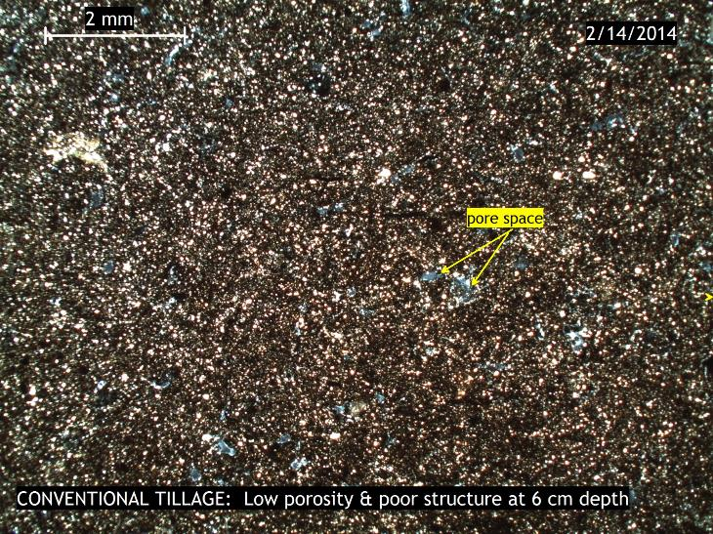

Slide 18
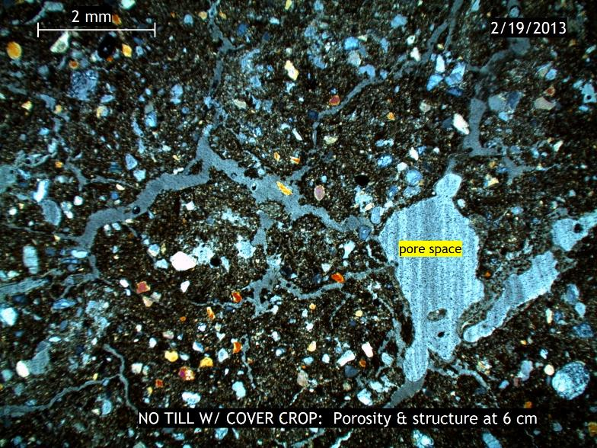

Slide 19
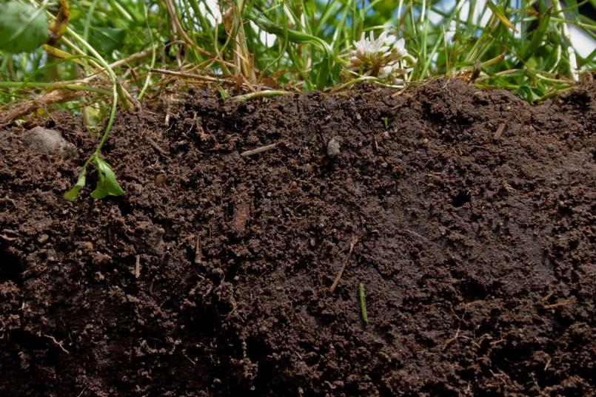
SOIL HEALTH:
The capacity of a soil to function as a vital, living ecosystem that sustains plants, animals, and humans.
Notes:
When we speak of soil health, we are talking about improving the capacity of soil to function as a vital, living ecosystem that sustains plants, animals, and humans.
This definition focuses our efforts on the importance of managing soils in a way that ensures they are sustainable for future generations.

Slide 20
Soil Health Functions?
Nutrient cycling
Water (infiltration & availability)
Filtering and Buffering
Physical Stability and Support
Habitat for Biodiversity
90% is mediated by soil microbes
Notes:
This is the definition of Soil health we are using. The term “Health” was purposely chosen instead of “quality”.
Quality implies analysis and quantifying
Health implies management actions that leads to a condition or state, there is something that can be done to change it in a positive trend
The key to the definition is that soil health is:
Continued capacity—implies rejuvenation and then sustainability
Soil is a living ecosystem– folks need to recognize the ground beneath them is a living ecosystem
Soil function – soils need to provide the basic functions below in order for food & fiber production to meet the demands in slide 1
Nutrient Cycling - Soil stores, moderates the release of, and cycles nutrients and other elements. During these biogeochemical processes, analogous to the water cycle, nutrients can be transformed into plant available forms, held in the soil, or even lost to air or water.
Water Relations - Soil can regulate the drainage, flow and storage of water and solutes, which includes nitrogen, phosphorus, pesticides, and other nutrients and compounds dissolved in the water. With proper functioning, soil partitions water for groundwater recharge and for use by plants and soil animals.
Biodiversity and Habitat - Soil supports the growth of a variety of plants, animals, and soil microorganisms, usually by providing a diverse physical, chemical, and biological habitat.
Filtering and Buffering - Soil acts as a filter to protect the quality of water, air, and other resources. Toxic compounds or excess nutrients can be degraded or otherwise made unavailable to plants and animals.
Physical Stability and Support - Soil has the ability to maintain its porous structure to allow passage of air and water, withstand erosive forces, and provide a medium for plant roots. Soils also provide anchoring support for human structures and protect archeological treasures.

Slide 21
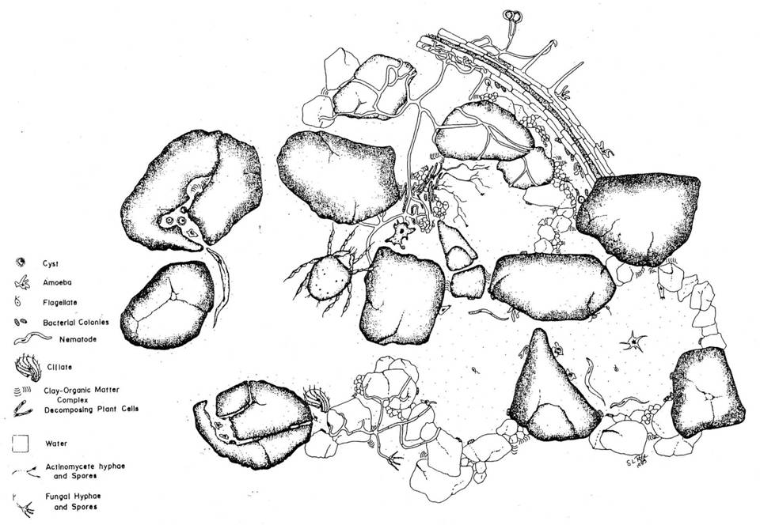
SOIL IS HABITAT
Food
Water
Shelter
Pore
Space
Notes:
View the soil as habitat for microorganisms, just as you might view forests or fields as habitat for animals. If we want to encourage a diverse and healthy habitat for microorganisms we must provide food, nutrients, proper aeration, pH, water, etc. Organisms live in the microscale environments within and between soil particles.

Slide 22
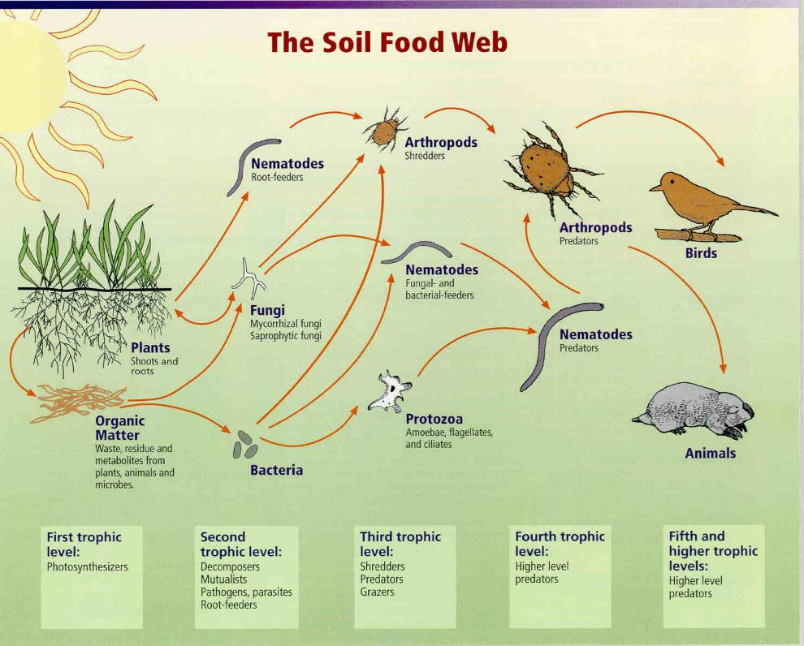
The Soil Food Web
Notes:
Most people are familiar with the above-ground food web: Plants are eaten by herbivores are eaten by carnivores, and so on. But most plant matter is not eaten by herbivores; it is decomposed by the underground food web.
Soil Foodweb is a community of organisms living all or part of their lives in the soil
Foodweb diagram shows a series of conversions of energy (arrows) and nutrients as one organism eats another
Foodweb fueled by primary producers (Photosynthesisers): plants, lichens, moss, bacteria, algae that use the sun’s energy to fix carbon dioxide
Most other soil organisms get their energy and carbon by consuming other organic compounds, organisms and waste by-products
All plants (grass, trees, shrubs, agricultural crops) depend on the soil food web for their nutrition.
File name: A-3 (145KB). (Also fw.jpg 574K, and fwb.jpg at 422K)
Image courtesy of the USDA-NRCS.

Slide 23
Historic Loss of Soil Carbon
Conventional
Tillage
Reduced
Tillage
61% of 1907
53% of 1907
From Lal et al., 1998
Notes:
Simulated total soil carbon changes (0 - 20 cm depth) from 1907 to 1990 for the central U.S. corn belt and a portion of the Great Plains. This indicates that soil organic carbon levels dropped to 53% of precultivation levels in the 1960s and increased subsequently with the adoption of conservation tillage practices and the advent of higher yielding varieties which produce more crop residues (Lal et al., 1998). Not sure the increase has happened as predicted in this model.
Relate this loss in carbon to the potential of soil to sequestor carbon. The soil has the potential to put back or store all this lost carbon. The potential is about 40% of the precultivation soil carbon for this area.
In general, the C content of soil organic matter is about 58%. Soil organic matter is a key indicator of soil quality and is an integrated measure of change in soil function. Generally, increases in soil organic matter reflect increases in soil quality. Soil can function as a sink for atmospheric carbon, and therefore has the potential to decrease atmospheric carbon and aid in mitigating global climate change.

Slide 24
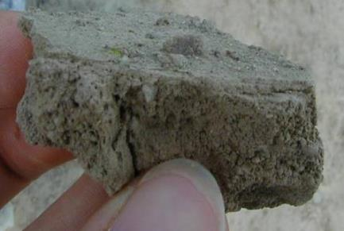
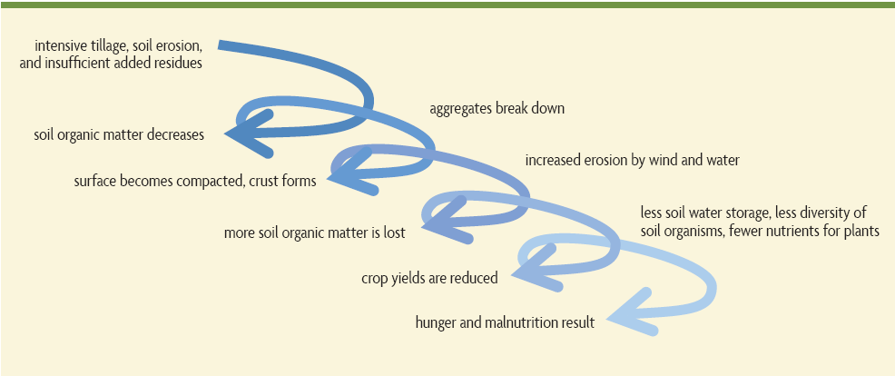
Downward Spiral of
Soil Degradation in annual systems
1. Intensive tillage, insufficient added residues, low diversity, no
surface cover
2. Soil organic matter decreases, erosion, subsoil compacted
3. Aggregates break down
5. Infiltration decreases
Erosion by wind and water increases,
Yield consistency declines
4. Surface becomes compacted, crust forms
7. More soil organic matter, nutrients, and top soil lost
6. MORE ponding & persistent
wetness, but LESS soil water storage; less rooting; lower nutrient access efficiency; less diversity of soil organisms, more disease and pests
8. Crop yields decline
9. Hunger and malnutrition, especially if little access to inputs
Modified from Building Soils for Better Crops
Notes:
If current management principles include: Intensive tillage, insufficient added residues, low diversity, no surface cover….follow the graphics.
Over time, the way we manage our soil can, and has, led to degraded soil functions. (mention the functions that we discussed earlier)
You may want to restate- … remember that prior to European settlement, agriculture lacked intensive tillage…we’ve not been at this in North America (or South) for very long. So there is a complacency that continuing to manage along the same path is sustainable.

Slide 25
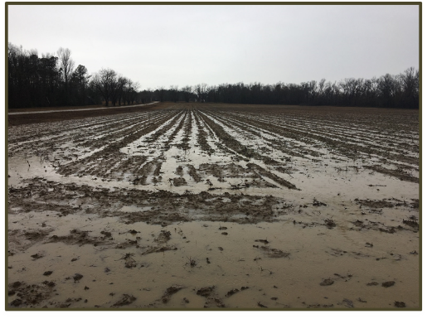
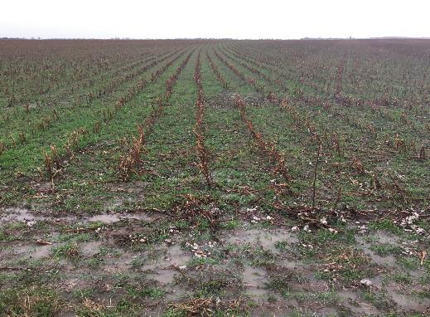
After the Storm…
Runoff from two different cropland managements in close proximity and on similar soils after 1” of rainfall in 30 minutes, Burke County, GA. 2/7/18.
Fall conventional tillage
without cover crop
Spring strip tillage with multispecies cover crop
Photos by Dan Wallace, USDA/NRCS, GA
Notes:
Coastal plain soils with loamy sand surface textures, well drained

Slide 26
Soil Health Principles
Minimize Disturbance
Maximize Soil Cover
Maximize Biodiversity
Maximize Presence of Living Roots
Notes:
We must integrate the Core 4 Principals of improving Soil Health into every aspect of management decisions.

Slide 27
Soil Health Principles To
Support High Functioning Soils
Maximize living roots
Feed diverse, continuous inputs (C sources, energy)
Minimize disturbance
Protect habitat (aggregates and organic matter)
Maximize cover
Maximize diversity
Notes:
Principles tend to do one of two things, they either Feed soil microbes by providing a ca continuous source of C or they Protect the habitat

Slide 28
The Fence Row Effect
Notes:
Most farmers who have studied yield maps have seen these principles at work. Ask- what happens to the yield map when you cross an old fence row, or maybe an old pasture that has been brought into production? … Most farmers in the room will start giving the thumbs up sign. Ask if the yield jumped a little or a lot. ..Most farmers in the room will start giving the thumbs up sign again
July 31, 2015 Aerial photo. In an extremely wet year why would this narrow part of the field look so much better?...
Judging from this tract boundary line, their used to be a fence row there.
The yield map would likely show an even greater advantage

Slide 29
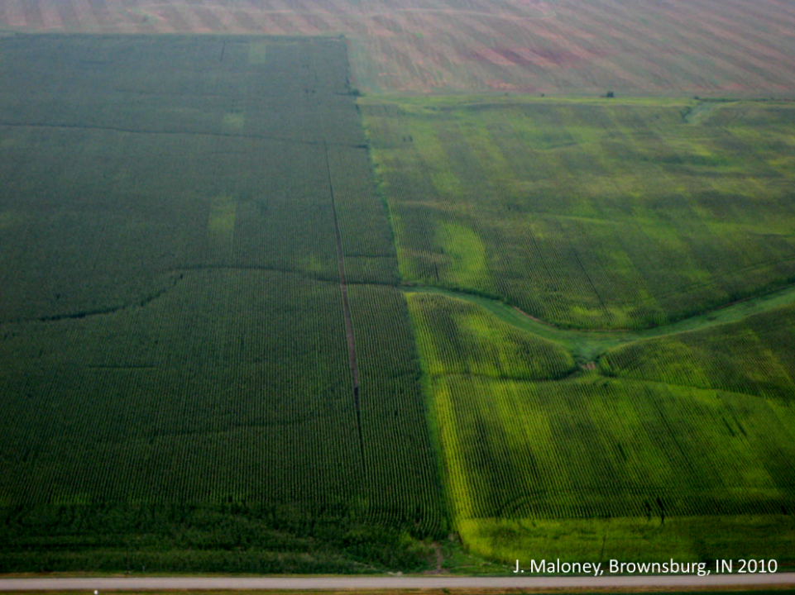
Principles at work
Notes:
.. .. Those fence rows that are now in production had all of the principles in place for longer that the rest of the field. The purpose of this section is to see if we can integrate management that regenerates soil function like the fence row all across the field…farm…landscape. This parable works well for cropland areas. There may be better parallels to use in other regions.

Slide 30
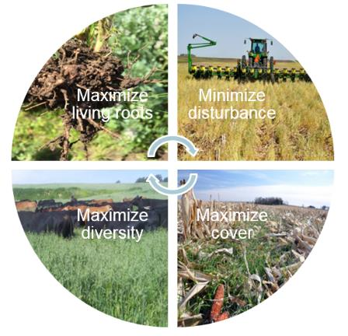
Soil Health Principles & Soil Function
Minimize Disturbance &
Maximize Soil Cover
Maintain stable aggregates
Reduce erosion and runoff risk
Buffer temperature
Reduce evaporation
Maintain soil organic matter
Protect Soil Habitat & SOM
Image courtesy of Barry Fisher, NRCS-SHD
Notes:
The first two principles focus on protection of the soil habitat: minimizing disturbance and maximizing soil cover maintains or increases stable soil aggregates and soil organic matter (SOM), and protects the fragile surface of the soil that is most susceptible to the degrading forces of wind and water. Covering the soil also buffers against extreme swings in temperature that stress plants and soil organisms, reduces evaporation rates, and increases water-use efficiency. SOM is highest at the soil surface and is critical for stabilizing soil aggregates. Maintaining SOM helps support additional soil functions including water infiltration and storage, nutrient-holding capacity and release, and habitat for soil biota.

Slide 31
Minimize Disturbance
Agricultural Disturbance can:
Disrupt or Destroy the “Soil Hot Zones”
Destroy “Habitat” for Soil Organisms
Creates a “Hostile” Environment
Three Types of Disturbance
  Physical (tillage)
  Chemical (fertilizer)
  Biological (pathogens and invasives)
Notes:
Who can name some types of disturbance?...click…The kinds of disturbances we’ve become accustomed to seeing in much of agriculture, and thought of as “normal”, aren’t really normal in nature and weren’t occurring during the development of our great soils which we have been blessed.

Slide 32
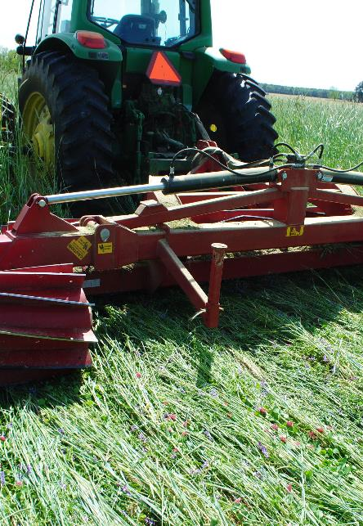
Manage More by
Disturbing Soil Less
Protects habitat
Moderates temp and moisture
Maintains soil aggregates
Controls erosion
Reduces oxidation of soil carbon
Notes:
We truly need to minimize disturbance to the extent possible and practical to realize these benefits. What do you think I mean by- “the extent possible and practical”. Short discussion.

Slide 33
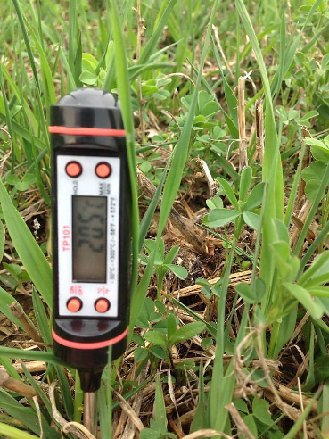
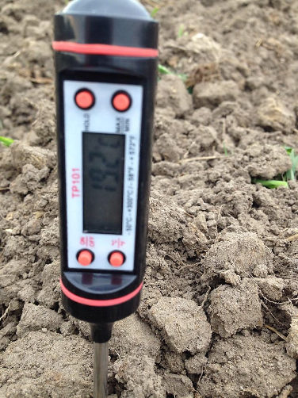
Spring time temps
66.57
68.90
Notes:
…And yet, is tilled soil always warmer?...It depends-time of day?, early season?, wet or dry etc, etc

Slide 34
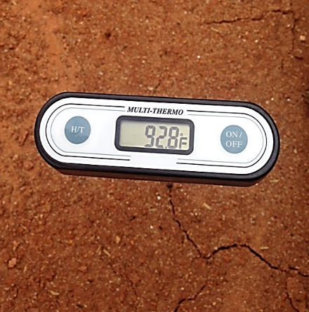
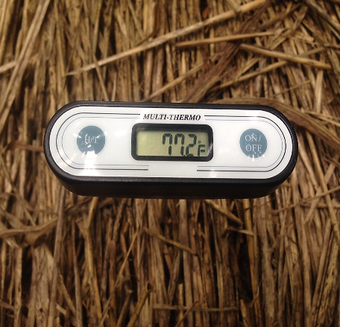
Summer Temps
Carbon mat: feeds soil, keeps it cool, suppress weeds, and protects from rain drop
Notes:
If you mechanically warm your soil in the spring are you giving up moisture, air and habitat in the summer.

Slide 35
When Soil Temperature Reaches…
140 F Soil bacteria die
130 F 100% moisture is lost through
evaporation and transpiration
113 F
Some bacteria species start dying
100 F 15% moisture is used for growth
85% moisture lost through
95 F evaporation and transpiration
70 F 100% moisture is used for growth
J.J. McEntire, WUC, USDA SCS, Kernville TX, 3-58 4-R-12198. 1956
Notes:
Soil temperatures are a way of determining the health of you cropland and pastures.
By placing a temperature gauge on the surface can show you what kind of micro climate you have created
Soil temperatures can exceed ambient air temperatures by 10 to 20 degrees
Plant use of moisture is directly linked to soil temperature
At 70 F soil temps 100% of the moisture is used for growth, none is loss.
At 100 F you lose 85% of your moisture through evaporation-transpiration.
At 113 F 100% of soil moisture is lost through evaporation-transportation, no plant growth is occurring
Plants natural reaction to hot temperatures is to evaporate soil moisture through there system to cool itself.
Protein cooks at 120 degrees F. Thus the plant will avoid being cooked by using all the moisture you have caught in the soil for Air Conditioning.
At 130 F soil organisms start to die
So it is important to manage for cool soil conditions. This is the biggest looser of soil moisture. Hot ground means you have created a drought even during moist years.

Slide 36
Soil Health Principles & Soil Function
Maximize Biodiversity &
Maximize Living Roots
Break disease/pest cycles
Stimulate/change belowground diversity
Increase soil organic matter
Increase nutrient cycling
Enhance plant growth
Increase predator & pollinator populations
Feed Biota
Image courtesy of Barry Fisher, NRCS-SHD
Notes:
The second two principles focus on feeding the organisms inhabiting soil. Maximizing the diversity of food (energy and carbon inputs) and aboveground biodiversity through increased plant, animal, or soil amendments increases the diversity of soil animals, microorganisms, and activities. Diversity not only refers to food sources, but also aboveground diversification of plants and animals, as well as microbial diversification underground. Diversification stimulates a host of additional benefits including breaking disease cycles, providing habitat for pollinators, wildlife, and beneficial predators, and stimulating plant growth.

Slide 37
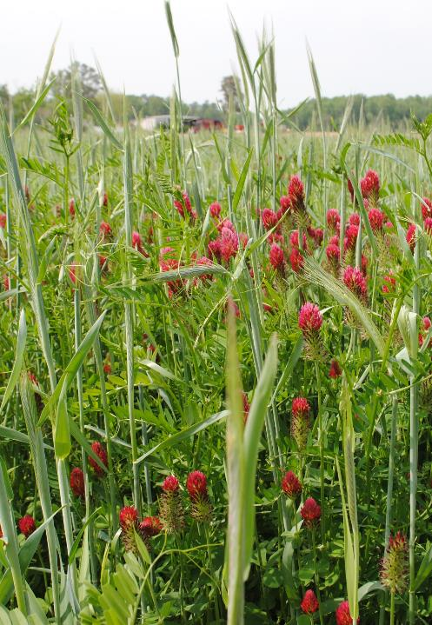
Diversify with
Crop Diversity
Plants interact with particular microbes
  Trade sugar from roots for nutrients and water
Microbes convert plant material to OM
Requires a diversity of plant carbohydrates to support the variety of microbes
Lack of plant diversity will drive system to favor some microbes more than others

Slide 38
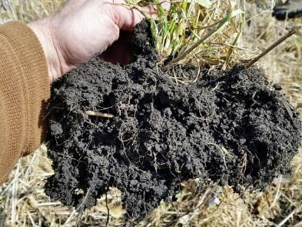
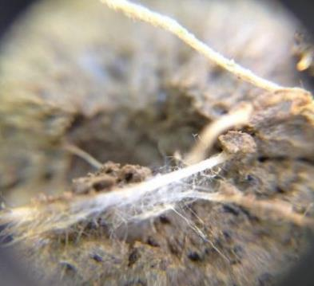
Soil Biology :
Aggregate stability will only regenerate biologically.
Balanced and diverse functional groups of biological populations are critical for restoring soil functions and building disease and pest defenses.
Colonizing mycorrhizal fungi and aerobic microbes (e.g.-rhizobium) build soil structure and cycle nutrients
Notes:
Maximizing diversity is really all about habitat for soil organisms… build it and they will come….feeding the soil biology. As we discussed before, without habitat, beneficial soil biology, such as mycorrhizal fungi and rhizobia bacteria that build structure and tilth, may also be lost. Without a balance of these organisms, the soils lose key functions… and are subject to compaction, crusting, and high bulk density.

Slide 39
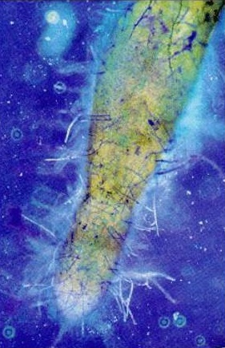
Grow Living Roots Throughout the Year
Increases soil microbe activity
Increases plant nutrient recoverability
Increases biodiversity and biomass of soil organisms
Improves physical, chemical and biological properties of soils
Sequesters nutrients
Increases OM
Notes:
In addition to cover we need to jumpstart the soil life and soil function.

Slide 40
Soil Health Management System
Collection of conservation practices/activities that focus on maintaining or enhancing soil health
Address all four of the soil health principles
Create a “synergistic” effect
Cropping system specific
Notes:
A collection of NRCS conservation practices that focus on maintaining or enhancing soil health by addressing the four soil health planning principles: minimize disturbance, maximize soil cover, maximize biodiversity and maximize presence of living roots. SHMS are cropping system specific and contain practices treat the entire field and when applied a system achieve the greatest impact on soil health by creating a synergistic effect as a system. Information obtained through soil health assessments can be used in developing SHMS in targeting specific constraints that have been identified.

Slide 41
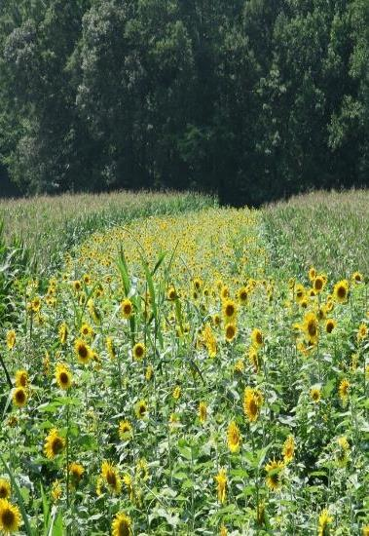
Core Soil Health Enhancing Conservation Practices
Conservation Crop Rotation
Cover Crop
No Till
Reduced Till
Prescribed Grazing
Notes:
Of the over 160 NRCS Conservation Practice Standards only a handful would actually be used in a SHMS
Most of the CPS are under engineering
Only 21 are agronomic in nature
9 are grazing
Soil Health is more than controlling erosion
These 5 practice make up the core of any SHMS

Slide 42
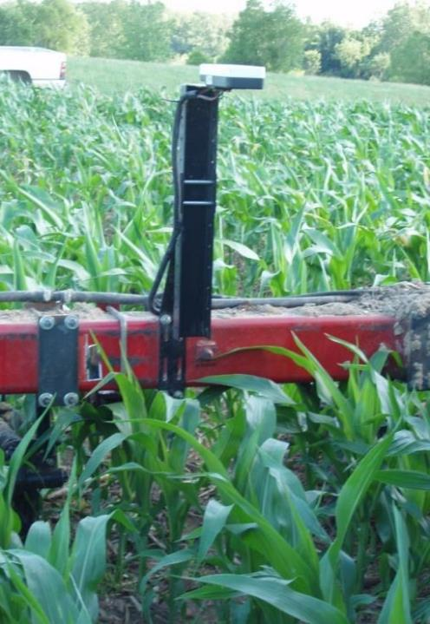
Synergistic Practices
Practice that increase soil health enhancement when applied in conjunction with the core practices
  Nutrient Management
  Pest Management
  Irrigation Water Management
Synergistic Effect: 1 + 1 = 3
Notes:
These practices added a synergistic affect when applied as a system
Synergistic = an interaction between practices that produce a combined effect greater than the sum of the practices separately

Slide 43
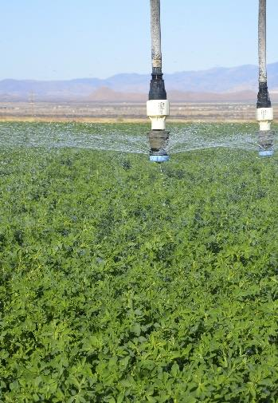
As Applicable Practices
Practices that address resource concerns that may not occur on all fields
Sight specific
Irrigation water management
Buffer practices
Waterways
Filter Strips
Notes:
These practices are those that would not be needed in every field, they tend to address site specific issues, e.g. runoff

Slide 44
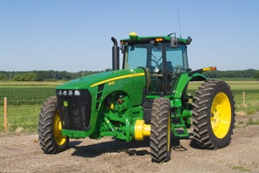
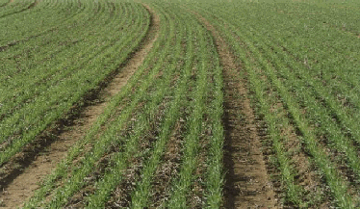
Best Accepted New Technology
Conservation activities that might not be in an NRCS conservation practice standard
Improve soil health
Controlled traffic pattern
Precision application of nutrients and pesticides
Use of floatation tires
Notes:
These are activities that benefit soil health but may not fall under an NRCS conservation practice standard
Allows for the use of innovative ideas

Slide 45
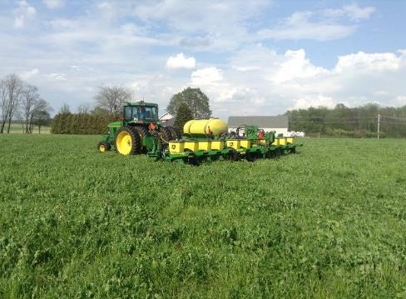
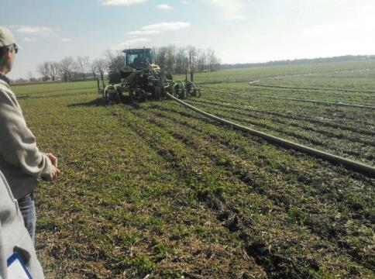
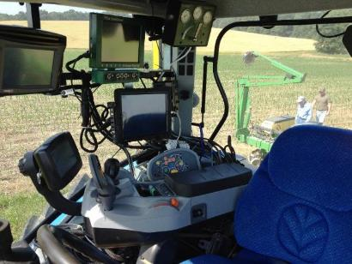
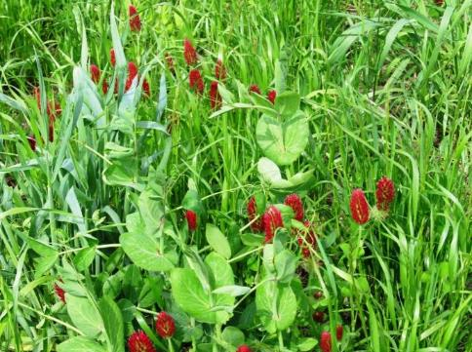
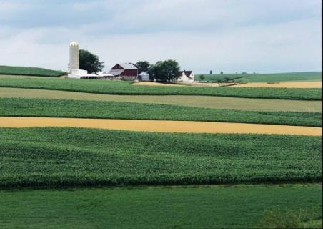
Quality No-Till/Strip-till
Adapted Nutrient Management
New Technology and Integrated Weed & Pest Management
We can package a system of practices that Improve Soil Health!
Prescribed Cover Crops
Diverse Crop Rotation
Notes:
Improving soil function is about optimizing and understanding all aspects of the conservation cropping system such that soil health is the central focus with every operation. Each practice should complement and enhance the others of the system.
Have an in depth class discussion on the difference between each single practice and how to integrate them into a SH system.
Quality No-till vs No-till…Adapted Nutrient Management vs Nutrient Management and so on for each.

Slide 46
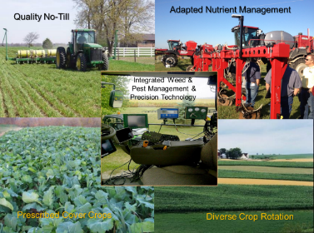
Soil Health Management System
Achieving soil health through:
      A Quality No-till (Never-Till) System
      Diverse and Strategic Cover Crops
      Adapted Nutrient Management
      Integrated Weed & Pest Management
      Diverse Crop Rotations
      Precision Farming Technology
      Prescriptive Buffers
Soil Health is not a destination...it’s a Journey
Notes:
“Soil health” is a journey that’s obtained by implementing a system of management practices that are often planned above and beyond the minimums in our standards.
It’s the implementation of a suite of conservation practices to a high-level/criteria, that leads to soil health and the subsequent treatment of Resource Concerns (RCs). Many RCs are linked to SH indicators (compaction, infiltration, water-holding capacity, nutrient cycling, biodiversity, etc.) and the resulting water quality, air quality, wildlife habitat, etc. benefits.
Discuss difference between minimum and high-level criteria

Slide 47
Key Performance Indicators

Slide 48
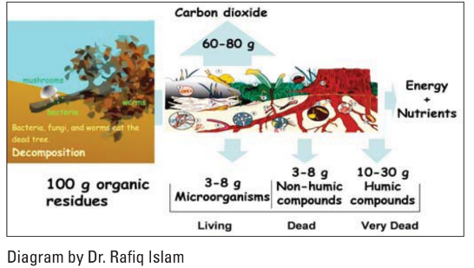
Biomass required to increase Soil Organic Matter
1% SOM weighs 20,000 Lbs.
Most crop residue is lost through decomposition
Use of Cover Crops
is the easiest way to increase SOM

Slide 49
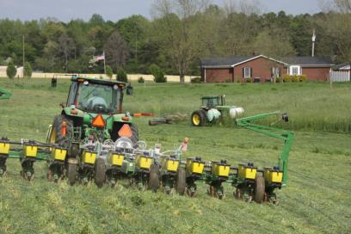
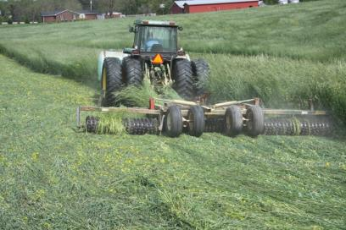
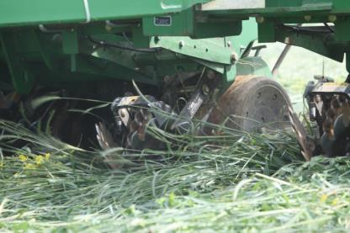
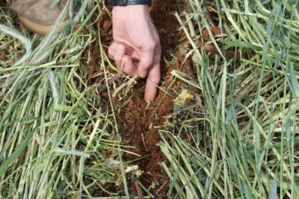
What’s Planting into 10,000 lbs. of residue looks like….

Slide 50
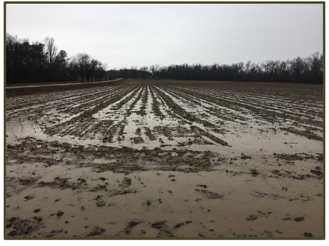
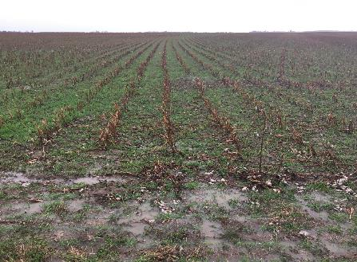
45% greater porosity increases infiltration rate by 167% for the first inch and 650% for the second inch
Karlen et al., 1998
Coshocton, OH ARS
  39 year SHMS
  Ave. Rainfall 38”
  Ave. Runoff .08”
North Appalachian Experimental Watershed
  4 year study (1978-82)
  Ave. Rainfall 41.8”
  Ave. Runoff No-Till .09” Conv. 7.01”
Photos by Dan Wallace, USDA/NRCS, GA
Notes:
Coastal plain soils with loamy sand surface textures, well drained

Slide 51
Aggregate Stability
BUILDING SOILS FOR BETTER CROPS
Notes:
You can use the demos to help illustrate this point

Slide 52
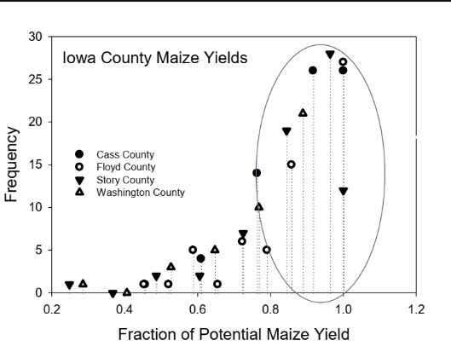
Variation in Yields
20% of the yield loss occurs 80% of the time due to water availability
The majority of yield losses due to the weather are short-term stresses
Dr. Jerry Hatfield, ARS

Slide 53
SOM & Available H₂O Capacity/Foot Soil
Inches H₂O per Foot of Soil
Percent Organic Matter
Hudson, 1994
Notes:
The value of soil organic matter in the soil is evident during a dry summer or a drought. Depending on soil structure, a sandy soil can hold 0.5 to 1 acre inch of water for each additional percent of SOM, while a silt loam soil may hold 0.8 to 1.9 acre-inches of water for each percentage increase in SOM. For every inch of rainfall, the increase in corn yield is about 8 bushels per acre.

Slide 54
Additional Day of AWC
(Based on Cotton use of .25”/day)
Hudson, D. H. Journal of Soil and Water March-April 1994
Notes:
Increasing SOM leads to reduced stress from drought. This table illustrates the number of days of available water that increasing SOM provides when corn is growing at it’s peak. A soil with 3% OM would have 4.5 to 5.6 days of available water compared to soils with 1% OM having only 1.6 days.

Slide 55
Healthy Soils for Sustainable Cotton Project
Partnership with:
Soil Health Institute
Wrangler Jeans
The Walmart Foundation
Goal: To quantify, expand and verify the productivity and environmental benefits of soil management systems used by cotton producers
2019 – Arkansas, Georgia & North Carolina
2020 – California, Mississippi & Texas

Slide 56
Key Objectives
Increase adoption of Soil Health Management Systems
  Soil Health training field days/workshop
  Soil Health Farmer Mentors
  Soil Healthy Technical Specialist
  Advanced training
Quantify the production and environmental benefits
  FieldPrint Calculator
  Soil health assessments
  Economic analysis

Slide 57

Healthy Soils for Sustainable Cotton CHALLENGE
Try a Soil Health Management System on your farm
2 fields to implement a system
  One going into cotton
  One coming out of cotton
Work with Soil Health Specialist to
  Design a system
  Conduct a soil health analysis
  Provide information to quantify benefits
Participate in Soil Health network

Slide 58
More Information
Healthy Soils for Sustainable Cotton Project
  Field Day and Advanced Soil Health Training
  Healthy Soils for Sustainable Cotton Challenge
    Soil Health Institute Website https://soilhealthinstitute.org/
  PDF Copy of Webcast download here
  ​Twitter @soil_institute
David Lamm
SHI Healthy Soils for Sustainable Cotton
Project Manager
dlamm@soilhealthinstitute.org
(336) 613-8322

