Slide 1
Woody Plants for Urban Bee Conservation
Which woody plants are most attractive to bees?
Research by
Bernadette M. Mach & Daniel A. Potter
University of Kentucky, USA

Slide 2
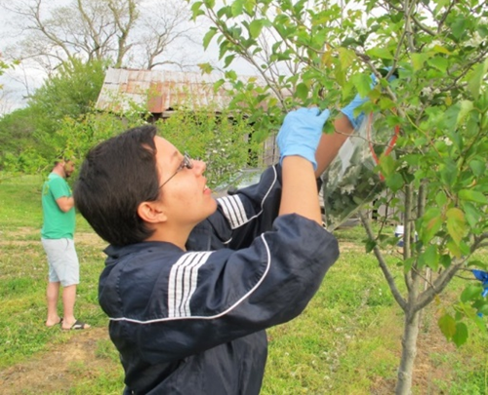
This study was part of the doctoral research of Bernadette [Bernie] Mach (PhD 2018)

Slide 3
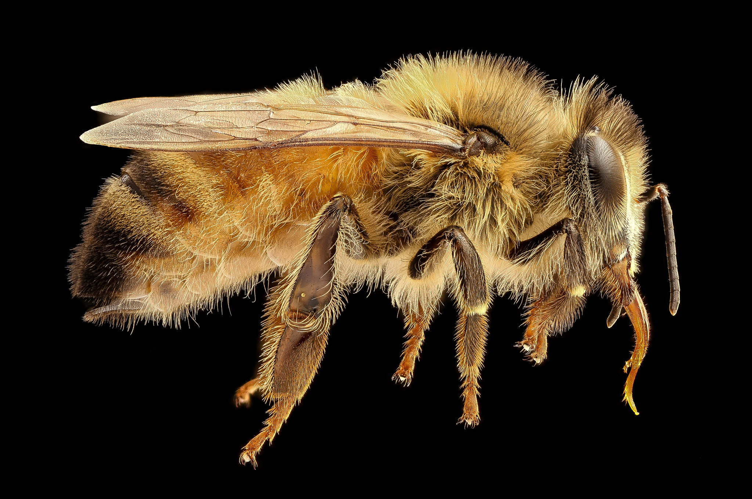
Image by
Sam Droege
Notes:
When people think of bees, most people think of (or are familiar with) the honeybee

Slide 4
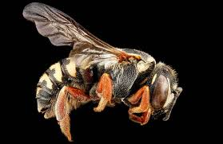
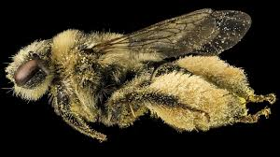
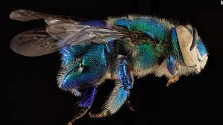
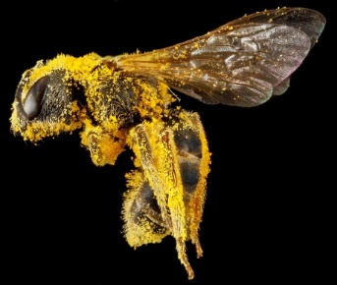
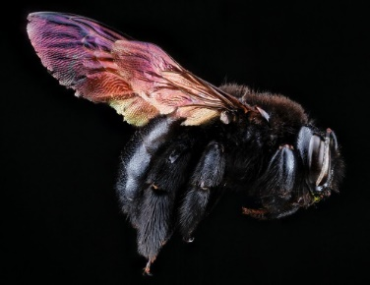
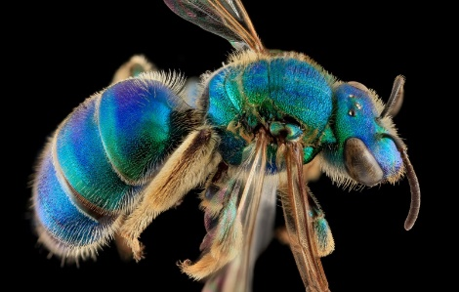
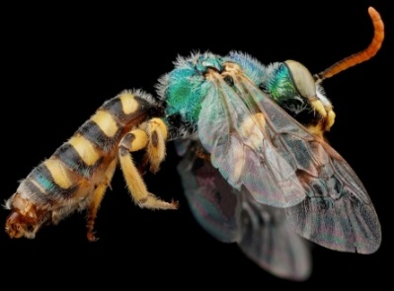
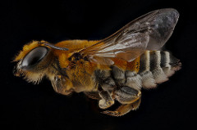
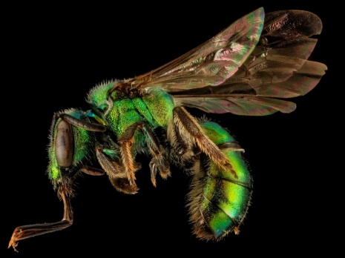
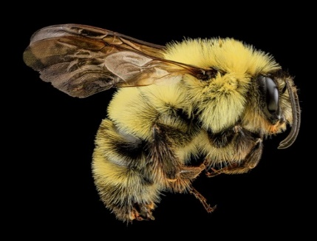
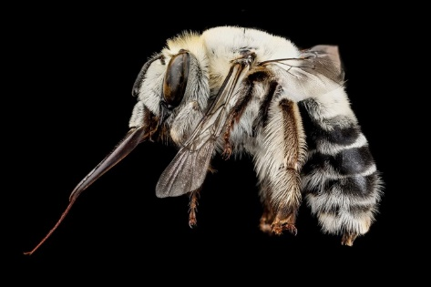
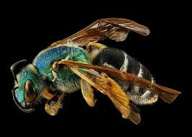
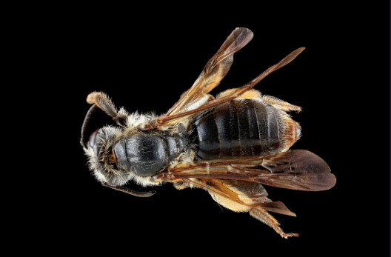
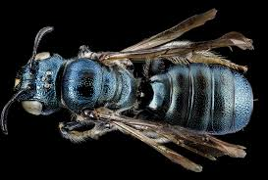
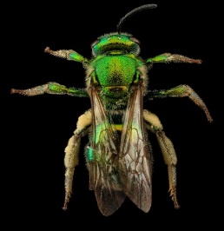
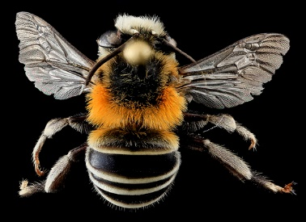
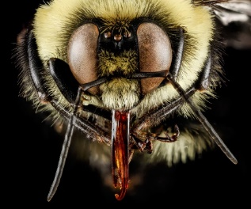
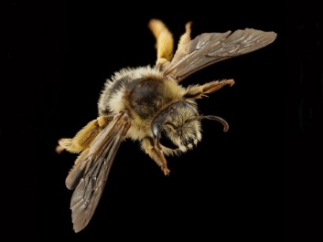
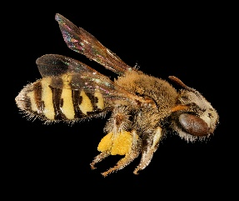
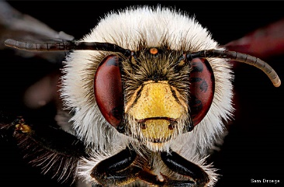
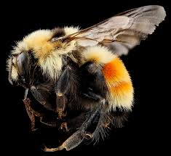
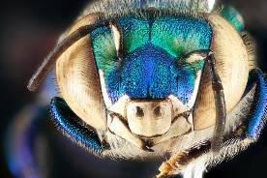
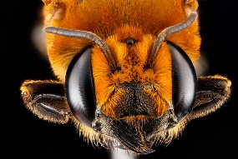
Composition by
Maria-Carolina Simao
Images by
Sam Droege
Notes:
However, there are over 4,000 (!) species of bees in the USA; 20,000+ in the world

Slide 5
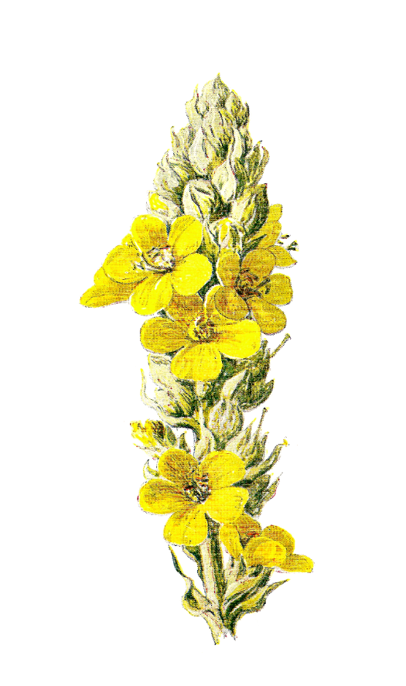
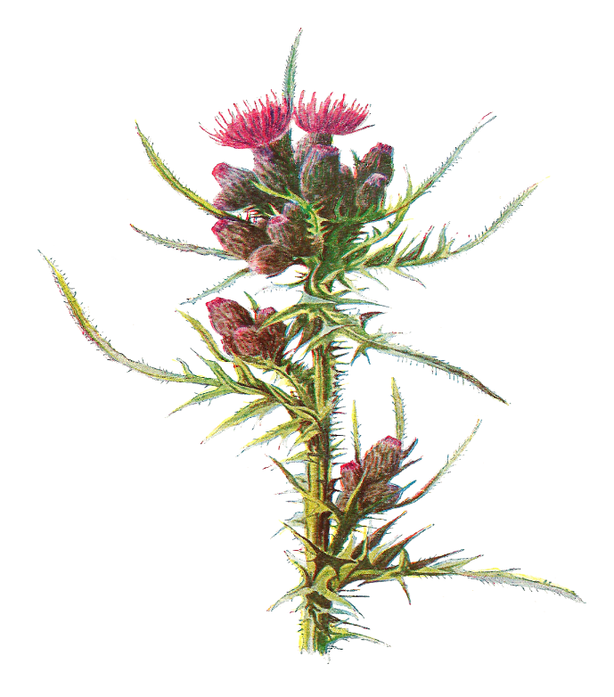
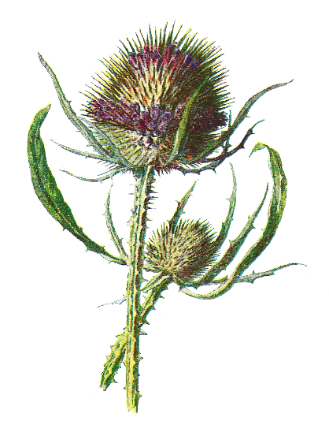
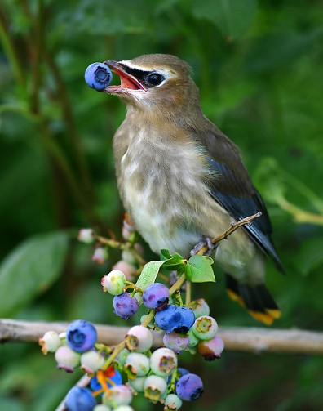
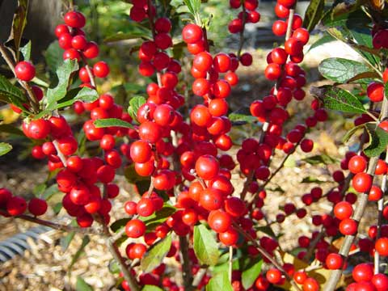
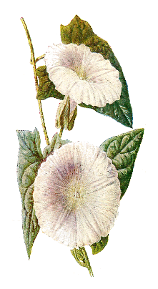
Bees are vital
Background
Project Goal
Data Collection
Findings
Recommendations
87 out of 115 food crops
$200 billion
78% plants
Klein et al. 2007, Proc. R. Soc. B
Gallai et al. 2009, Ecol. Econ.
Ollerton et al. 2011, Oikos
Notes:
One of the most commonly cited reasons that bees are so important is because of their connection to food production. It’s not that if all bees died we would have no food at all–as a lot of our grains, for instance, are pollinated by wind–but…it’s actually a lot of our fruits and vegetables (our sources of a lot of our micronutrients) that are pollinated by bees. 87 out of the leading 115 global food crops in the world have some level of dependency on animal pollinators, and this service that bees provide is estimated to be valued at about 200 billion dollars.
(CLICK) But it’s not just food production that bees are good for, bees are very important parts of our ecosystems and help pollinate many plants. Out of all the flowering plants in the world, it’s estimated that about 78% of these angiosperms have some level of dependency on animal pollinators.

Slide 6
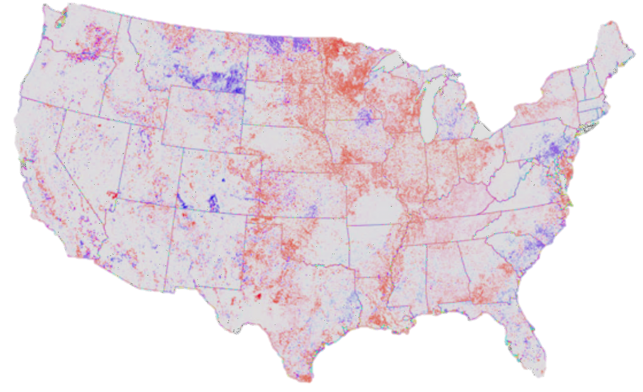
Bees are vital, but there are signals of decline
Background
Project Goal
Data Collection
Findings
Recommendations
Bee Abundance
Increased
Decreased
Koh et al. 2016, PNAS
Notes:
The problem is, we have reason to believe that they’re in decline. A recent paper tried to model what’s been happening to bee abundance in the United States, and their results are shown in this map here. I’ve simplified the legend here so that you can see that the cooler colors (blues/purples) represent areas where the model predicted bee abundance has increased, while the warmer colors (reds/pinks) represent areas where the model predicted bee abundance has decreased. What I’d like you to get from this map is that more areas are warmer colors (where bees have decreased) than cooler colors.

Slide 7
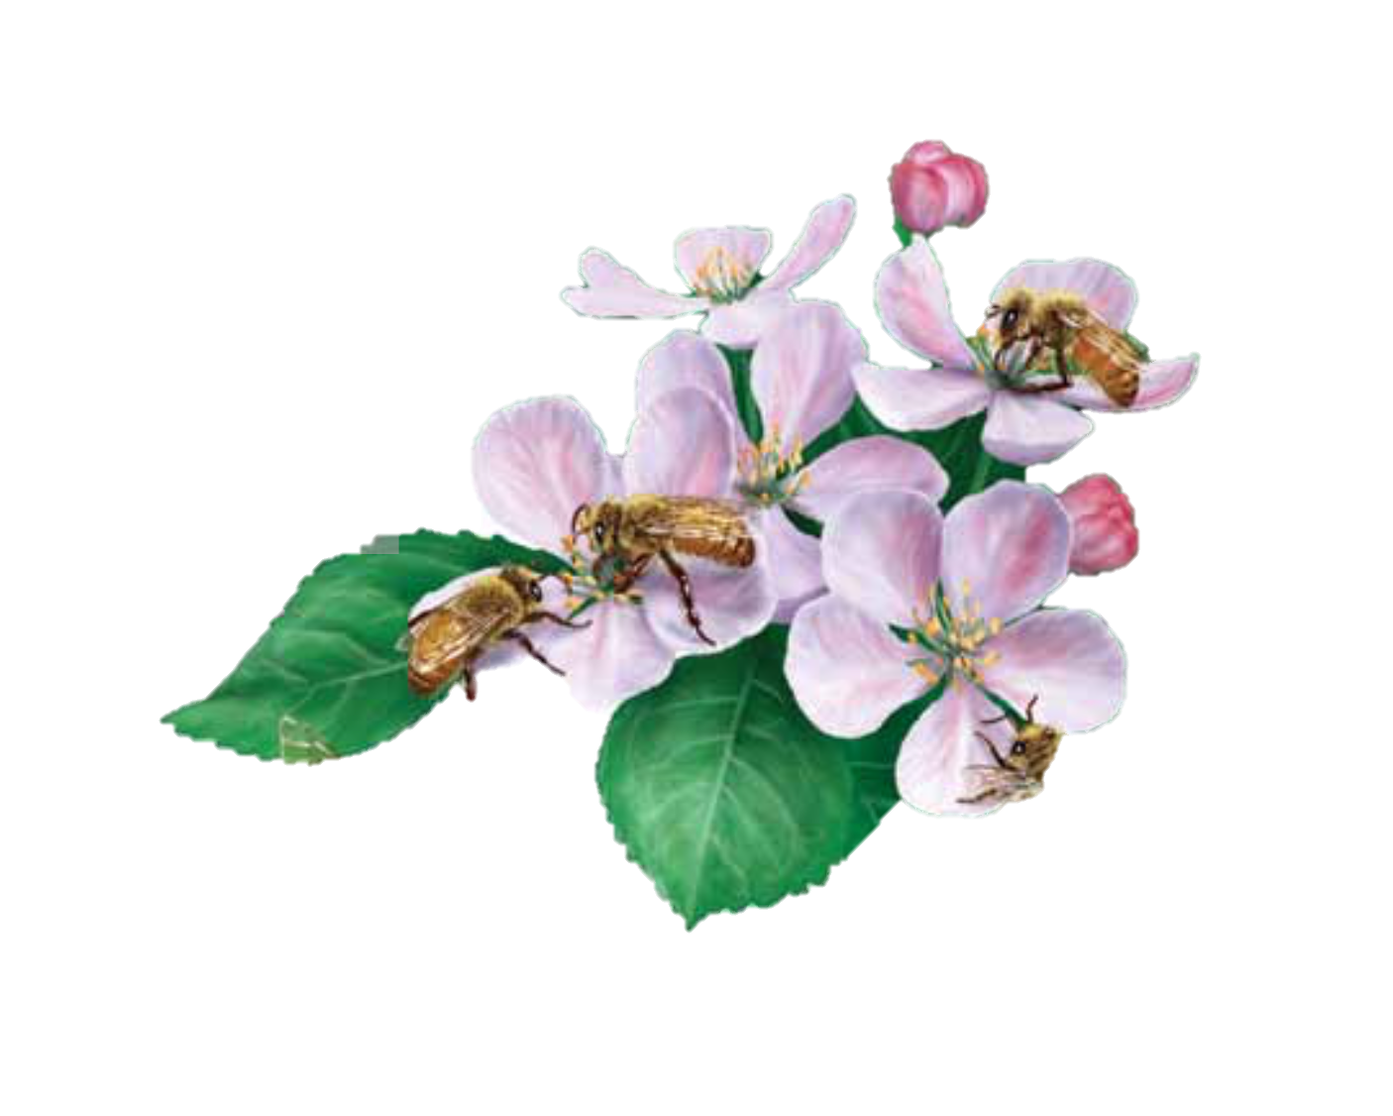
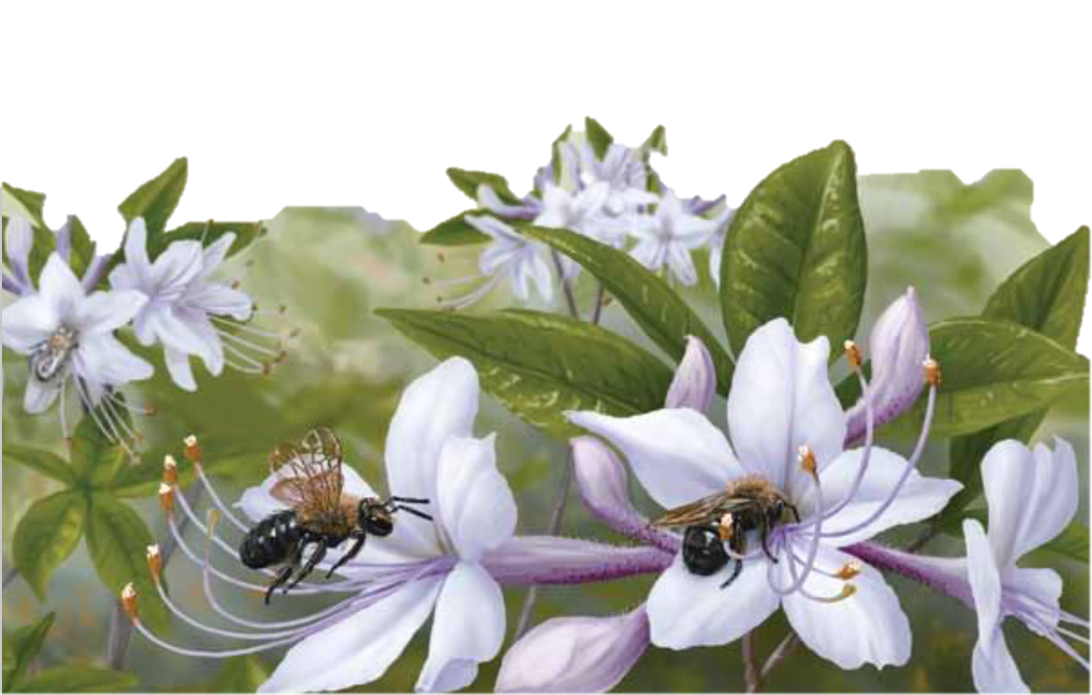
Bees need food
Background
Project Goal
Data Collection
Findings
Recommendations
Flowers:
provide vital pollen and nectar
Illustrations by Steve Buchanan

Slide 8
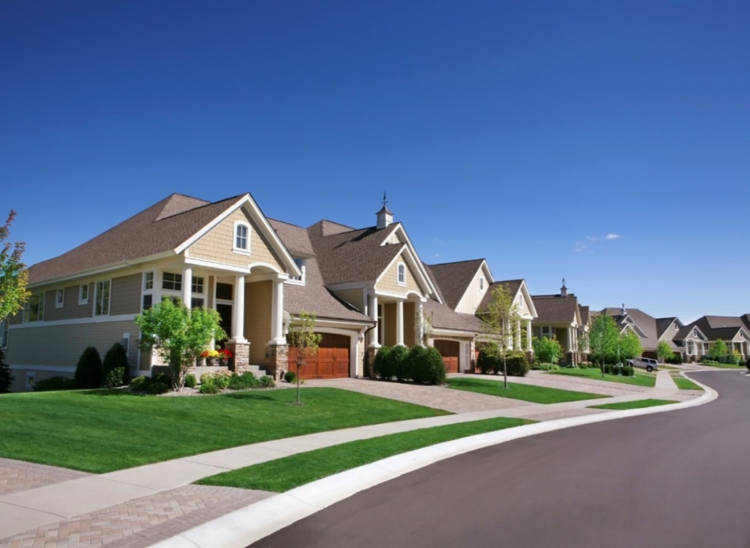
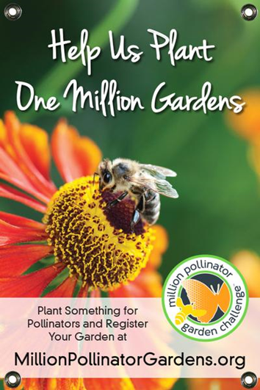
The best way to help urban bees is to give them more and better food
Not much for bees here!
Better!

Slide 9
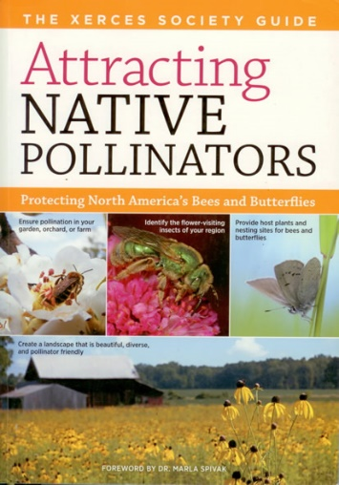
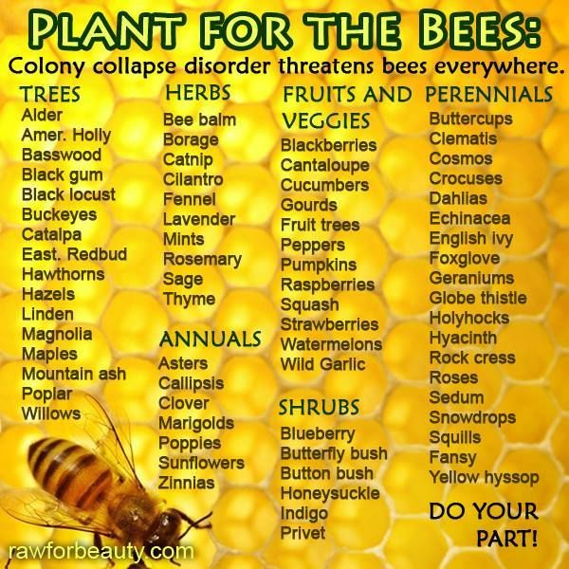
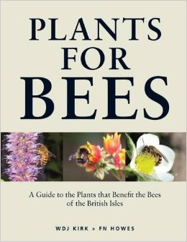
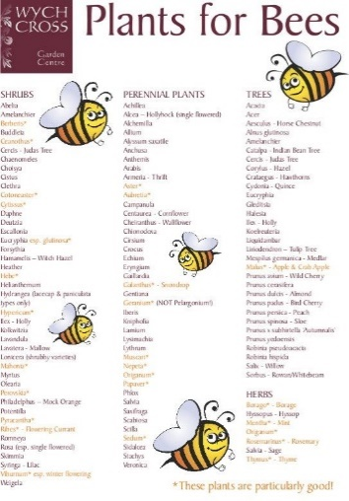
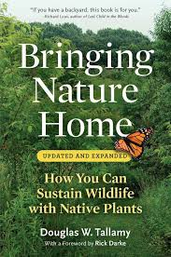
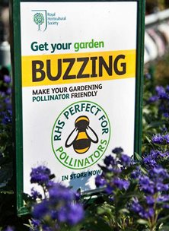
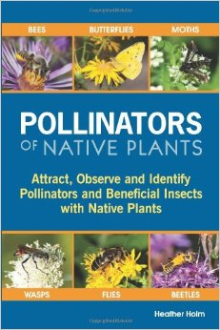
In an effort to help pollinators…
Background
Project Goal
Data Collection
Findings
Recommendations
A rush to plant flowers!

Slide 10
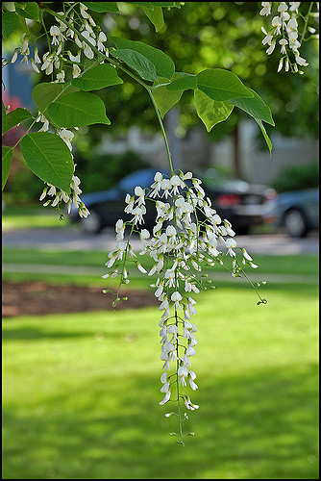
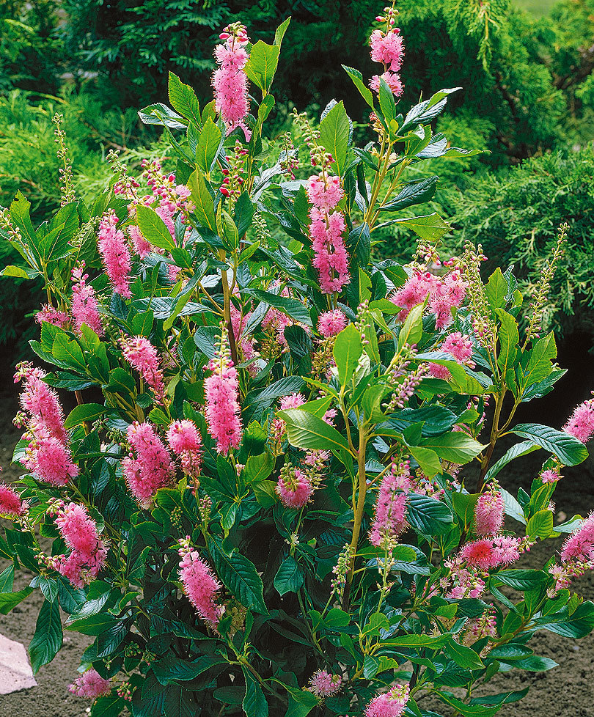
A single tree or shrub can provide 1000s of flowers with high-quality pollen and nectar
Background
Project Goal
Data Collection
Findings
Recommendations
But there is very little scientific evidence on which woody plants attract which pollinators
Tom Gill, some rights reserved
Kentucky yellowwood
Summersweet (Clethra)

Slide 11
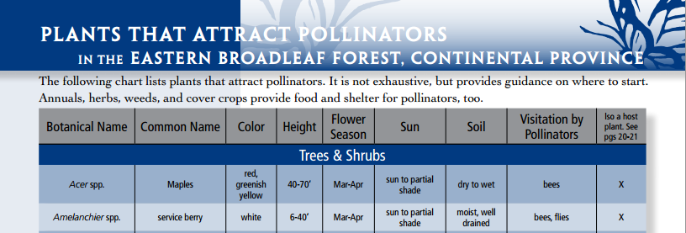
Recommendations for bee-friendly woody plants are rarely backed by hard data
Background
Project Goal
Data Collection
Findings
Recommendations
What type? How bee-attractive is it?

Slide 12
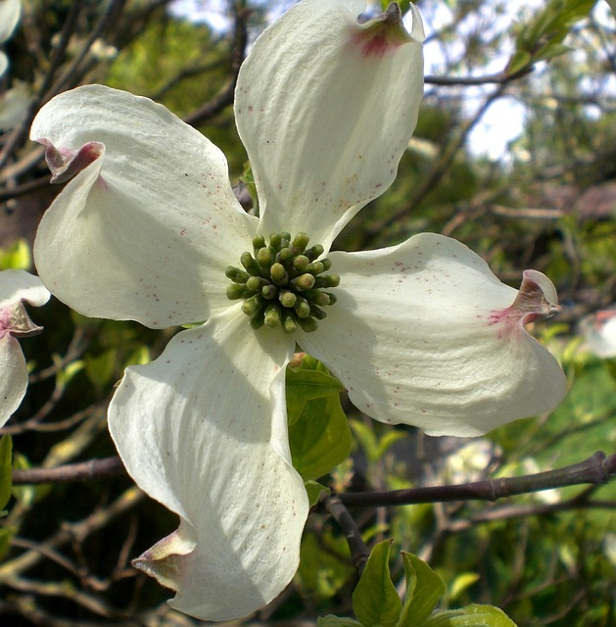
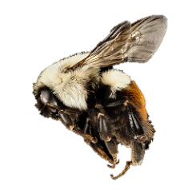
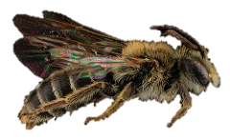
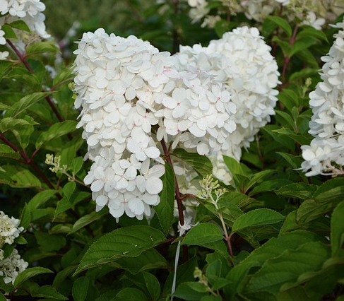
Project Goal:
Background
Project Goal
Data Collection
Findings
Recommendations
Document which flowering woody plant species attract bees in urban areas
Number and Types of Bee Visitors Recorded
Woody Plants
Flowering dogwood
Comus florida
Honey bees,
Bumble bees, etc.
?
Higan cherry
Prunus subhirtella ‘autumnalis’
Mining bees
PG Hydrangea
Hydrangea paniculata
Sweat bees
Cherry laurel
Prunus laurocerasus
Leaf-cutter bees,
Mason bees, etc.
Notes:
1st set of line: is it possible that each flower attracts an equal number of each type of bee?
Remaining set of lines: or it that some could attract just a few types of bees, and more of certain species than others?

Slide 13
Details of Data Collection
Background
Project Goal
Data Collection
Findings
Recommendations
72 woody plant species, 5 separate sample sites for each

Slide 14
Details of Data Collection
Background
Project Goal
Data Collection
Findings
Recommendations
Urban Areas:
central Kentucky & southern Ohio

Slide 15
Details of Data Collection
Background
Project Goal
Data Collection
Findings
Recommendations
Urban Areas:
central Kentucky & southern Ohio, 373 sites
Municipal and institutional landscapes
Cemeteries
Street trees
Arboreta
Home landscapes

Slide 16
Details of Data Collection
Background
Project Goal
Data Collection
Findings
Recommendations
We compared plants’ attractiveness to bees by timed “snapshot” counts
Then we collected 50-bee sample from each of 5 sites (250 bees) per plant species

Slide 17
Details of Data Collection
Background
Project Goal
Data Collection
Findings
Recommendations
11,275 bees were collected and identified
Bee numbers and diversity were compared between woody plant species

Slide 18
What did we find?
Background
Project Goal
Data Collection
Findings
Recommendations
1. Different woody plants attract different bee communities
2. Flower form matters
3. Native and non-native plants both attract diverse communities of bees

Slide 19
What did we find?
Background
Project Goal
Data Collection
Findings
Recommendations
1. Different woody plants attract different bee assemblages
Flowering crabapple
Fuzzy Deutzia

Slide 20
Different woody plants = different number and species of bees
Background
Project Goal
Data Collection
Findings
Recommendations
Number and Types of Bee Visitors Recorded
Woody Plants
Honey bees,
Bumble bees, etc.
Eastern redbud
Cercis canadensis
Higan cherry
Prunus subhirtella ‘autumnalis’
Mining bees
PG Hydrangea
Hydrangea paniculata
Sweat bees
Cherry laurel
Prunus laurocerasus
Leaf-cutter bees,
Mason bees, etc.

Slide 21
Some woody plants attract diverse bee assemblages, others only a few species
Background
Project Goal
Data Collection
Findings
Recommendations
Mock Orange (Philadelphus)
Chaste tree (Vitex)

Slide 22
What did we find?
Background
Project Goal
Data Collection
Findings
Recommendations
1. Different woody plants attract different bee communities (location matters too!)
2. Flower form matters
3. Native and non-native plants both attract diverse communities of bees

Slide 23
Flower form matters
Background
Project Goal
Data Collection
Findings
Recommendations
Good!
Prairie
rose
Hydrangea paniculata
Pretty useless
Hybrid tea
rose
Hydrangea arborescens

Slide 24
What did we find?
Background
Project Goal
Data Collection
Findings
Recommendations
1. Different woody plants attract different bee communities (location matters too!)
2. Flower form matters
3. Native and non-native plants both attract diverse communities of bees

Slide 25
It is commonly held that native plants are best for bees – but is that always true?
Background
Project Goal
Data Collection
Findings
Recommendations

Slide 26
Native v. Non-native
Background
Project Goal
Data Collection
Findings
Recommendations
Both can attract low or high numbers of bees
Flowering dogwood
Cornus florida
American yellowwood
Cladrastis kentukea
Native
Serviceberry
Amelanchier spp.
Winged sumac
Rhus copallinum
Roughleaf dogwood
Cornus drummondii
Nonnative
Blue/China holly
Ilex x meserveae
Higan cherry
Prunus subhirtella ‘autumnalis’
Bee bee tree
Tetradium danielii
Total number of bees

Slide 27
Native v. Non-native
Background
Project Goal
Data Collection
Findings
Recommendations
Both can attract diverse bees communities
Native
Non-native
Eastern redbud
Chaste tree
Bottlebrush buckeye
Seven-Son flower
Devil’s walking stick
Cornus mas

Slide 28
Question:
Background
Project Goal
Data Collection
Findings
Recommendations
Do native woody plants provide higher quality floral resources than non-natives?
Pollen and nectar was collected from bee-attractive native and non-native plants matched for bloom date
Collecting nectar from
a holly flower
Samples were analyzed for key nutrients (sugars and amino acids)

Slide 29
Answer:
Background
Project Goal
Data Collection
Findings
Recommendations
Nutrients in pollen and nectar vary by plant species, but … Both native and non-native woody plants can provide quality food for bees and other pollinators!
Virginia spirea
Monarch on Seven-son flower

Slide 30
Summary:
Background
Project Goal
Data Collection
Findings
Recommendations
1. Different woody plants attract different bee communities (location matters too!)
2. Flower form matters
3. Native and non-native plants both attract diverse communities of bees

Slide 31
Building a Bee-Friendly Landscape
Background
Project Goal
Data Collection
Findings
Recommendations
Include verified bee-friendly plants
Buttonbush
Dwarf fothergilla
Fuzzy deutzia
Glossy abelia
St. John’s Wort
Summersweet Clethra
Virginia spiraea
Winterberry holly

Slide 32
Building a Bee-Friendly Landscape
Background
Project Goal
Data Collection
Findings
Recommendations
Many of the best “bee magnets” are also relatively pest-free!
Black gum
St. John’s Wort
False Indigo
Seven-Son flower
Amur Maackia
Bee Bee Tree
Glossy abelia

Slide 33
Building a Bee-Friendly Landscape
Background
Project Goal
Data Collection
Findings
Recommendations
Plant a variety of trees and shrubs that bloom at different times of the growing season
Early spring
Summer
Autumn
Cornelian cherry dogwood
Bottlebrush buckeye
Seven sons flower tree

Slide 34
Building a Bee-Friendly Landscape
Background
Project Goal
Data Collection
Findings
Recommendations
Provide flowers throughout the seasons
Choose some from each column (examples):
Spring | Early Summer | Late Summer
Serviceberry | Bottlebrush buckeye | Bee bee tree
Crabapple | Climbing prairie rose | Winged sumac
False Indigo | Clethra | Glossy abelia
Eastern redbud | Hydrangea paniculata | Seven son flower tree
Cornelian cherry | St. John's wort | Chaste tree
Winter king hawthorn | Winterberry | Devil's walking stick
American yellowwood | Golden rain tree | Buttonbush
Foster's holly | Amur maackia
Flowering cherry | Virginia spirea

Slide 35
Horticultural
Research Institute Website

Slide 36
Marketing Opportunities
Background
Project Goal
Data Collection
Findings
Recommendations
Bee-friendly plants open new marketing opportunities for growers and retailers

Slide 37
Acknowledgements
Funding
NIFA SCRI Grant 2016-51181-25399 “Protecting Pollinators with Economically Feasible and Environmentally Sound Ornamental Horticulture”
NIFA IR-4 Grant 2015-34383-23710
USDA-ARS
State Agricultural Experiment Stations
Slideshow Design and Study Guide
Maria-Carolina Simao

Slide 38
Research Team
James Bethke (University of California-ANR)
Lea Corkidi, Leah Taylor
Christine Casey (University of California-Davis)
JC Chong (Clemson University)
Rich Cowles (Connecticut Agricultural Experiment Station)
Brian Eitzer (Connecticut Agricultural Experiment Station)
Dan Gilrein (Cornell Cooperative Extension of Suffolk County)
Christina Grozinger (Penn State University)
Emily Erickson, Doug Sponsler
Zachary Huang (Michigan State University)
Hayk Khachatryan (University of Florida)
Elena Nino (University of California-Davis)
Cristi Palmer (IR-4, Rutgers University)
Amy Abate, Dave Bodine, Tom Freiberger, Yu-Han Lan, Maria-Carolina Simao
Harland Patch (Penn State University)
Daniel Potter (University of Kentucky)
Adam Baker, Bernadette Mach, Carl Redmond
Dave Smitley (Michigan State University)
Erika Hotchkiss, Colin O’Neal
Kimberly Stoner (Connecticut Agricultural Experiment Station)
Nishanth Tharayil (Clemson University)

Slide 39
Stakeholder Advisory Group
Jennifer Browning, BASF
Joe Chamberlin, Valent Corporation
Harvey Cotten, Horticulture Research Institute
Stephanie Darnell, Bayer Environ. Science
Dave Fischer, Bayer Environmental Science
Rufus Isaacs, Michigan State University
Gary Mangum, Owner, Bell Nurseries
Dustin Meador, Center for Applied Horticulture Research
Terril Nell, American Floral Endowment
Randy Oliver, Scientific Beekeeping
Ed Overdevest, Owner, Overdevest Nurseries
Jay Overmyer, Syngenta Crop Protection
Casey Sclar, American Public Gardens Association
Becky Sisco, IR-4 Western Region
Tim Tucker, Amer. Beekeeping Federation
Mark Yelanich, Metrolina Greenhouses, Inc.
Vickie Wojcik, Pollinator Partnership
Ex officio: Tom Moriarty, Tom Steeger, EPA

Slide 40
Additional Acknowledgments
Background
Project Goal
Data Collection
Findings
Recommendations
This study was also supported by grants to D. A. Potter’s research program from:
Bayer North American Bee Care Center
Horticultural Research Institute
University of Kentucky Nursery Research Endowment Fund

Slide 41
Thank you!
NIFA SCRI Grant 2016-51181-25399
“Protecting Pollinators with Economically Feasible and Environmentally Sound Ornamental Horticulture”

